Slide 1




Towards a sustainability process for
GEOSS Essential Variables
11-12 June 2015, Bari-Italy
INTRODUCTION
Name(s): Palma Blonda
Institution: CNR_ISSIA, Bari-Italy
blonda@ba.issia.cnr.it
Coordinating an Observation Network of Networks EnCompassing saTellite and IN-situ to fill the Gaps in European Observations

Slide 2

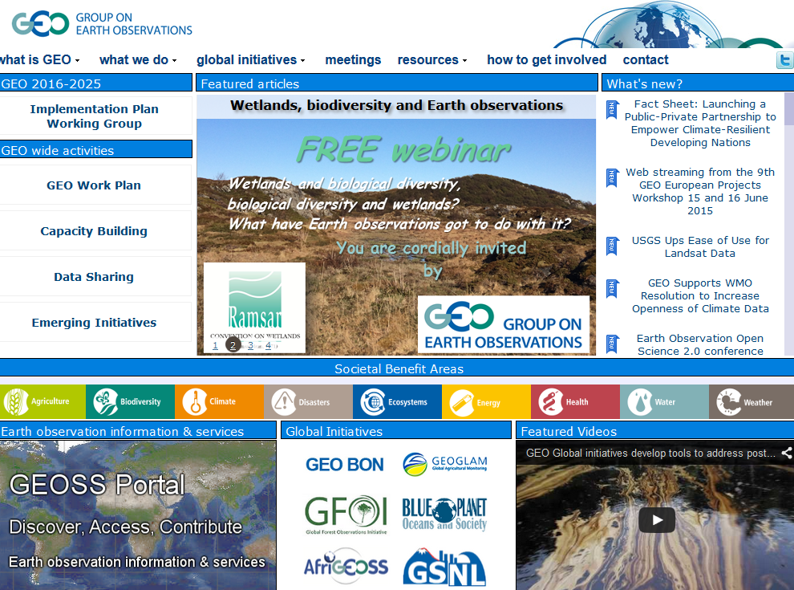

GEO-GEOSS
9 Societal Benefit Areas
Horizon2020-ConnectinGEO project Coordination and Support action

Slide 3


Issues for discussion
The EV concept is considered fundamental to enabling evidence based environmental monitoring in support to: scientists, observing system operators, programme planners, policymakers (Bojinski, 2014; Friedel, 2012).
A continuous reviewing process for:
  Consistency in the definition: application dependent?
  Assessment of adequacy: new requirements? (e.g., from data measurements to fluxes of energy, carbon, water) new models
  Long term data curation, publication and discovery infrastructures for heterogeneous Big Data
  Gaps analysis for operational implementation interactions between research and SMEs
  Validation

Slide 4
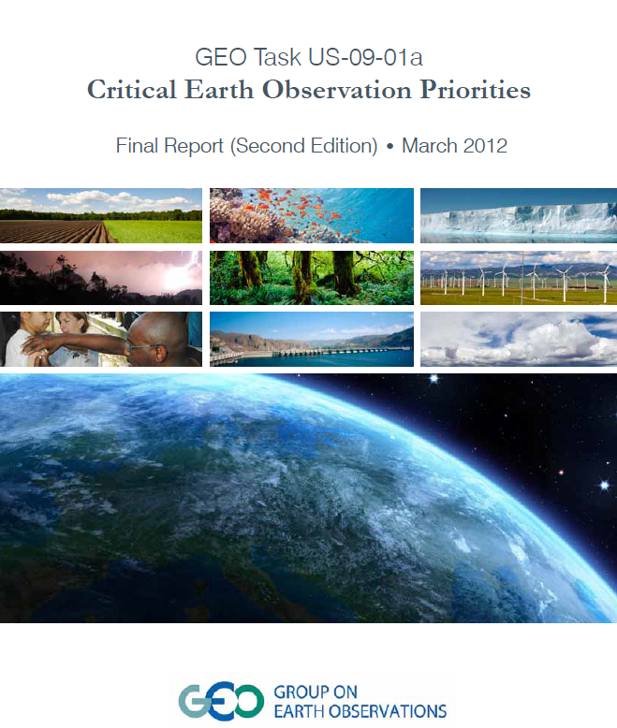
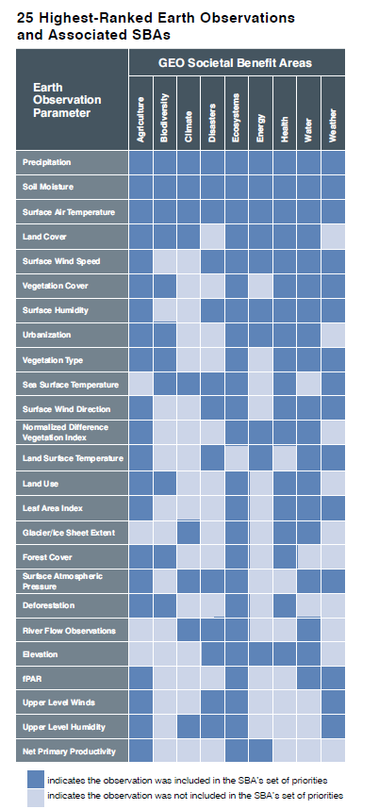
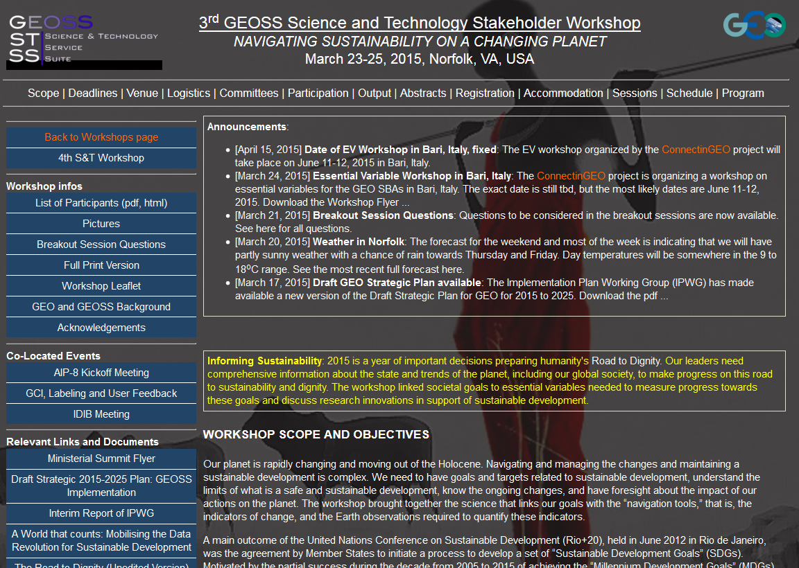

Slide 5
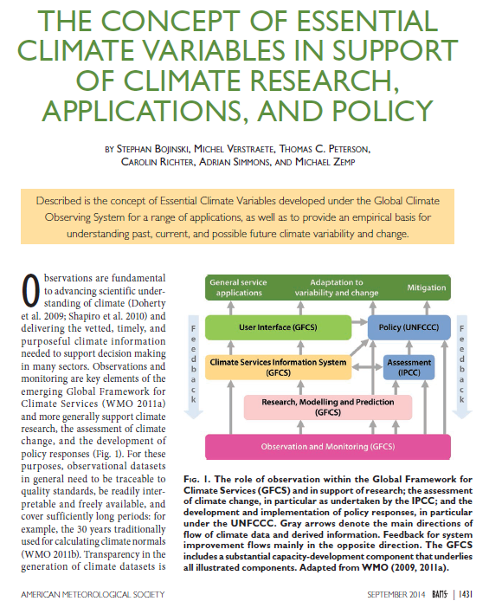
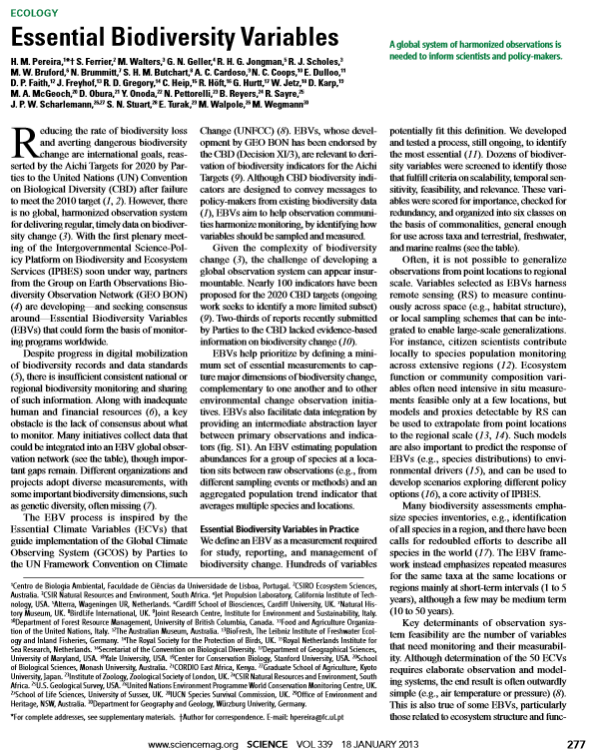
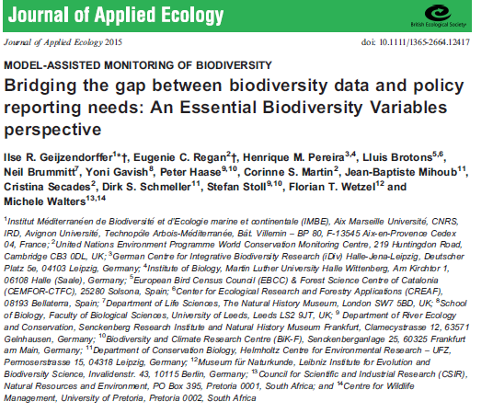
GCOS activities
GEO_BON activities
2013
2015

Slide 6
Overall objectives
We would like to learn from communities about the status and evolution of the EV concept
Provide insights to GEO for satisfying the GEOSS Societal Benefit Areas

Slide 7
Questions for the speakers and contributing Audience
Status of existing EVs in the specific domain
The process underlying EV definition
EVs validation and use
Describing the monitoring networks currently operational
Assessing EV observational needs and readiness
Gaps and requirements
Conclusions

Slide 8
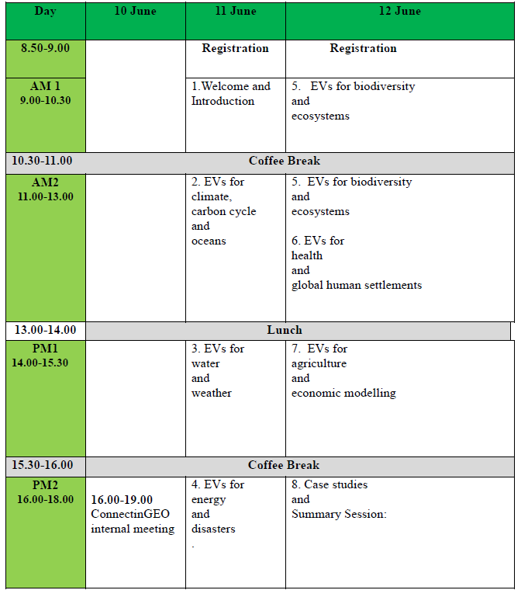
6:45 pm Visit to the old town
Meeting point: Piazza Ferrarese, building at the let side of the main entrance
9:00 pm Dinner at” La Batigia”

Slide 9
From global to local: why in Bari at the Dipartimento Interateno di Fisica
Southern Europe - Southern Italy: an opportunity for students and researchers to give rise to new interdisciplinary research
Space research since early 80s, thanks to Prof. Luciano Guerriero, the first President of ASI (1988)
Theoretical physics in support to modelling
INFN Infrastructures for Big Data analysis

Slide 10
References
S. Bojinsky, M. Verstraete, T.C. peterson, C. Richter, A. Simmons, M. Zemp, 2014. The concept of Essential Climate Variables in support of climate reearch, applications, and policy. American Meteorological Society, Sept. 2014, 1431-1441

