Slide 1




Citizen Science to Capture EVs
11-12 June 2015, Bari-Italy
Societal Benefit Area: Cross-cutting
Name: Ian McCallum, Steffen Fritz
Institution: IIASA
Ecosystems Services & Management
Earth Observation Systems
Coordinating an Observation Network of Networks EnCompassing saTellite and IN-situ to fill the Gaps in European Observations
YOUR LOGO

Slide 2
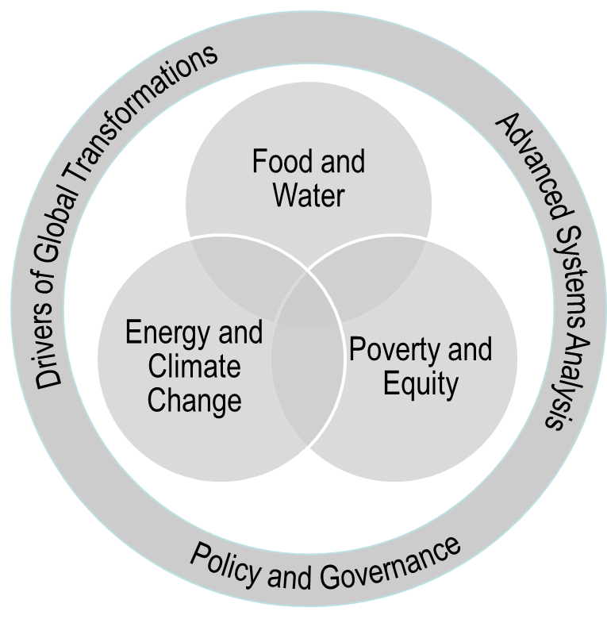
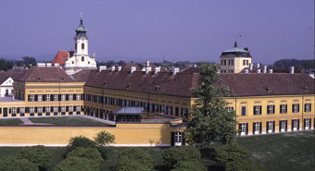
IIASA
Mission: provide insights and guidance to policymakers worldwide…
GEO Participating Organization

Slide 3
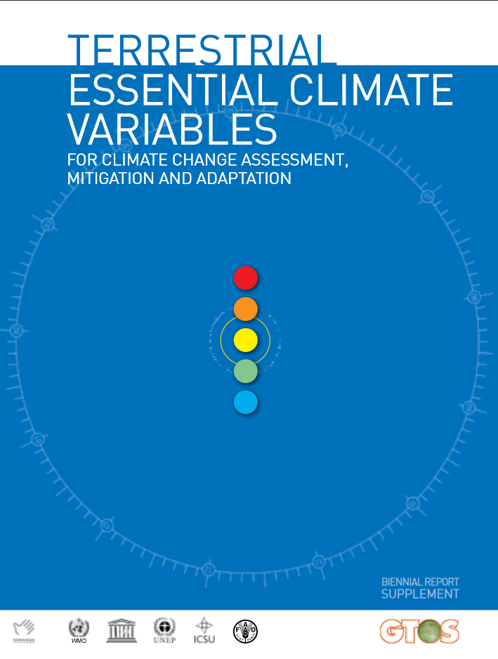

Citizen Science, SBAs and EVs

Slide 4
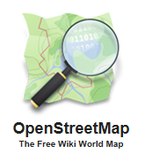
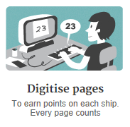


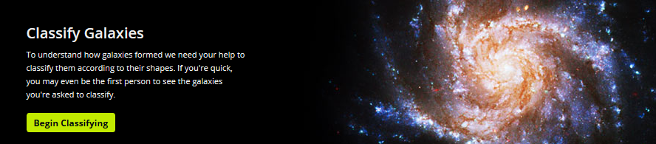




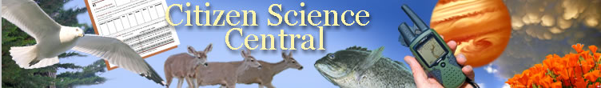

Examples of Citizen Science
Notes:
Very simple answer: by getting involved through crowd-sourcing. By asking ordinary citizens to help collect and contribute information online, we can build vast, open source databases that can be used for many different scientific applications. There are many successful examples of crowdsourcing which have led to new scientific discoveries and better open source maps.

Slide 5

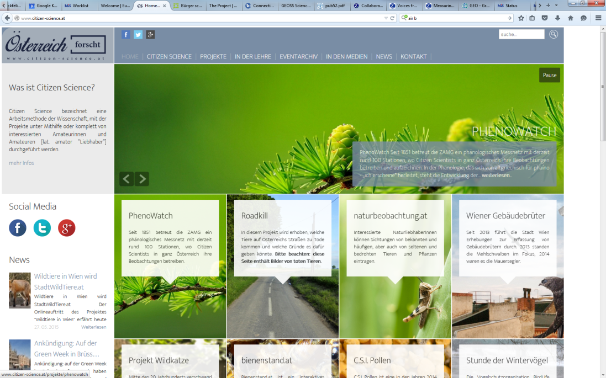
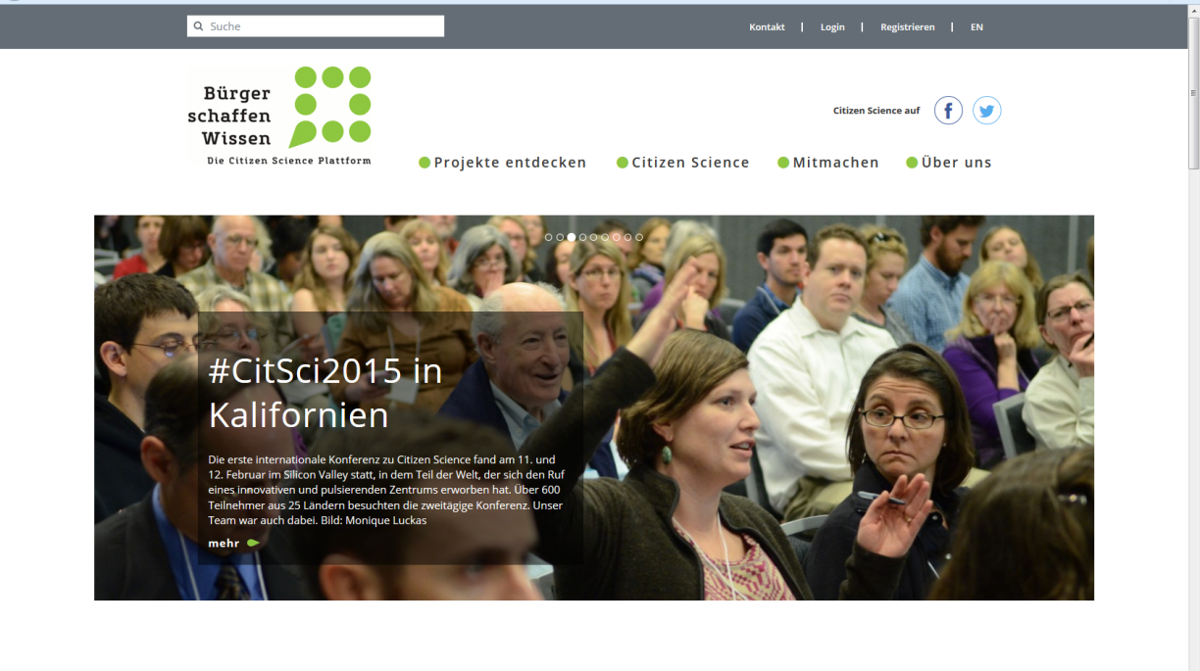
Citizen Science Associations

Slide 6
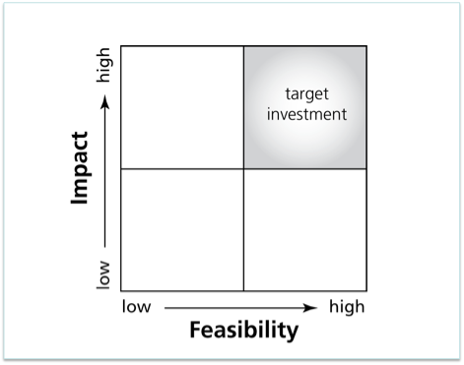
Impacts vs Feasibility
Citizen
Science??

Slide 7
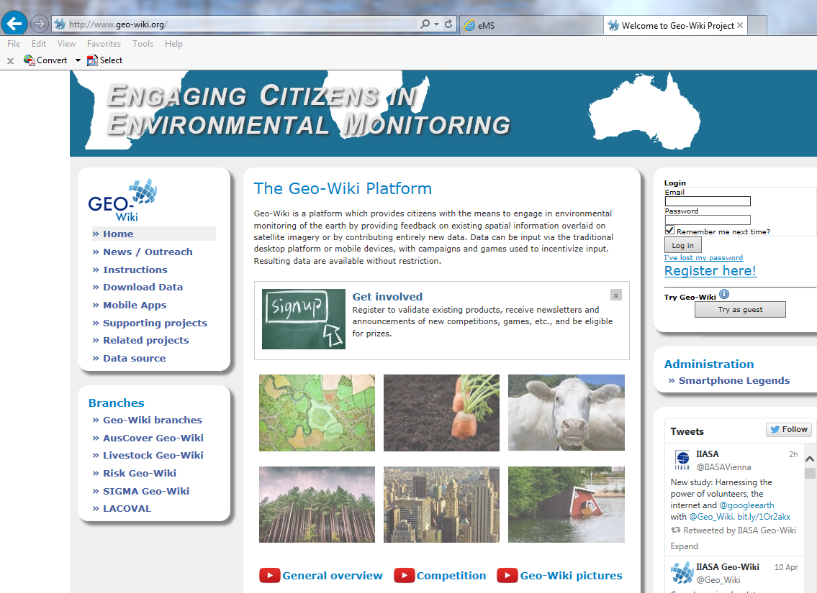
http://www.geo-wiki.org

Slide 8
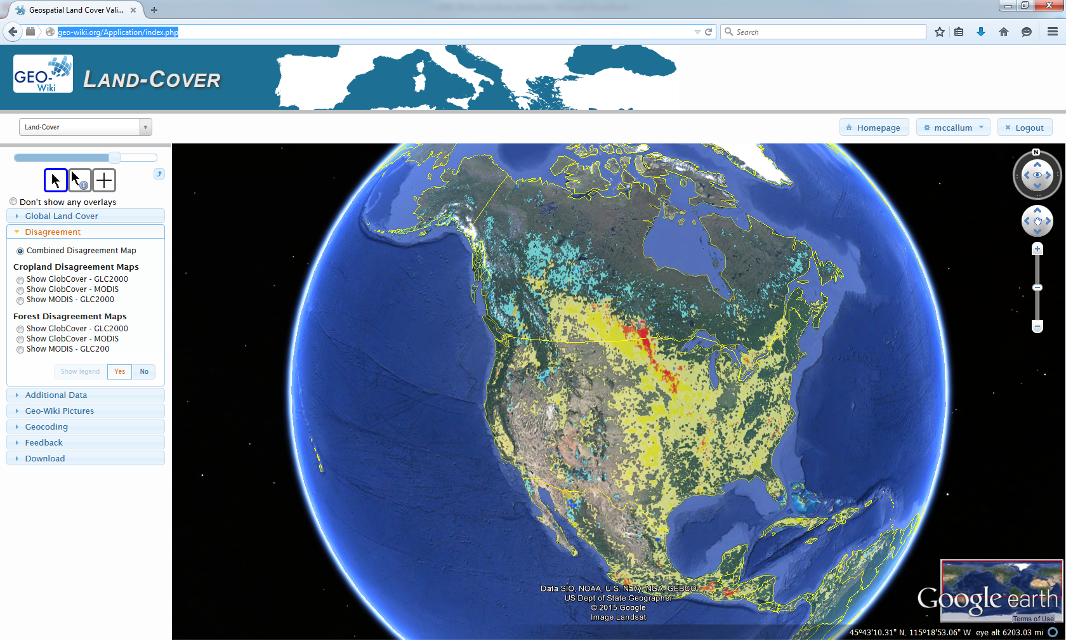
Motivation for Citizen Science
Estimates of Global Cropland Extent Vary between
1.2 and 1.7 billion hectares

Slide 9
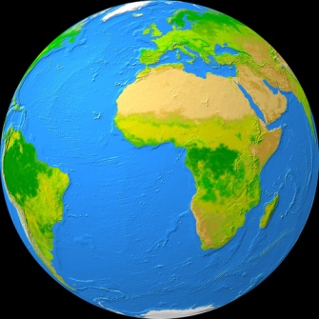
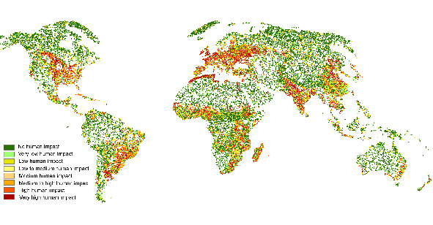
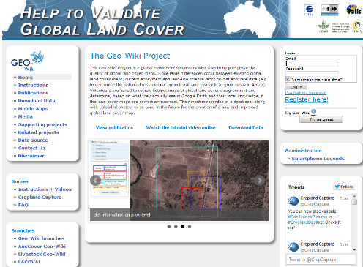
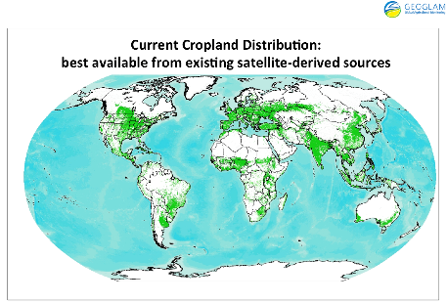
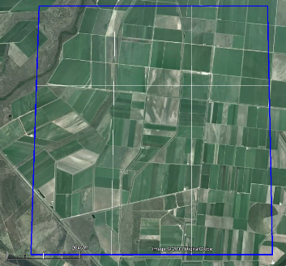
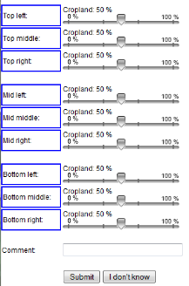
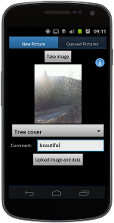
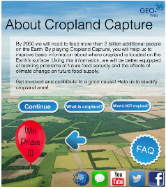
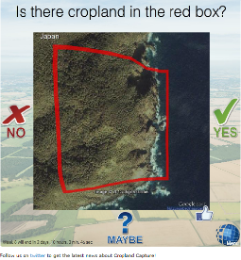
Visualization
of Global Land Cover,
Biomass, Photos, etc.
Crowdsourcing of
Land Cover
(Google Earth, Bing Maps)
Geo-Wiki
Creation of Hybrid
Land Cover Maps
Validation of Land
Cover Maps
In-situ Data via
Geo-Wiki
Pictures app
Serious Games
(Cropland
Capture)

Slide 10
Global Hybrid Land Cover Map
First attempts at using Geographically Weighted Regression
See et al. (2014) in ISPRS journal

Slide 11
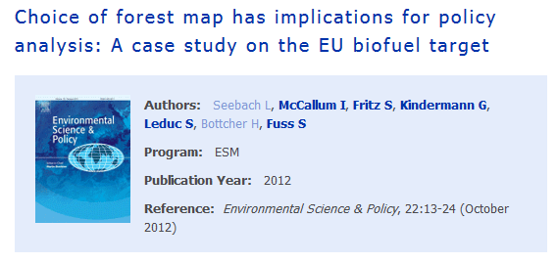
EV Validation
The sensitivity analysis showed that the choice of the forest cover map has a major influence on the model outputs in particular at the country-level, while having less influence at the EU27 level.

Slide 12
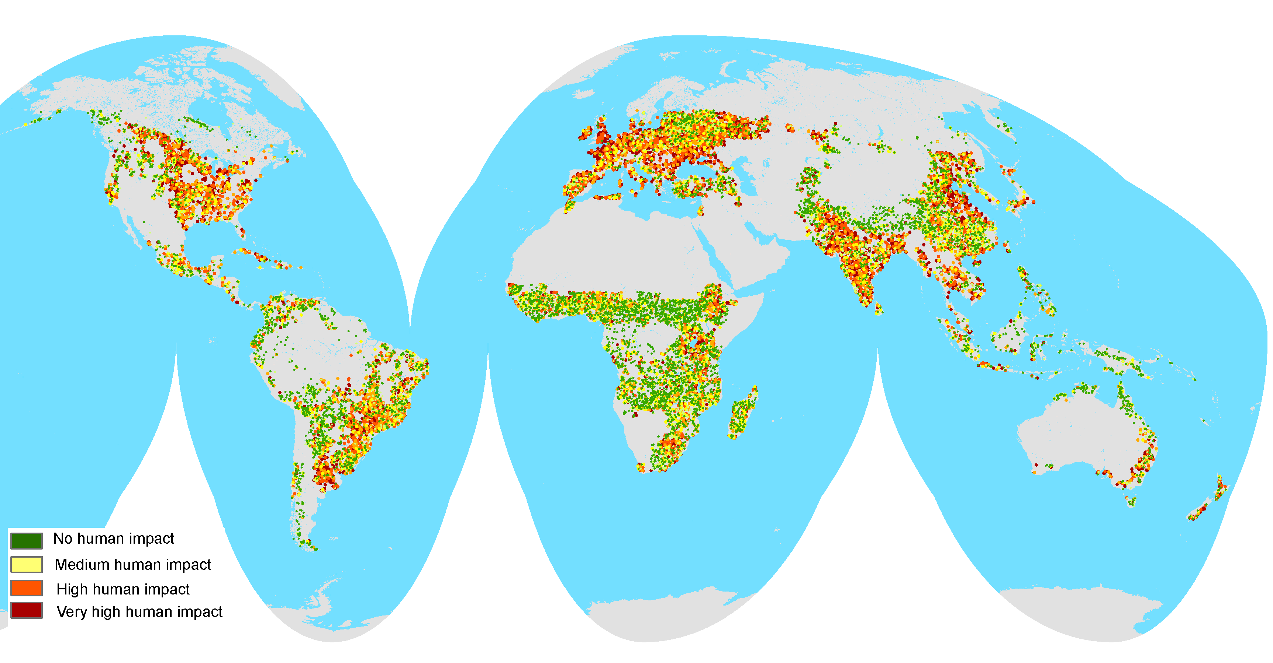
Downgrading recent estimates of
land availability using crowdsourcing
Cai et al., 2011
1107 mil. hectares
Fritz et al.
375 mil. hectares
Fritz et al, 2013, Environmental Science and technology
Notes:
We have collected more than 250 000 global land cover validation points. We use the points for clreating global hybrid maps. In a recent publication we used geo-wiki to downgrade recent estimates of land availability for biofuel production.

Slide 13
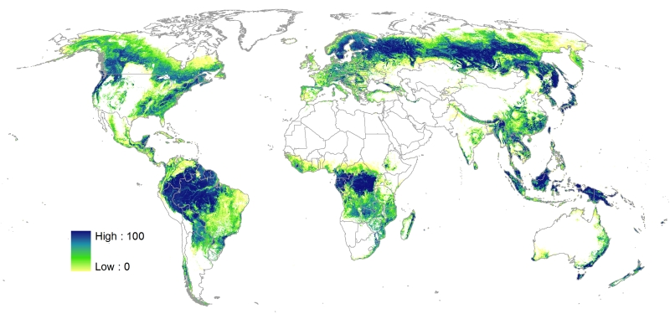
Global Forest Cover Map
Used Geographically Weighted Regression at each pixel
Schepaschenko et al. (2015) Remote Sensing of Environment

Slide 14
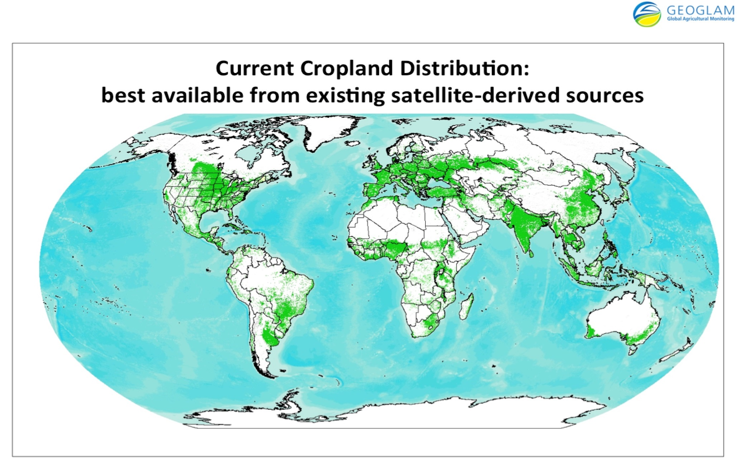
One Use of the Data: % Global Cropland Product
Fritz et al. 2015 Global Change Biology
Notes:
Openly acknowledged as the best source of baseline cropland information by GEOGLAM

Slide 15
Global Field Size Map

Slide 16
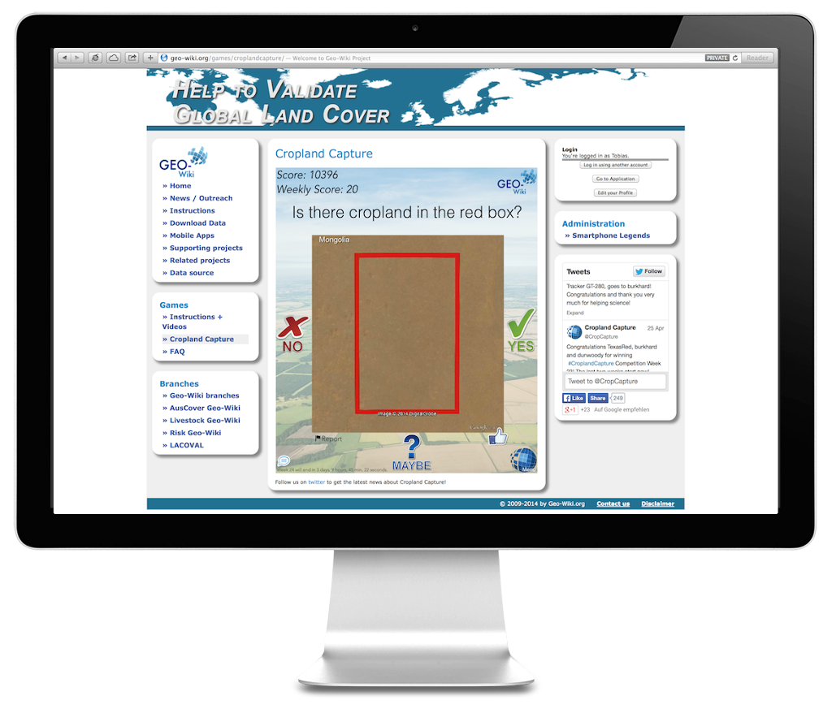
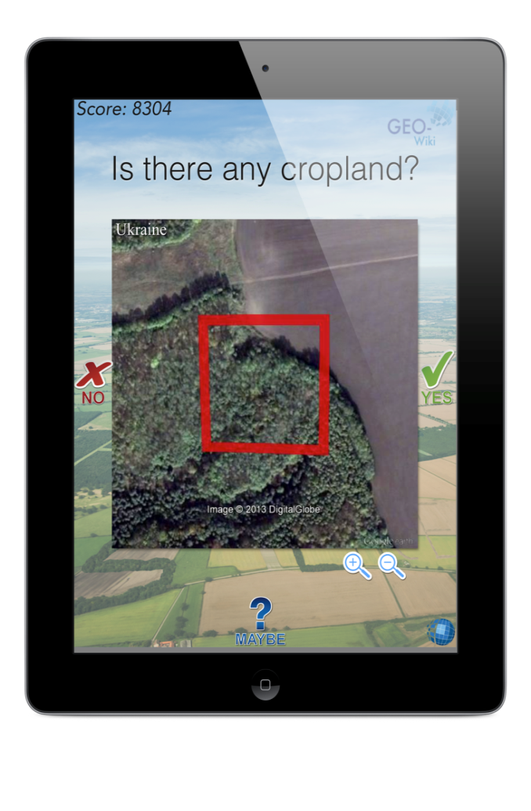
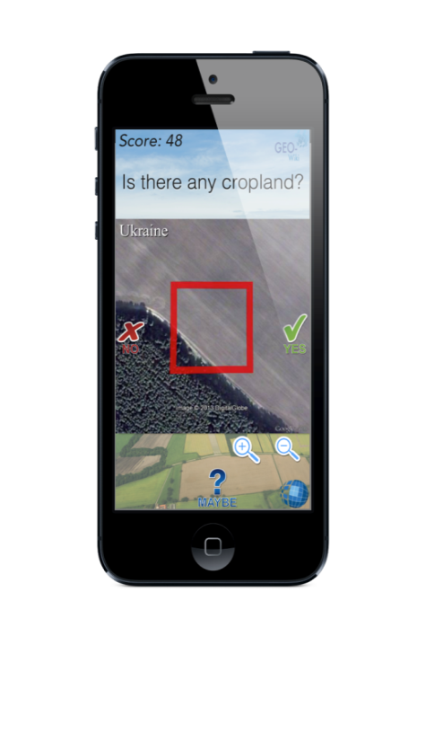
Gaming
Notes:
What is Cropland Capture? Cropland Capture is a cross platform serious game. It runs on mobile devices like the iPhone or Android devices, tablets like the iPad and also on the browser.

Slide 17
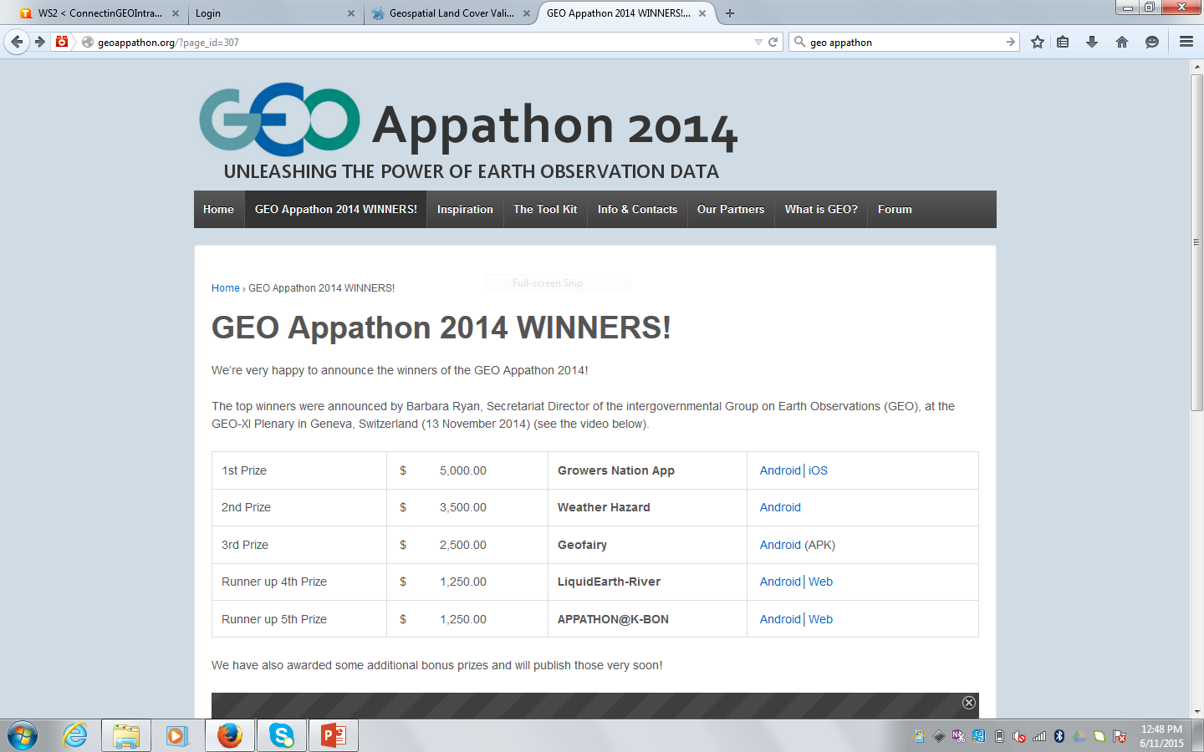
GEO Appathon Winner

Slide 18
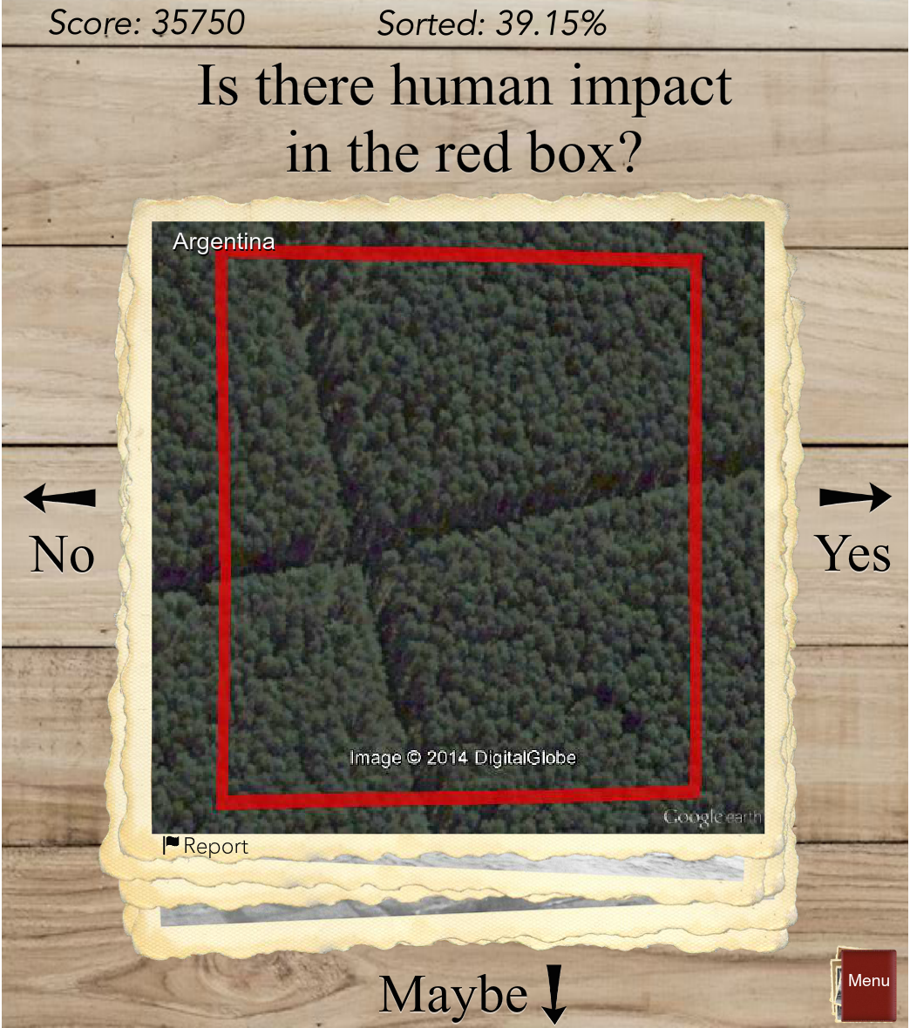
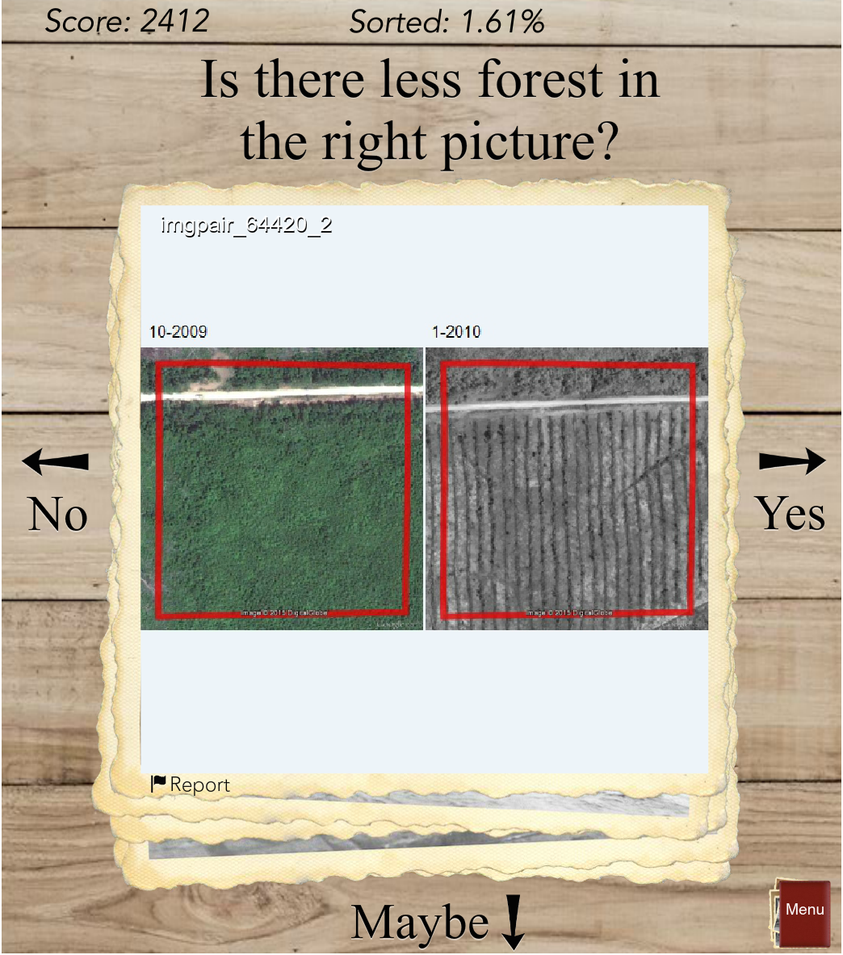

Slide 19
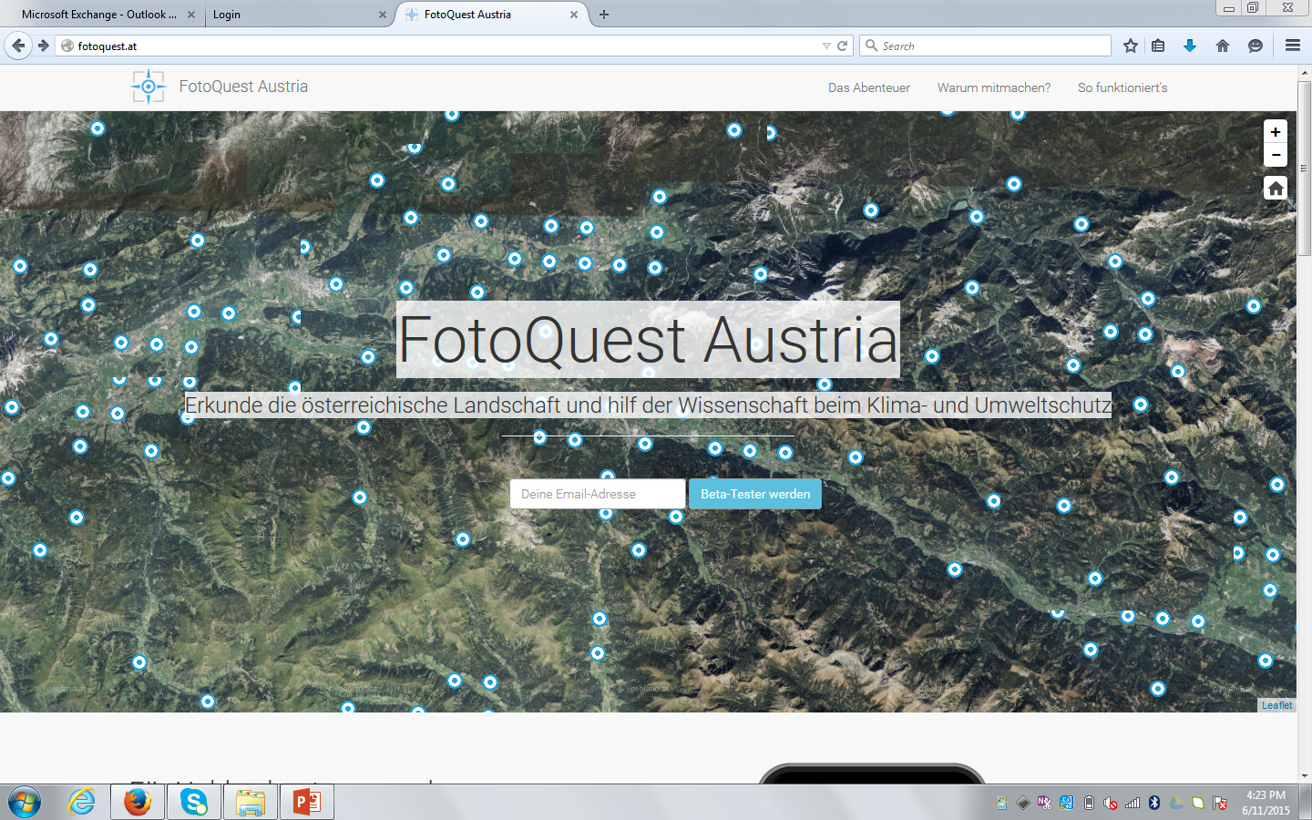
FotoQuest Austria

Slide 20
Conclusions
Citizen Science can help across most SBAs
Citizen Science could address data needs where feasibility has been limiting
Citizen Science has reduced costs
In-situ should feature prominently in GEOSS
Continue to support newly formed Citizen Science associations

