Slide 1




Towards a sustainability process for
GEOSS Essential Variables
11-12 June 2015, Bari-Italy
Societal Benefit Area: Ecosystems
Name: M. Adamo, F. Lovergine, C. Tarantino and P. Blonda
Institution: CNR-ISSIA
Coordinating an Observation Network of Networks EnCompassing saTellite and IN-situ to fill the Gaps in European Observations

Slide 2

Habitat map proposed as EV
Who the users are?
Habitat map is used by ecologists and management authorities of protected areas
Habitat mapping is linked to Biodiversity Strategy

Slide 3
Assessing EV observational needs and readiness
Habitat mapping features:
  Temporal frequency: every six year according to the Habitat Directive; once per year is suggested
  Spatial resolution: High (3-30 m) to Very High spatial (< 3m) resolution
  Accuracy: at least 85%
Challenges:
  VHR data for free to researchers and public administration
  Centralized ancillary/in situ data

Slide 4
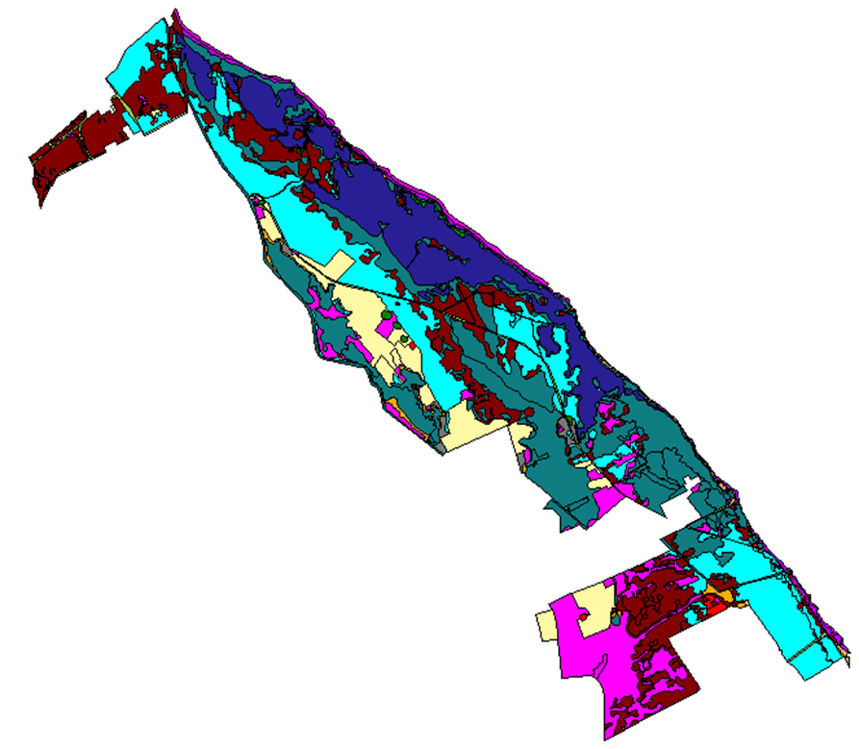
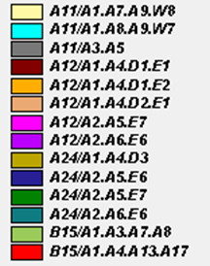
LC to Habitat Mapping
Study Area: Le Cesine (Puglia)
Input data:
  Land Cover map
  (in FAO-LCCS Taxonomy)
  In situ data

Slide 5
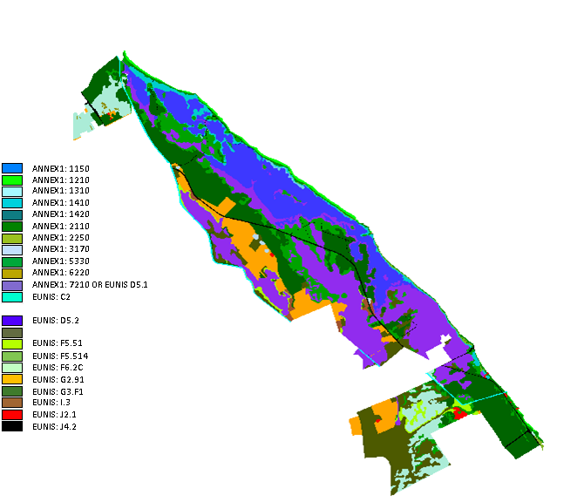
LC to Habitat Mapping
Output data:
  Habitat map
  (in Annex I or EUNIS Taxonomy)
  Accuracy
OA = 97% (± 0,02)

Slide 6
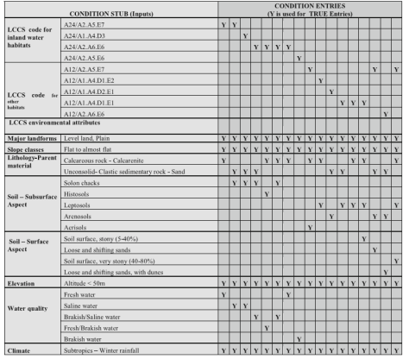
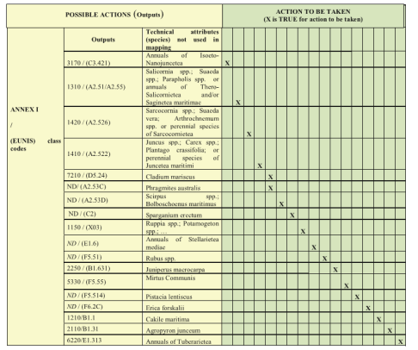
LC to Habitat Mapping
Approach: Knowledge-based

Slide 7
LC to Habitat Mapping

Slide 8
Gaps and requirements
  EO data availability: VHR data
  In-situ data availability
  Algorithms for habitat mapping: knowledge based rules
  Data repositories for the long term preservation of habitat maps
  Infrastructure for EVs publication
  - GEOSS
  - Copernicus

Slide 9
Future work
  Generalization of rules and methodology
  Workflow implementation as WPS in AIP-8

