Slide 1
Towards a sustainability process for GEOSS Essential Variables
11-12 June 2015, Bari-Italy
Recommendations and timeline
A. Bombelli, P. Blonda
Coordinating an Observation Network of Networks EnCompassing saTellite and IN-situ to fill the Gaps in European Observations
YOUR LOGO

Slide 2
Recommendations
… will be part of the workshop report
Key questions to be addressed are:
is it possible to find a common definition valid for all the EVs in the different communities?
is it possible to develop a common methodology for identifying all the different EVs?
…?

Slide 3
Workshop Report
It should address the following issues:
Assess the status of existing EVs in the different GEO SBAs; EVs list
Review the different processes (criteria, methods, etc.) to define and identify EVs
Find commonalities; identify “super-EVs
Validation and applicability
Monitoring networks
Observational needs and readiness
Gaps and priorities
Recommendations and way forward

Slide 4
Timeline
WE:
1st draft of the report
YOU + scientific committee:
review it
WE:
finalization
of the report
June
July
August
September
Afterwards….
End of 2015: Scientific paper?
2017 (end of ConnectinGEO): update?

Slide 5
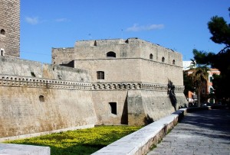
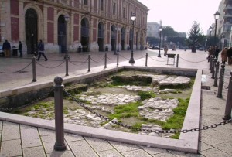
THANKS!

