Slide 1




Towards a sustainability process for
GEOSS Essential Variables
11-12 June 2015, Bari-Italy
Societal Benefit Area: Disasters
OBSERVATION SYSTEMS IN THE FRAMEWORK OF THE EPOS-IP PROJECT:
THE CASE OF THE VOLCANOLOGICAL COMMUNITY
Giuseppe Puglisi
Istituto Nazionale di Geofisica e Vulcanologia
Sezione di Catania – Osservatorio Etneo
Coordinating an Observation Network of Networks EnCompassing saTellite and IN-situ to fill the Gaps in European Observations

Slide 2

Status of existing EVs in the domain
Is your community (Solid Earth Science ) developing a set of area-specific EVs?
NO
If not, is the community planning to start this in the near future?
  Have you attended previous meeting?
  Are you considering reference documents from other domains?
NOT YET

Slide 3
Describing the monitoring networks currently operational
Do you have a database with information on the EVs?
Do you know network currently operational for medium-term/long-term monitoring?
Are the current operational networks operated by your community measuring the EVs?

Slide 4

Solid Earth Science community @ EU
Fragmentation: seismologists, volcanologists, geologists, geodesists, geomagnetic, rock-physics laboratories, anthropogenic hazard, …
Existing Research Infrastructures (RI) & facilities: networks, laboratories, observatories, …
How do we can coordinate this community ?

Slide 5
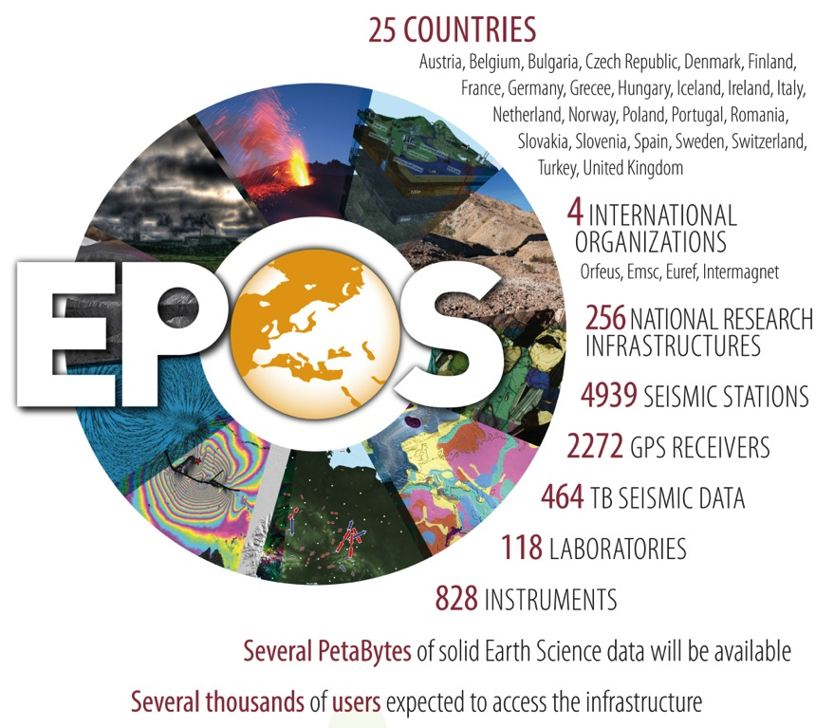
What is EPOS?
EPOS is a long-term plan for the integration
of research infrastructures for solid Earth Science in Europe
EPOS integrates the
existing (and future) advanced European facilities into
a single, distributed,
sustainable infrastructure
taking full advantage of new e-science opportunities

Slide 6







Solid Earth Science
Different communities involved
Multidisciplinary contributions
Community building
Services to society
Geo-Hazards
Geo-Resources
Environmental hazards (including anthropogenic hazard)
Notes:
DESCRIBE SOLID EARTH, SPECIFYING THAT:
WE STUDY THE WHOLE SOLID COMPONENT OF OUR PLANET (FROM THE INNER CORE TO THE SURFACE)
WE STUDY PROCESSESS EVOLVING IN VERY DIFFERENT TIME SCALES (from μιχρο−seconds to thousands years)
- WE STUDY PROCESSESS EVOLVING IN VERY DIFFERENT SPATIAL SCALES (from ΝΑΝΟΜΕΤΕΡΣ ΤΟ ΤΗΟΥΣΑΝΔΣ ΚΜ)

Slide 7
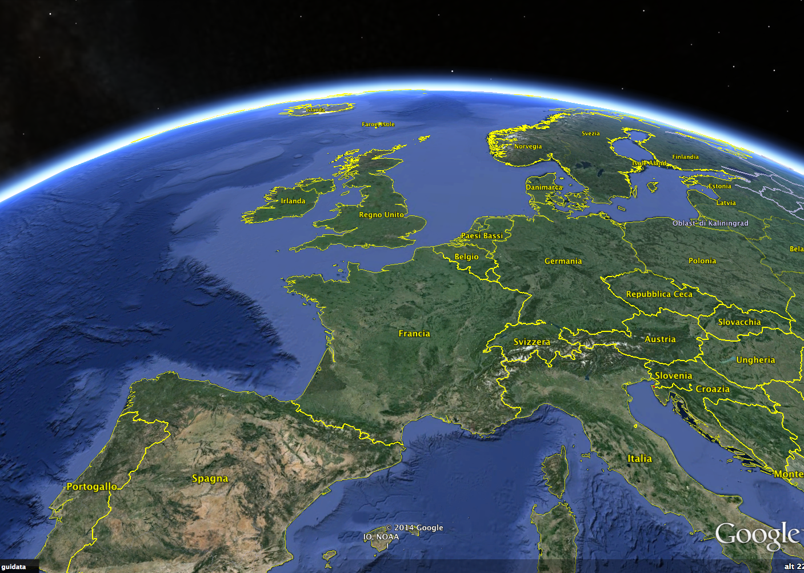
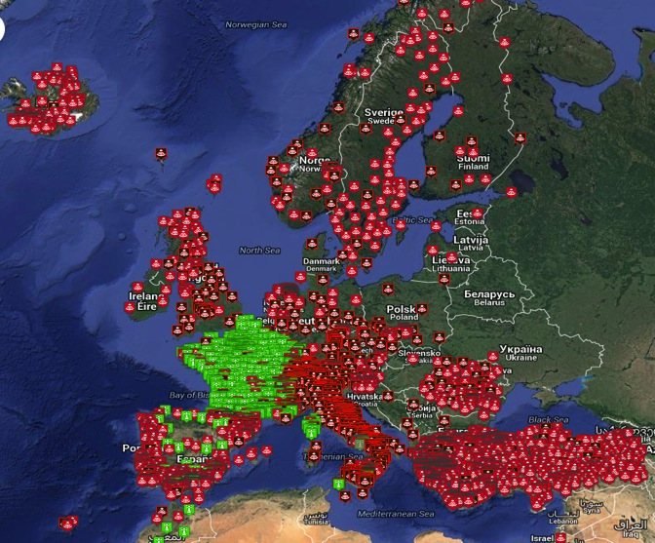
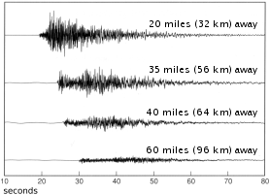
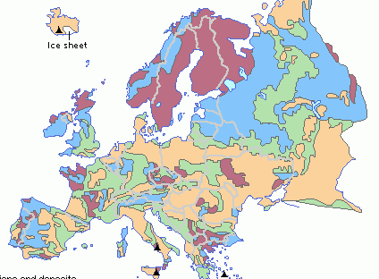
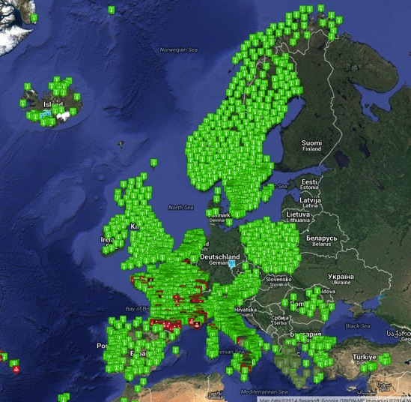
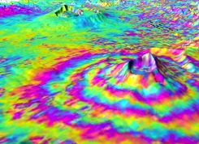
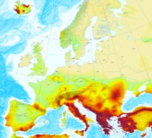
EPOS: a single, pan-European distributed RI
TCS Seism.
TCS GNSS Data
ICS-C
ICS-D
TCS Anthrop Hazard
TCS Geomag Obs.
TCS Volcano Obs.
TCS Subsur Data
TCS Geology
TCS Satellite Data
TCS Exper. Labs
ECO
TCS Seismology
80 Seismic Networks
4800 Seismic Stations
1 PB of Data
Seismograms
Geological Maps
_ Diverse Data _
TCS Geodesy
56 GNSS Networks
2230 Seismic Stations
1.2 PB of Data
SAR
Interferograms
Hazard Maps

Slide 8
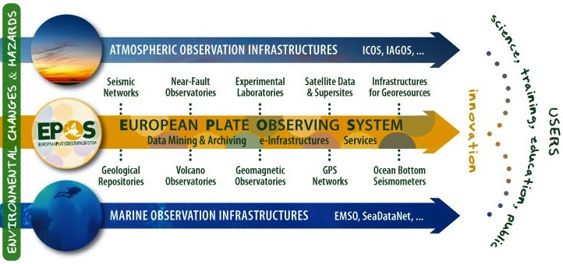
The EPOS Community
EPOS integrates a large number of infrastructures and communities
EPOS will increase their efficiency, improve and simplify their use, and allow multilateral strategic coordination for their
sustainability, operation, and development

Slide 9






Slide 10
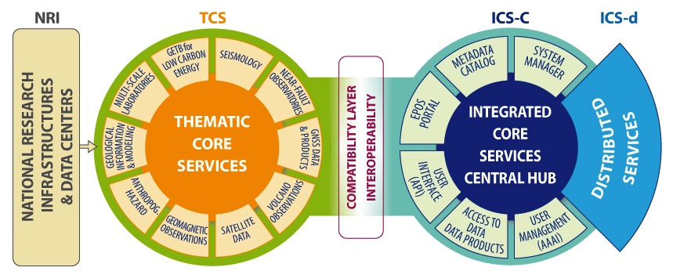
Functional Architecture
How will EPOS work?
community-specific integration
novel e-infrastructure
Interoperability
Brokerage
Data generation
Data collection
Responsible
of sustainability
and operation
IPR
Data curation
Metadata
Registration
Community Services
Standardization
Data pocilies
Metadata registry
Processing
Aggregation
Integrated analyses
Visualization
Procurement
Sustainability

Slide 11
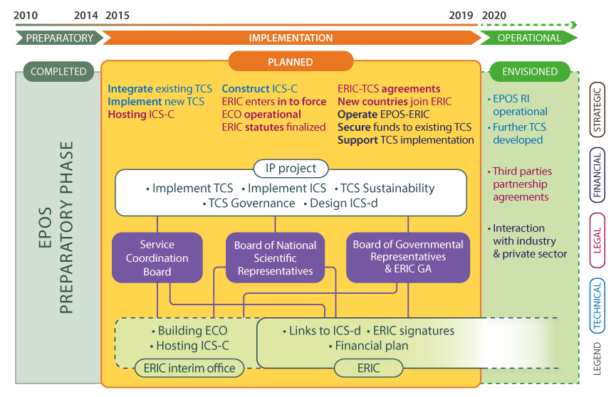
EPOS Timeline: the plan for the next 5 years

Slide 12

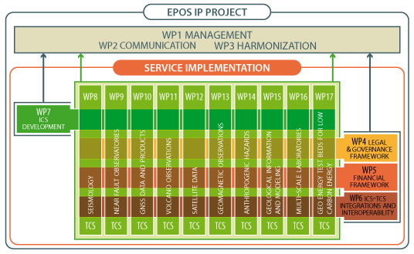
EPOS IP Concept
Volcano Observations Use Case

Slide 13
Strategic Objectives of the Volcano Observations TCS
To network the existing volcanological services for sharing data, products and tools within the European volcanological community and, through the link with the ICS, with users and stakeholders outside this community.
The services are both “virtual” and “physical”.
To identify synergies with other communities involved in EPOS (e.g. seismology and geodetic), in order to avoid duplications in the implemented services or tools

Slide 14
Definition of the community
The European Volcanological community is made of two groups: Volcano Observatories (VO) and Volcano Research Institutions (VRI)
  VO: “In situ” (close the volcanoes) complex Research Infrastructures, formally commissioned to perform the volcano monitoring;
  VRI: involved in the education sector or in top-level research and observing activities (e.g., HPC modelling or Earth Observations centres; Temporary experimental data providers, etc.) without specific legal commitments to volcano monitoring.

Slide 15
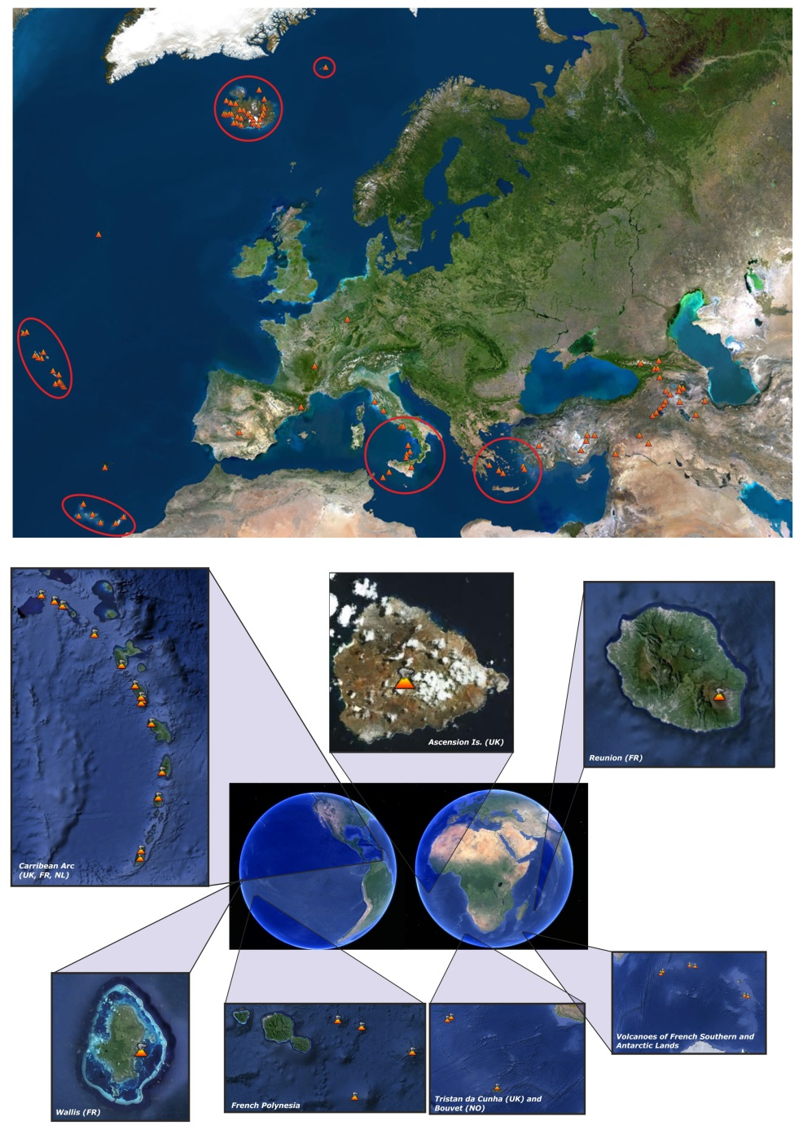
“European” volcanoes and Volcanologists
Volcanological community
13 VO and > 70 VRI

Slide 16
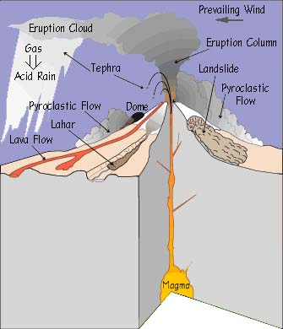
Volcanoes release Earth’s “inner energy”, mass release & mechanical/thermal energy releases producing a variety of “primary and secondary volcanic phenomena”, such as:
Primary Phenomena
  lava effusion/extrusion (flows/domes)
  volcanic explosions
  volcanic gas release (in the air, soils or groundwater)
  earthquakes
  ground fracturing and creeping
  ground deformations
  thermal anomalies (ground, water)
  potential field changes (gravity, magnetic, electric)
Secondary Phenomena
  tsunami
  morphological changes
  hydrothermal and geothermal activity (hot springs,
  geysers)
  fumarole fields
  volcanic plumes
  pyroclasts’ fallout
  pyroclastic flows
  lahars
The Products of Eruptions
Courtesy of USGS

Slide 17
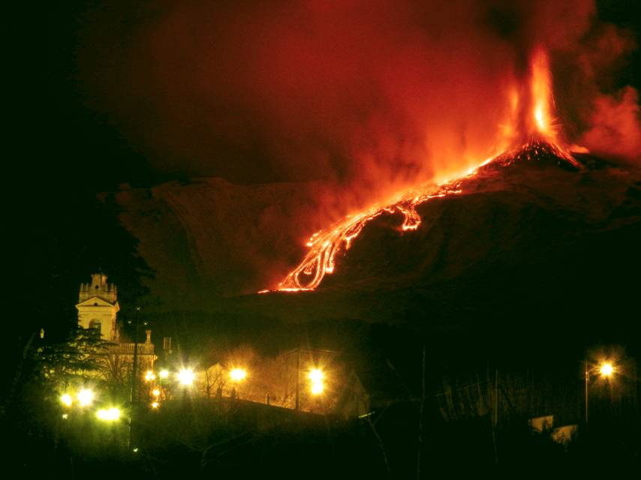
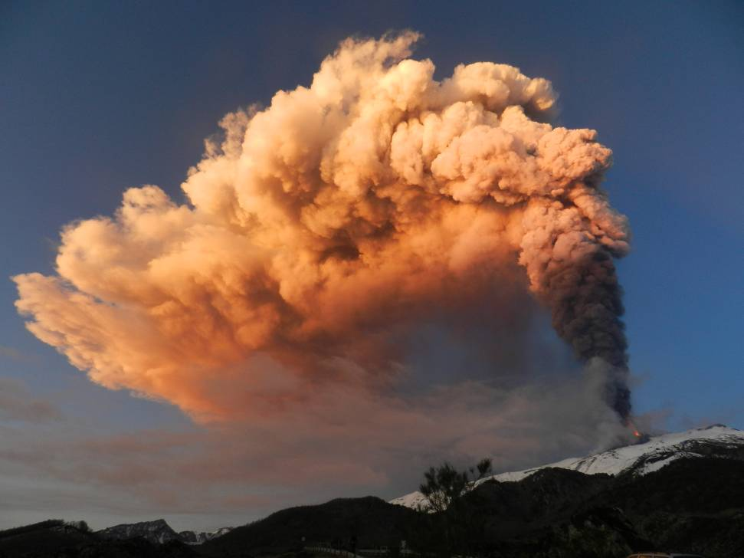
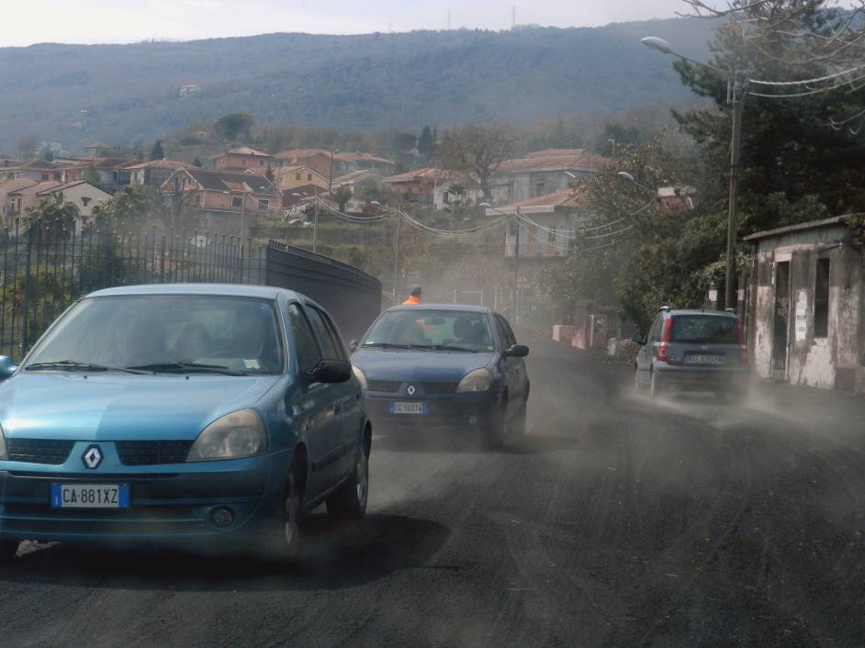
Societal impacts

Slide 18
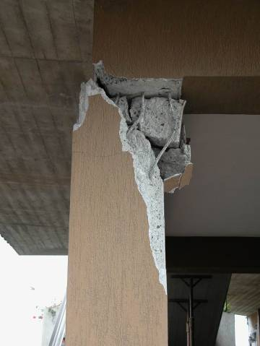
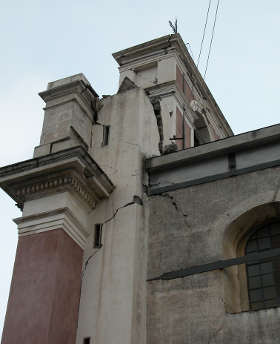
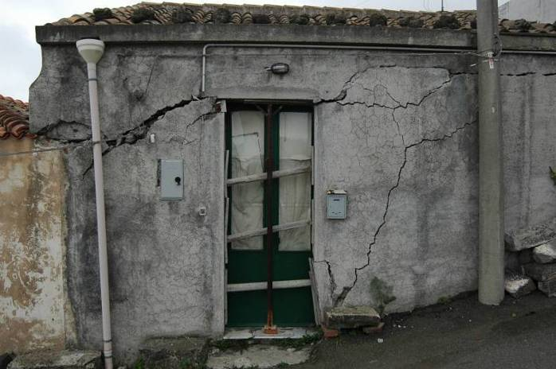
Societal impacts
… but not only volcanic hazard: MULTI-HAZARD. Examples of the effects of seismicity and landslides.

Slide 19
In order to track and study changes in the behaviour of active volcanic systems, so as to interpret and modelling the processes on the basis of volcanic crisis, systematic observations of different volcano parameters, thus Volcano Monitoring, is needed.
Volcano Monitoring
includes
In-situ monitoring
techniques
Space-borne
remote sensing
Ground-based
remote sensing
Volcano Observatories Space Agencies
Multidisciplinary approach

Slide 20
Main challenges in monitoring active volcanic systems
Phenomena (large spectrum):
Variation in time (from seconds to years)
Variation in space (from meters to kilometers)
Variation in energy (kind of eruptive phenomena, e.g. from mild explosive activity to Plinian eruptions)
Technologies and methodologies :
Instrumental limits (e.g., resolution, sensitivity, accuracy, sampling rate, …),
Operational conditions (e.g. need of specific CAL/VAL activities)
Technological advances,
New methodological requirements (e.g., operations in the sea)
… some examples of such challenges it follows

Slide 21
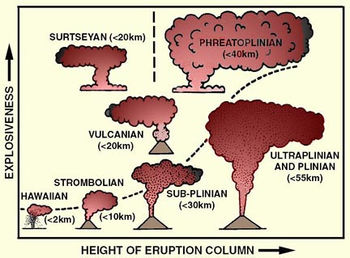
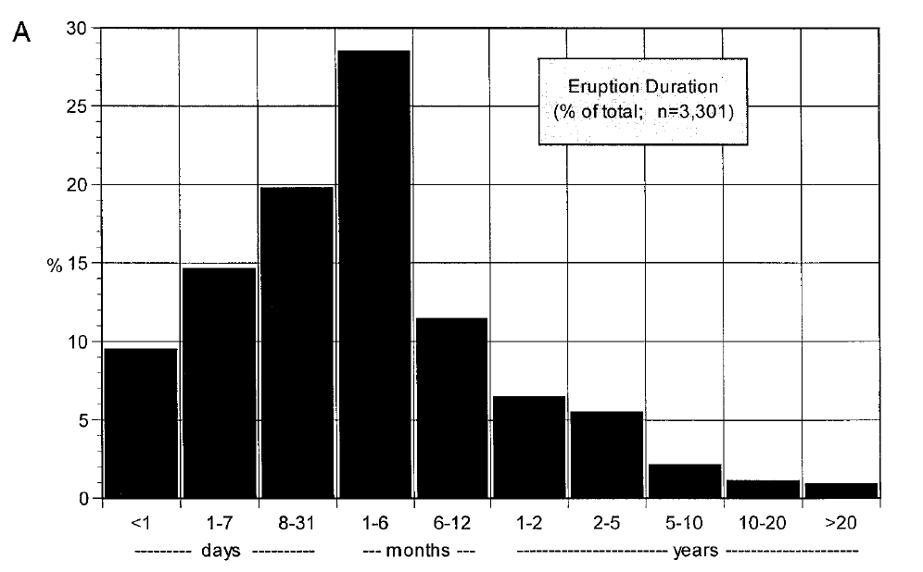
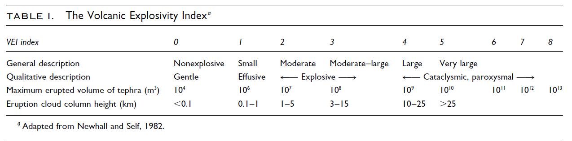
Volcanic eruptions
Modified from Cas et al. (1988)
Duration
(ENERGY)
Energy

Slide 22
Dimensions of
ground deformations in volcanic areas
(Origin of) Phenomena
Intensity of deformations
Area
Times of evolutions
Deep magmatic sources (> 8-10 km)
0.001 – 0.01 m
10² - 10³ Km²
years
Shallow magmatic sources (3-8 km)
0.01 – 0.1 m
10 - 10² Km²
months-years
Dykes and very shallow magmatic sources (< 3 km)
0.1 – 1 (+) m
1 - 10 Km²
hours-days
Slow fault movements (creep)
0.001 - 0.1 m
0.1 - 10 Km²
years
Fault movements (earthquakes)
0.01 - 1 m
1 - 10² Km²
seconds
Lava flow compactions
0.01 - 1 m
1 - 10² Km²
years
Flanks instabilities (no collapses)
0.01 – 1 m
1 - 10 Km²
years

Slide 23
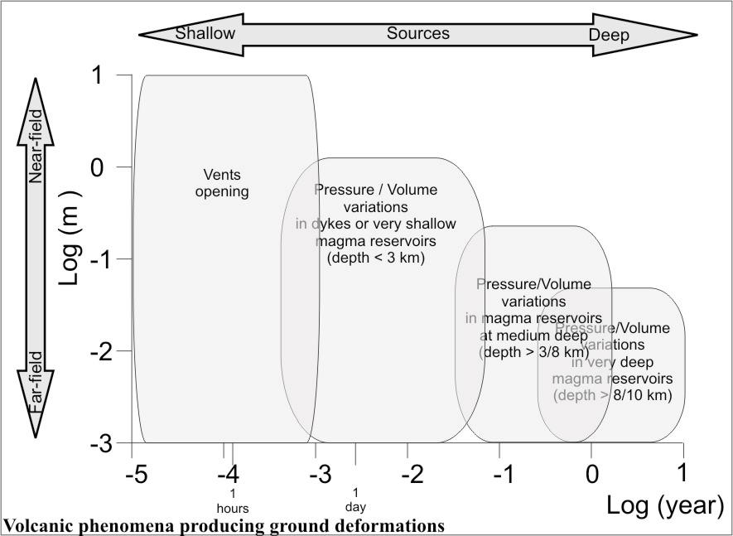
Order of magnitude (in time and space) of ground deformation phenomena due to volcanic sources

Slide 24
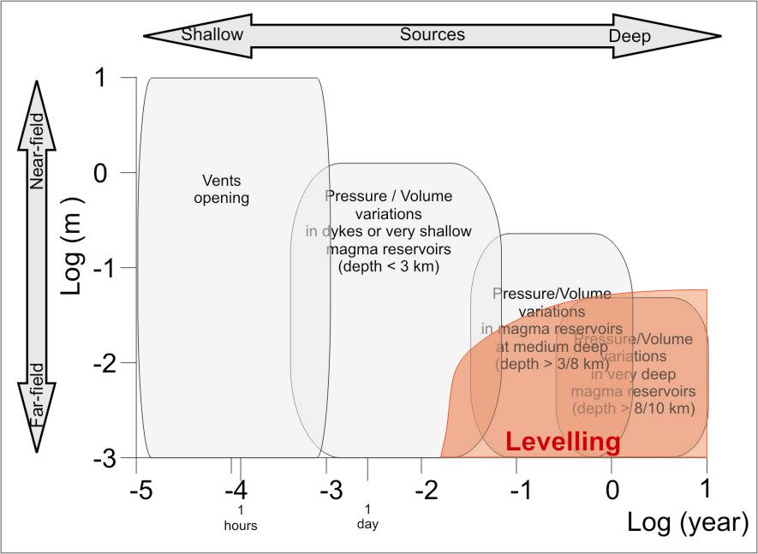
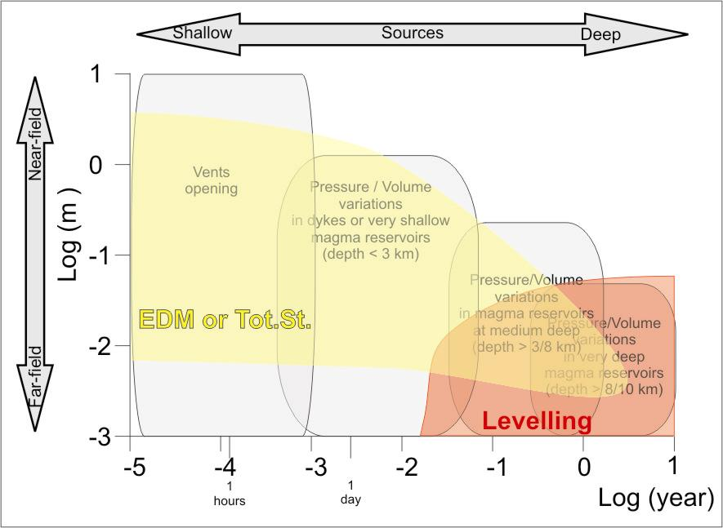
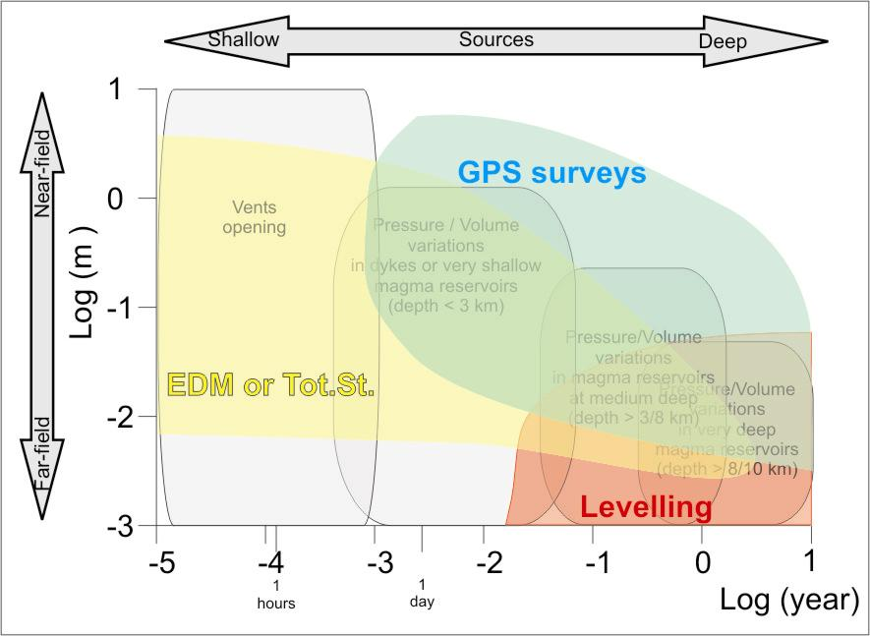
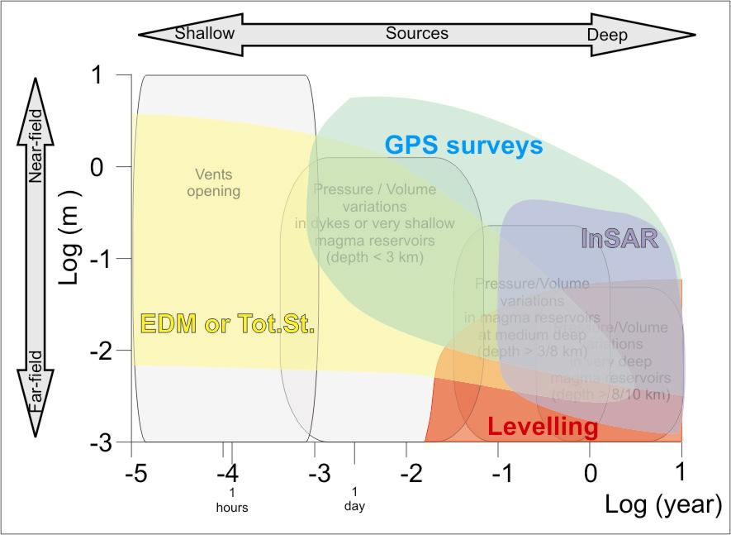
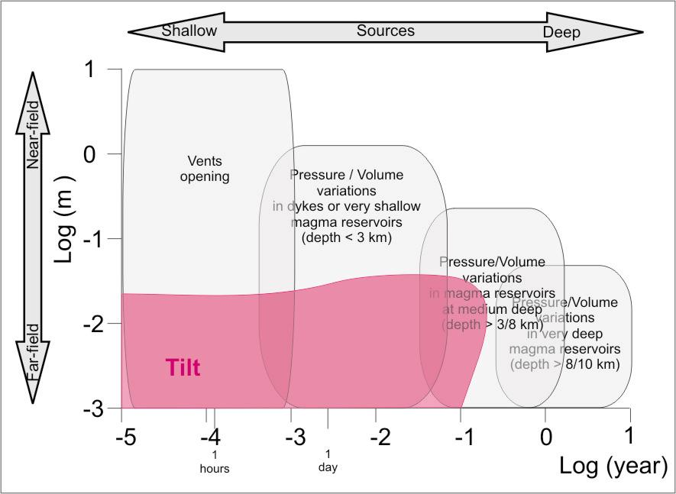
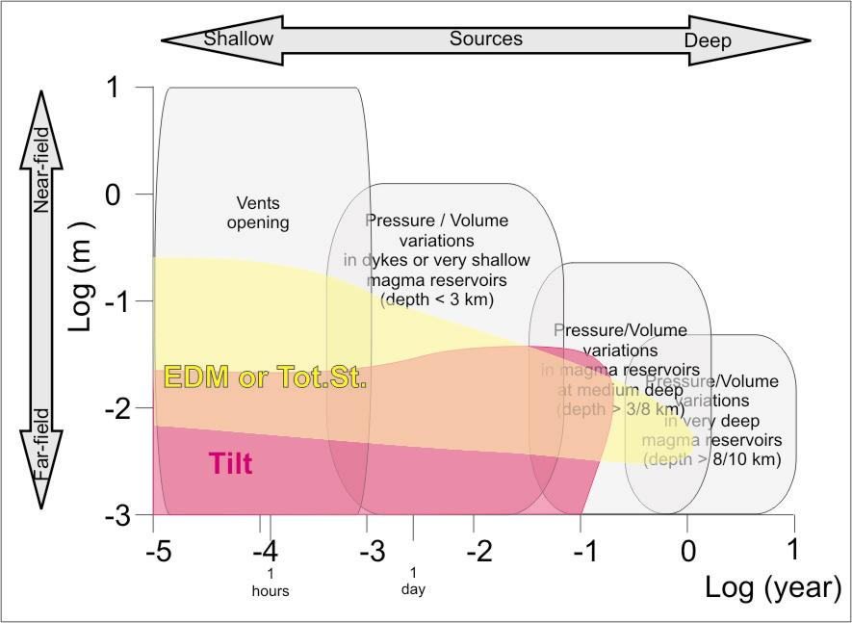
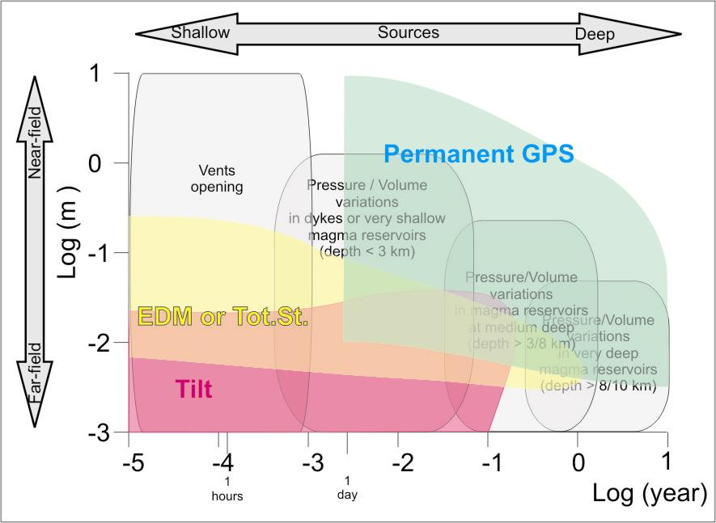
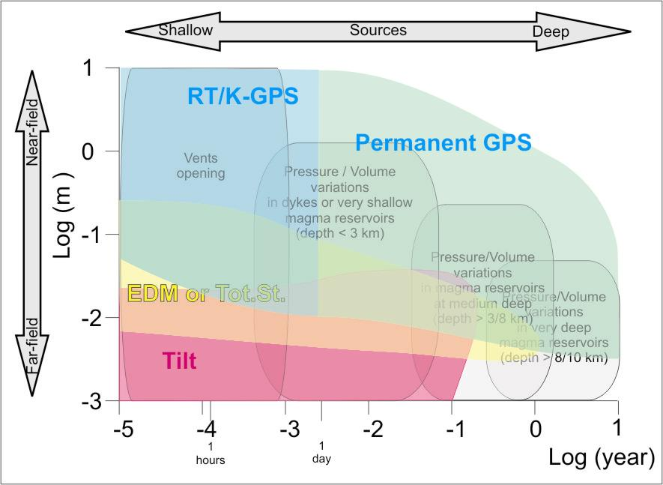
Summary of geodetic monitoring techniques
Non-continuous (or periodic) monitoring techniques
Leveling
EDM or Total Stations Surveys
GPS Surveys
SAR based techniques
The areas plot the most favorable conditions to apply the particular technique (not always exclusively)
Continuous monitoring techniques
Tilt or strainmeters
Automatic EDM or Total Stations
Permanent GPS (daily)
Real-time and/or kinematics GPS

Slide 25
Definition of the data types for volcano monitoring
Monitoring techniques vs. Phenomena
 | Seismic Net. |  |  | Geodetic Networks |  |  |  |  |  |  |  |  | Volc. Data |  | Potential Field Networks |  |  |  |  |  | Remote Sensing |  |  |  |  | Fluids Data |  |  |  | Environmental Hydro. Data
 | Velocimeters | Accelerometers | Infrasounds | GNSS Systems | Tiltmeters | Strainmeters | Tide Gauges | Gravimeters | Gradiometers | Total Stations | Levelings | Laser Scaners | Geologic surveys | Petrologic Monitor. | Scalar Magentom. | Magentic Surveys | Vector Magnetom. | Geoelectric Self Pot. | Geoelectric Sound. | Magnetotelluric | SAR; GBSAR; GBRAR | Visible Satellite Data | IR/UV Satellite Data | Ground Bas. Camera | LIDAR | T (fumaroles, soil) | Soil-gas fluxes | Chemistry of rivers | Chemistry of fluids | Piezometers | Ground- river-waters | Air Temperature | Air Pressure | Air Humidity | Anemometric Data
Lava Flows/Dome or Lahars emplacements | X |  |  |  |  |  |  |  |  |  |  |  | X | X |  |  |  |  |  |  | X | X | X | X | X
Volcanic explosions |  |  | X |  |  |  |  |  |  |  |  |  | X | X |  |  |  |  |  |  |  | X | X | X | X
Pyroclastic flows / fallout |  |  |  |  |  |  |  |  |  |  |  |  | X | X |  |  |  |  |  |  |  | X | X | X | X |  |  |  |  |  |  | X | X | X | X
Earthquakes and fault creeping | X | X | X | X | X | X |  |  |  |  | X |  |  |  |  |  |  |  |  |  | X
Ground Deformation / Morphological changes |  |  |  | X | X | X | X |  |  | X | X | X |  |  |  |  |  |  |  |  | X |  |  |  | X |  |  |  |  |  |  | X | X | X
Potential Field changes (magnetic, gravity, electric) |  |  |  |  |  |  |  | X | X |  |  |  |  |  | X | X | X | X | X | X
Thermal anomalies (ground waters) |  |  |  |  |  |  |  |  |  |  |  |  |  |  |  |  |  |  |  |  |  |  | X | X |  |  |  |  |  |  |  | X | X | X
Gas emission (in air, soil, groundwater) |  |  |  |  |  |  |  |  |  |  |  |  |  |  |  |  |  |  |  |  |  |  | X | X |  | X | X | X | X |  |  | X | X | X | X
Geothermal Fields (hot springs, geysers) |  |  |  |  |  |  |  |  |  |  |  |  |  |  |  |  |  |  |  |  |  |  | X | X |  |  | X | X | X | X | X
TCS Seismology (TBV)
TCS GNSS (and Geodesy) (TBV)
TCS Satellite data (TBV)
techniques
phenomena
Preliminary Survey

Slide 26
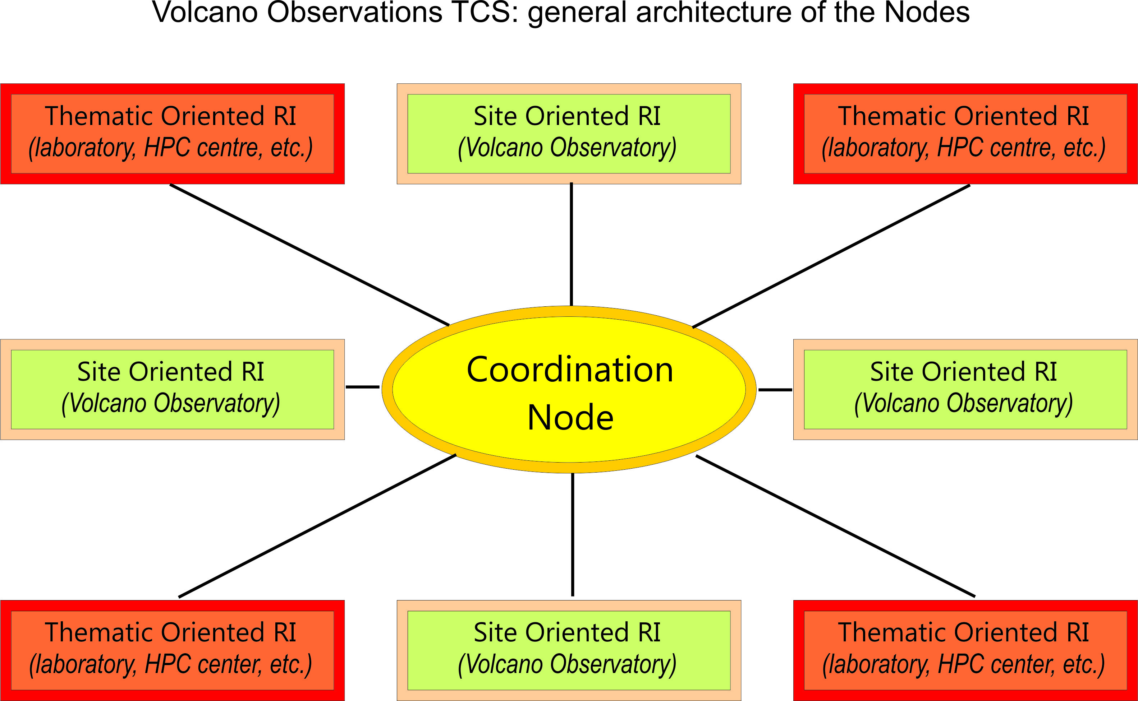
Volcano Observations TCS: outline of the architecture
Site oriented (Geographical-RIs). They are directly connected to a volcanic area and thus to a multidisciplinary monitoring system. They are geographically identified and defined.
Thematic oriented (Non-Geographical RIs). They are not involved in local monitoring. They could be infrastructures that produce data and services dealing with volcano monitoring and scientific research (e.g., ESA, ASI, GVM, etc.). They can provide complementary services to the Earth Observation, catalogues, Laboratories etc.
Link with ICS
FUTUREVOLC
EC Supersite Project
MED-SUV
EC Supersite Project

Slide 27
Best Practices for volcano monitoring
To adequately monitoring a volcano it is needed to know the volcano !
Good Data for Good Science
Essential Variables
Monitoring
Research
Essential Variables ????
Positive feed-back between Research and Monitoring

Slide 28
Volcano Monitoring & E.V.
Multidisciplinary data sets are currently evaluated to assess the volcanic hazard;
The community is able to identify the most significant observations (e.g., by applying BET)
Each volcano usually shows different set of significant observations
FIRST CONCLUSIONS:
  E.V. in volcanology should be volcano-dependent !
  Analysis of E.V. candidates through time & volcanoes

Slide 29
Ideas to identify E.V.
Suggestions from Climate community: “ … An ECV is a physical, chemical or biological variable or group of linked variables that critically contributes to the characterization of Earth’s climate. … (Bojinsky et al., 2014);
… For these purposes, observational datasets need to be traceable to quality standards, be readily interpretable, freely available and cover long period (e.g. 30 Y for WMO) (Bojinsky et al., 2014)
Currently, only very few of observables meet some of these requirements, on a very few volcanoes: seismology, ground deformation, EO data ?.
Example from Differential SAR Interferometry (DInSAR)

Slide 30
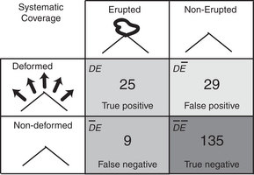
Ideas to identify E.V.
~ 200 volcanoes have been monitored by DInSAR through last 18 Y (Biggs et al., 2014);
In about 80% of studied cases DInSAR is informative
In absolute only 34 volcanoes erupted; is this data set enough ?
18 Y (or 30 Y) is an enough period for volcanic (or Solid Earth) processes ?

Slide 31
Conclusions
E.V. concept has not been applied in Earth Science (and Volcanology) so far;
The implementation of EPOS, as R.I. for accessing a wide multidisciplinary data sets (volcanologic use case) is a strategic asset for the application of E.V. in Earth Science community;
The ideas is to adopt a selection criteria conforming that proposed for climate observations.
… as well as what we learned from this workshop (e.g. impact vs. feasibility analysis)

Slide 32
EPOS: a single, pan-European distributed RI
TCS Seism.
TCS GNSS Data
ICS-C
ICS-D
TCS Anthrop Hazard
TCS Geomag Obs.
TCS Volcano Obs.
TCS Subsur Data
TCS Geology
TCS Satellite Data
TCS Exper. Labs
ECO
EPOS
Thanks you

