Slide 1




Towards a sustainability process for
GEOSS Essential Variables
11-12 June 2015, Bari-Italy
Societal Benefit Area: Water (River Discharge)
Name: Ulrich Looser
Institution: Global Runoff Data Centre (GRDC) at the BfG
Coordinating an Observation Network of Networks EnCompassing saTellite and IN-situ to fill the Gaps in European Observations

Slide 2

Status of existing EVs in the domain
Is your community developing a set of area-specific EVs?
  Yes
  How do you define EV?
EVs should support the work of the UNFCCC, the IPCC and other international conventions and bodies. EV is technically and economically feasible for systematic observation. International exchange is required for both current and historical observations. (GCOS)

Slide 3
The process underlying EV definition
What criteria, methodology, and process are used to identify EVs?
  Bottom-up: Availability of in-situ data for river discharge provided by National Hydrological Services (NHSs).
  Top-down: River discharge has a role in driving the climate system as the freshwater inflow to the worlds oceans may influence oceanic circulation patterns at inter-annual to decadal time scales.
  River discharge serves as an indicator for climatic change and variability as it reflect changes in precipitation and evapotranspiration.
  EV is required for baseline monitoring of UNFCCC and IPCC activities and assessments.

Slide 4
The process underlying EV definition
What criteria, methodology, and process are used to identify EVs? (…continued)
  Do you have a template to document an EV?
  Yes, templates are provided within the framework of the GCOS reporting duties (Adequacy of Monitoring Networks) and the GCOS Implementation Plan

Slide 5
EVs validation and use
To what extent are these EVs validated and used
  Validation process as EV within the GCOS-TOPC framework (Implementation Plan and Adequacy Reporting) to support UNFCCC, IPCC and other UN Conventions
Are the EVs linked to applications and users?
  Used by a large modelling community (hydrology, ocean & climate) dealing with global change, for water resources assessment, climate services, calibration of satellite data, etc.

Slide 6
ECV River Discharge
Origin of discharge measurements
Long-term river discharge measurements are the essential information source for many water resource applications, including
  water engineering designs,
  flood protection,
  irrigation scheduling,
  international water allocation agreements
  ecosystem management
  water management plans

Slide 7
EVs validation and use
How is a community agreement reached?
  Through an open review process, also managed by the GCOS secretariat
Is a community review process in place?
  Yes
Are the EVs linked to an international body and is this body involved in accepting the EVs?
  Yes, UNFCCC, IPCC, UNCCD, WCRP, GEWEX, WMO, UNESCO, UNEP, GEO, etc.

Slide 8
Describing the monitoring networks currently operational
Do you have a database with information on the EVs?
  Yes. The GRDC which operates under the auspices of the World Meteorological Organisation (WMO) and supports research on climate variability and global change. The Global Runoff Database at GRDC is a unique collection of river discharge data collected at daily or monthly intervals from more than 9,200 stations in 160 countries. This adds up to around 385,000 station-years with an average record length of 42 years.

Slide 9
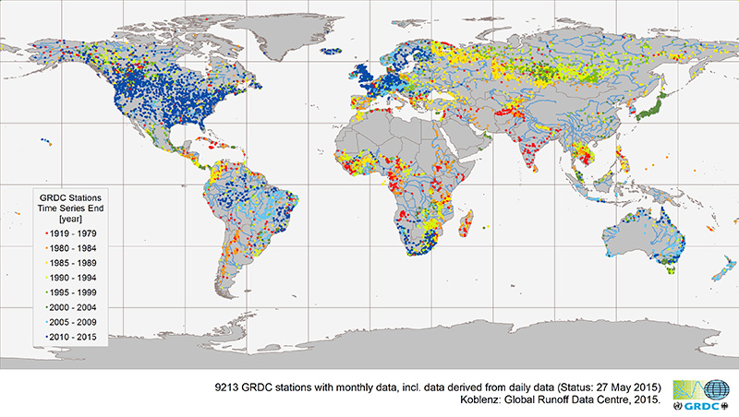
Status of the Global Runoff Database
Global Coverage of GRDC Stations indicated by time series end
>385 000 station years

Slide 10
Describing the monitoring networks currently operational
Do you have a database with information on the EVs?
  Yes. The Global Terrestrial Network for River Discharge (GTN-R).
  Based on its data holdings, GRDC has identified a priority network of 450 reference stations along the continental coastlines representing the major rivers by the most downstream GRDC-station to capture the freshwater fluxes into the World's oceans.

Slide 11
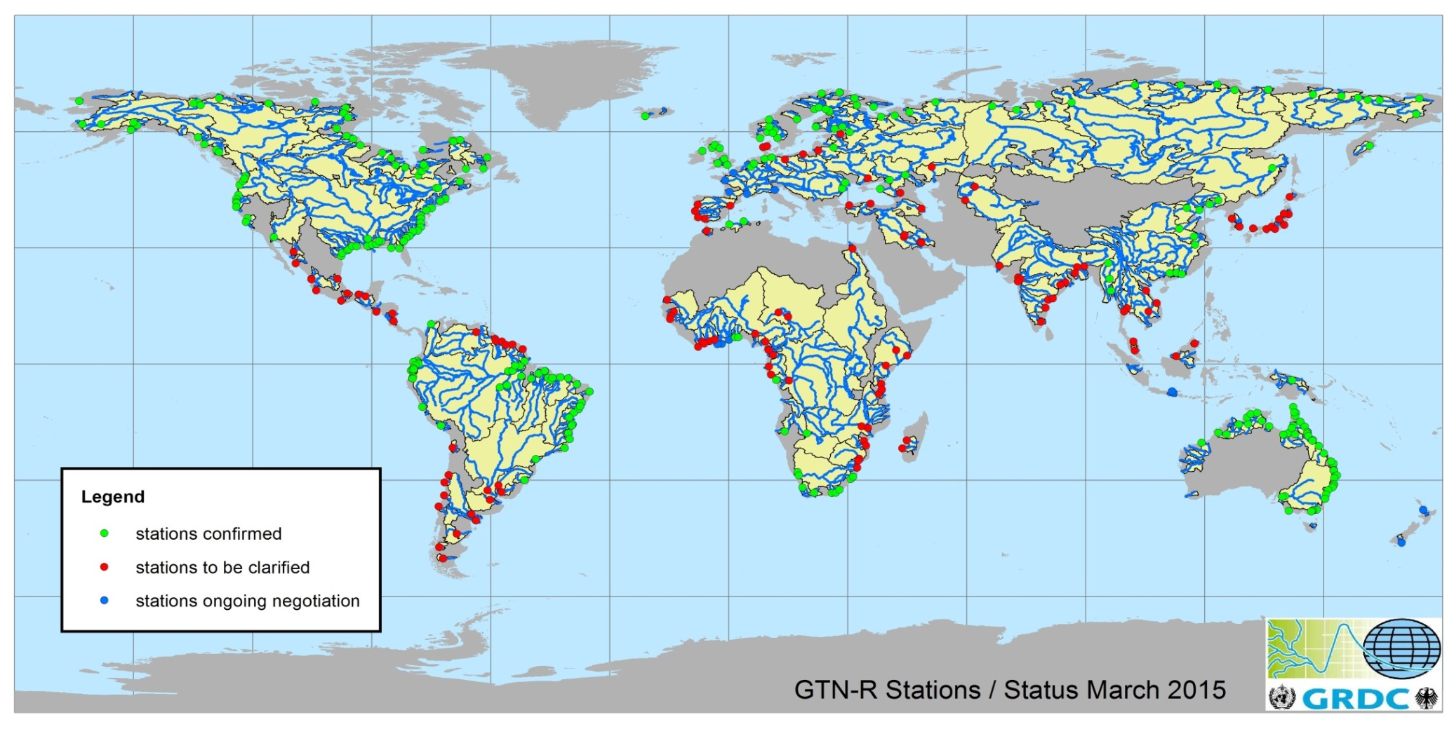
Global Terrestrial Network for River Discharge (GTN-R)
Network Status
GTN- R status as of 13 March 2015
281 Stations confirmed
165 Stations to be clarified

Slide 12
Describing the monitoring networks currently operational
Are the current operational networks operated by your community measuring the EVs?
  The monitoring networks and stations are operated and maintained by the National Hydrological Services. The WMO urges its members to share data freely with the scientific and research community based on WMO Resolution 25 (CgXIII-1999)

Slide 13
Assessing EV observational needs and readiness
For some Use Case, have you already focused on EVs’ features:
  Temporal frequency
  Daily for most models with mounting requirements for higher temporal resolution (hourly) but not yet feasible on a global scale
  Spatial resolution
  GTN-R capturing major rivers draining to the world oceans, for modelling special datasets with even distribution of stations
  Accuracy
  Processes for accuracy described in ISO standards and WMO guides and manuals

Slide 14
ECV River Discharge
ISO Standards
ISO/TC 113 Hydrometry
Scope:
  Standardization of methods, procedures, instruments, and equipments relating to techniques for hydrometric determination of water level, velocity, discharge and sediment transport in open channels, precipitation and evapotranspiration, availability and movement of ground water, including:
    terminology and symbols;
    collection, evaluation, analysis, interpretation and presentation of data;
    evaluation of uncertainties.
  61 published ISO standards related to the TC and its SCs (number includes updates)

Slide 15

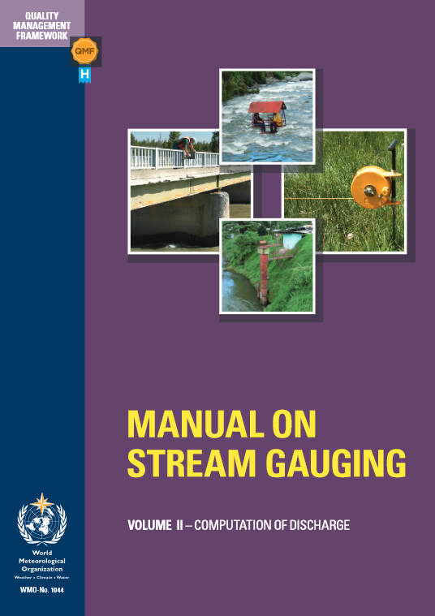

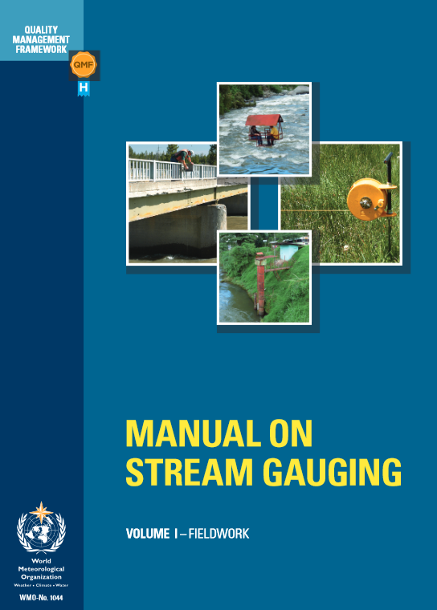
ECV River Discharge
WMO Guides and Manuals issued by the CHy

Slide 16
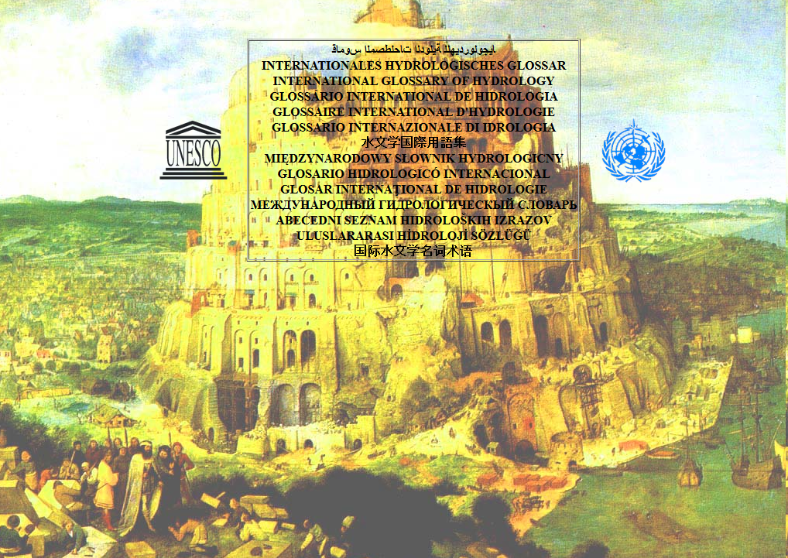
ECV River Discharge
WMO – UNESCO International Glossary of Hydrology

Slide 17
Assessing EV observational needs and readiness
Challenges and how these are addressed
  Data sharing obstacles due to:
      Data Policy
      Technical
      Administrative
      Institutional
      Funding
  Resource constraints for comprehensive data acquisition, maintenance and distribution

Slide 18
Gaps and requirements
Have you already carried out a gap analysis utilizing the EVs to identify gaps and priorities in terms of:
  EO data availability:
  Resolution issues, both temporal and spatial, but improving (SWOT Mission 2020)
  In-situ data availability
  Repeatedly done by GRDC through WMO CHy, TOPC, GCOS
  Data repositories for the long term preservation of EVs
  Yes, GRDC and others
  Infrastructure for EVs publication
  Yes, GCOS and TOPC

Slide 19
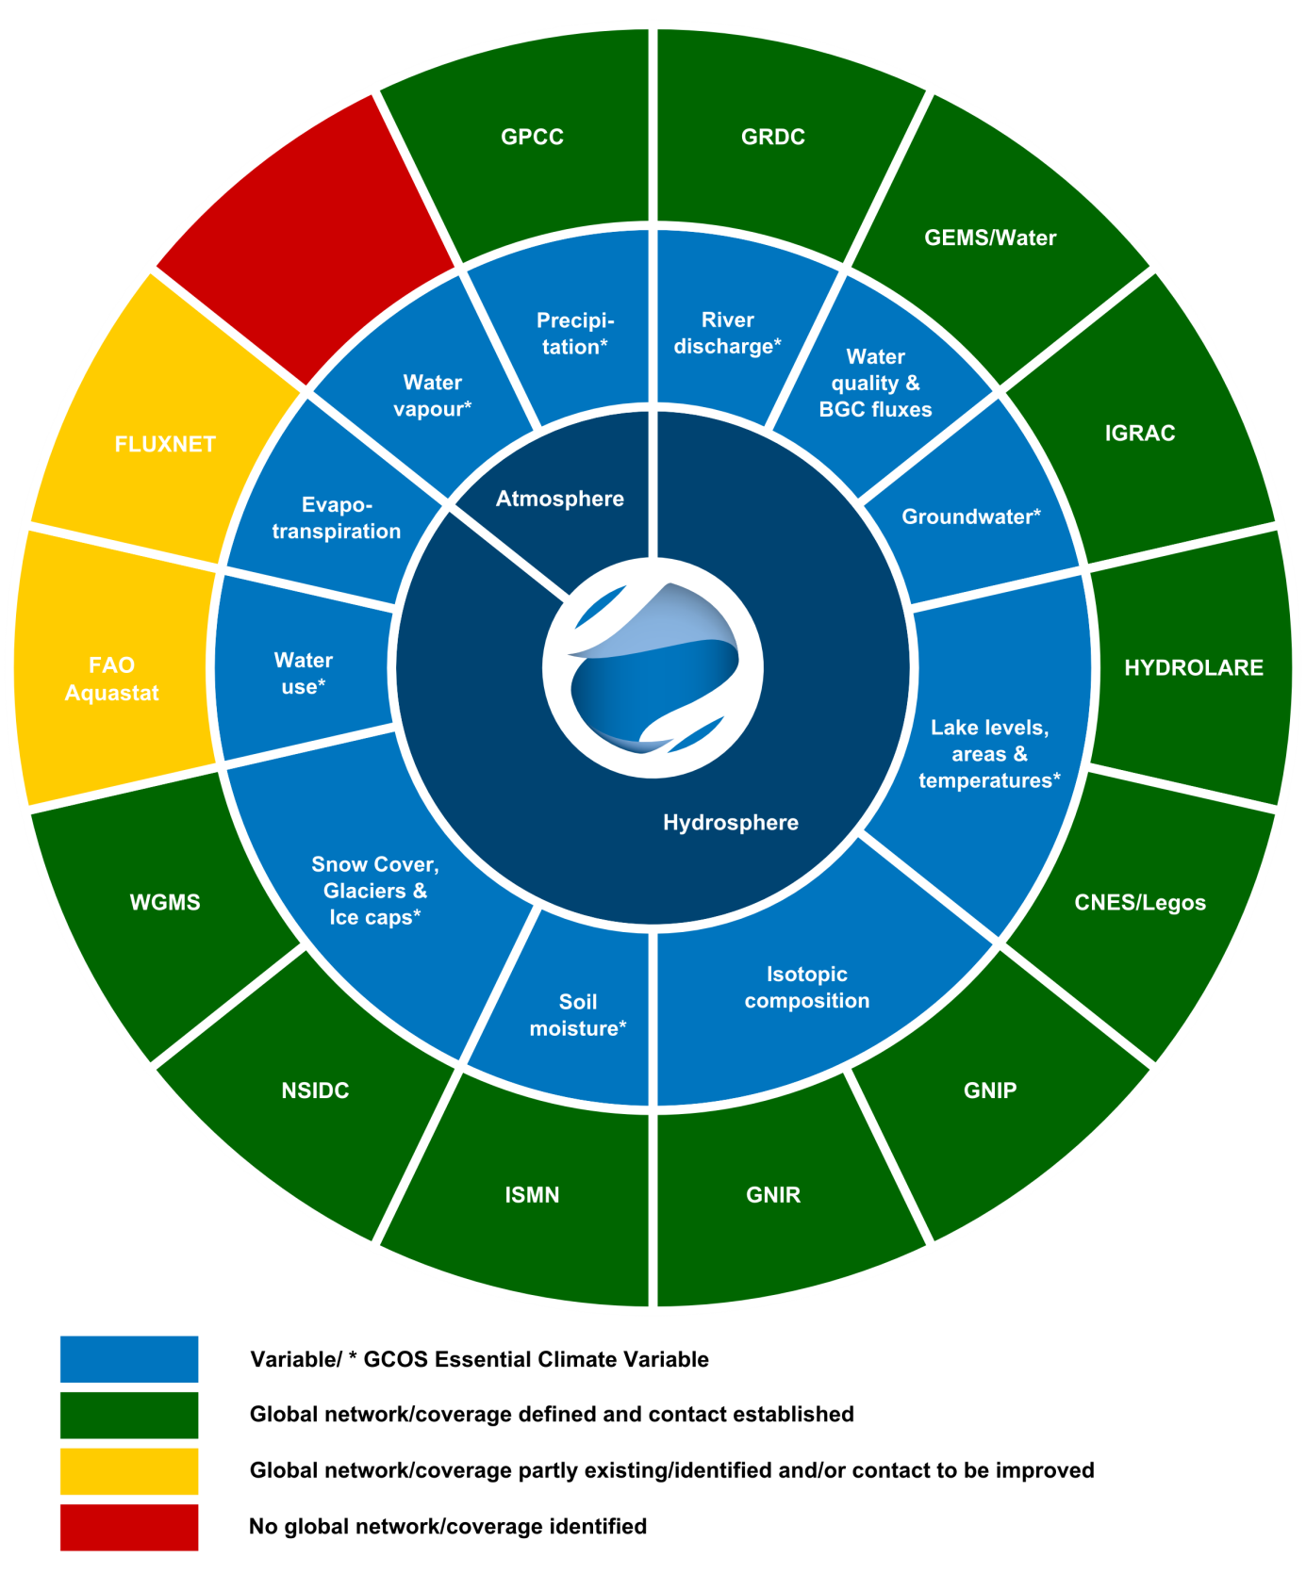
Global Terrestrial Network Hydrology (GTN-H)

Slide 20
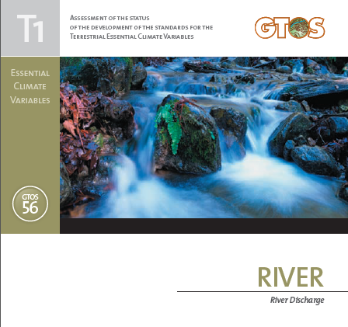
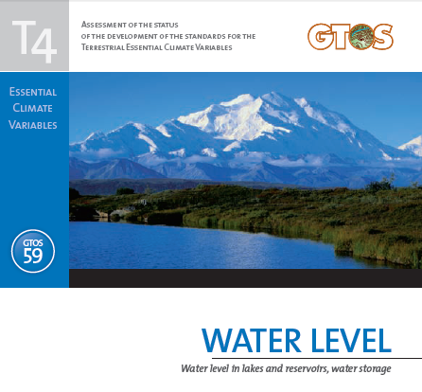
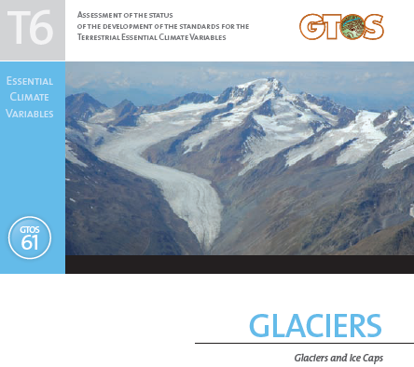
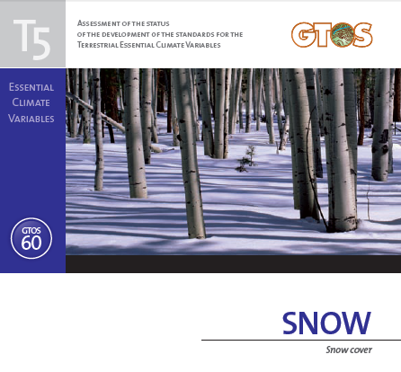
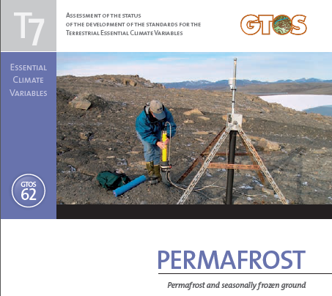
ECV Reports for Terrestrial Observing Systems developed by GTOS with support from TOPC and GCOS (Selection only)
Not completed:
T2 Water Use
T3 Groundwater

Slide 21
Conclusions
Overlapping with EVs in other domains (SBA):
  Yes, Water is a key element in basically all SBAs
Priorities for EVs operational monitoring:
  Total flux to ocean stations and climate sensitive stations (minimal human impact)
Future work
  Improve data sharing mechanisms
  Develop space based complementary measurements which can be used as alternatives in data sparse areas
  Improve quality of observations

