Slide 1
Towards a sustainability process for GEOSS Essential Variables
11-12 June 2015, Bari-Italy
Summary
Coordinating an Observation Network of Networks EnCompassing saTellite and IN-situ to fill the Gaps in European Observations

Slide 2
What is essential
Any Variable is “essential” for somebody or for achieving something
GEOSS must capture what somebody and something are
Consider a Scope (keep it simple, please)
Consider EVs to achieve that scope
To talk about EVs connected to a given scope/target and a CoP

Slide 3
Open challenges (for GEOSS)
“raw” data
user “needs”
EVs
EVs
EVs
Observations
Indicators

Slide 4
Defining EVs
This is a governance and social task, as well as a scientific one
Communities of Practices have been defining “their” Essential Variables for providing services
GEOSS must consider them all
Like for data interoperability standards
To deal with “many” EVs belonging to the same domain (SBA)

Slide 5
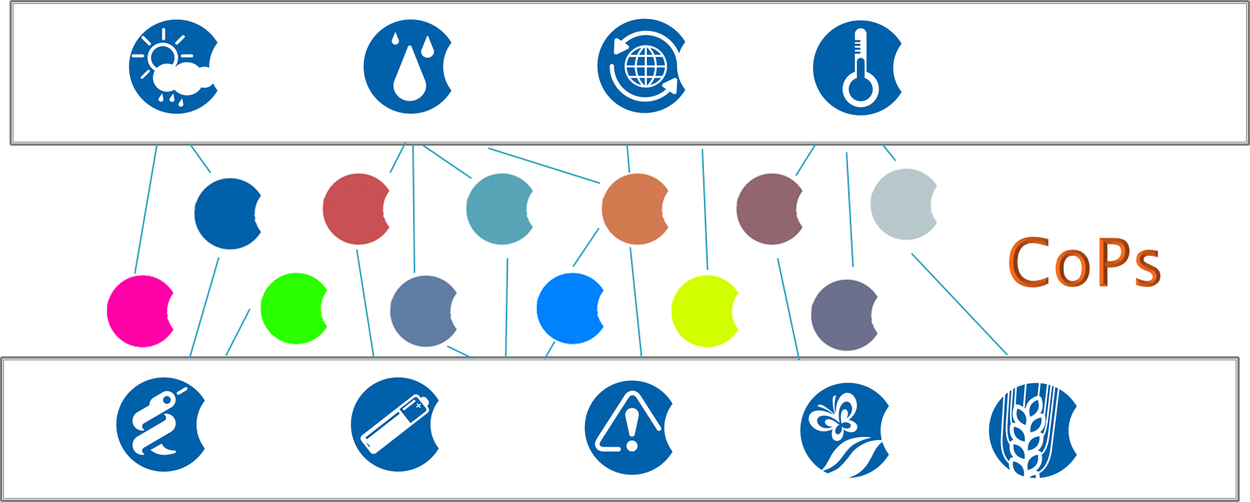
Open challenges (for GEOSS)
Different maturity levels
Global vs Local
Harmonization / Alignment
EVs
EVs
EVs
EVs
EVs
EVs
EVs
EVs

Slide 6
Process
Relevance
Strategic Goals, Programmes
Goal-based
Expertise-based
EVs
Observations, Measurements
Feasability

Slide 7
Starting points / Aspects
EVs
User Needs
Targets Goals//Services
Governance
Actual Measurements
Actual Workflow
Directives
All these relevance and feasibility “aspects” must be considered by GEOSS

Slide 8
Communities at work
Possible starting points for ConnectinGEO
Climatology
Hydrology
Agriculture
Biodiversity
Oceanography
Weather
… .
Cross-domain EVs to be recognized by GEOSS

Slide 9
Knowledge sharing
Knowledge bodies to be shared
Essential variables
Features (requirements)
Workflows to generate them
accessibility, re-producability
Related publications
accessibility
… .

Slide 10
Sustainability
Not Clear
Data provision
Processing Provision
…. .

