Slide 1
Chilean SDI Integrating GEO: Interoperability Challenges for Supporting Disaster Management
11-12 June 2015, Bari-Italy
Societal Benefit Area: Disasters
Alvaro Monett --Chile Capacity Building Working Group
Ministry of National Property – SDI Executive Secretariat

Slide 2
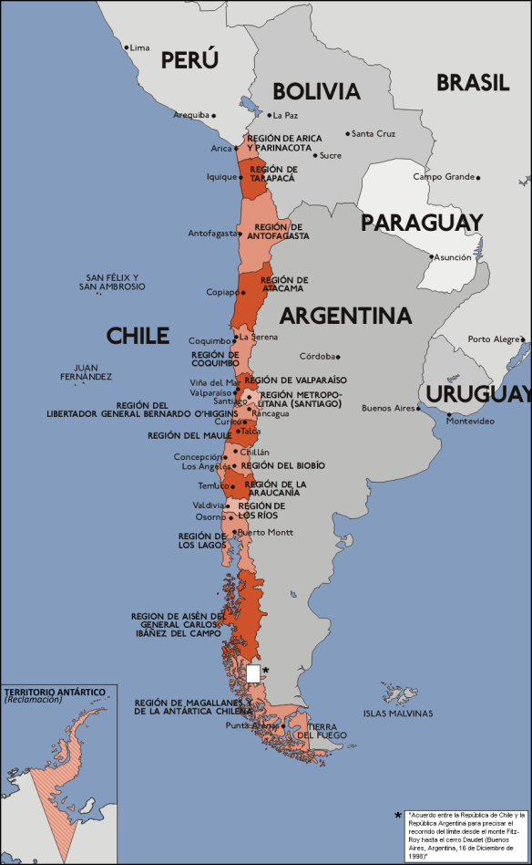
Chile: the country
Population: 16.572.475 (2012)
Area: 775.776 Km2 (IGM 2007)
Lenght: 4.337 Km2 (IGM 2007)
Regions: 15
Comunnes (municipalities): 346

Slide 3
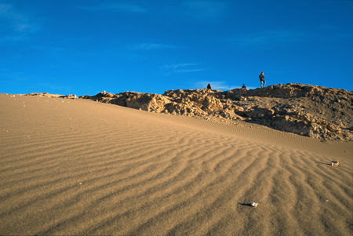
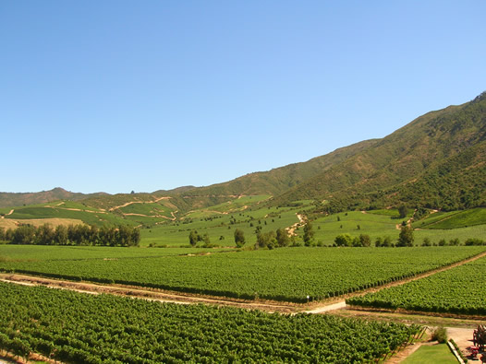
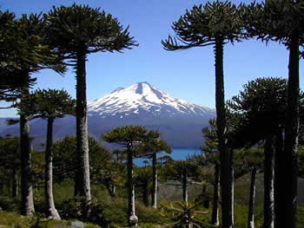
A diverse geography

Slide 4
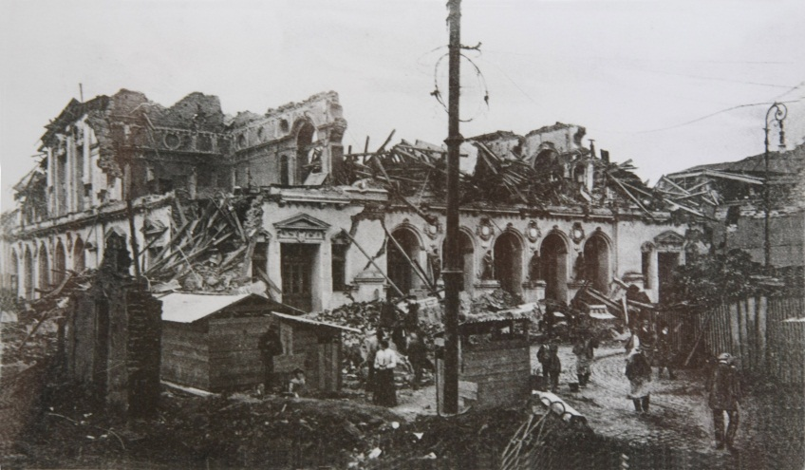
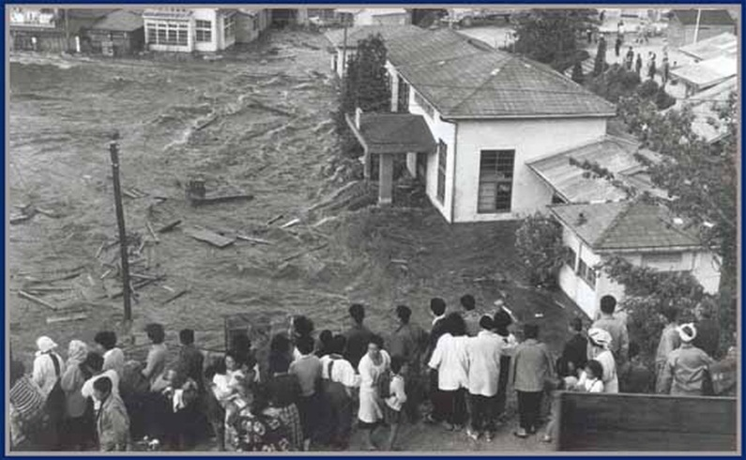
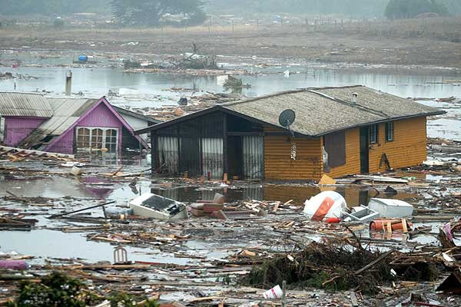
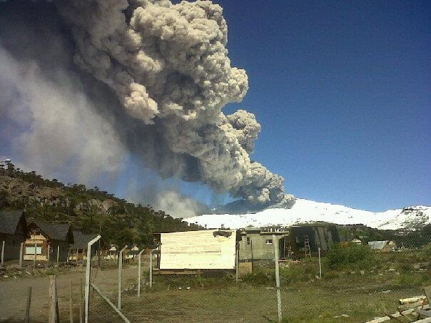
Long story of disasters
Valparaíso, 1906
Valdivia, 1960
Concepción, 2010
Vn. Copahue, 2010

Slide 5
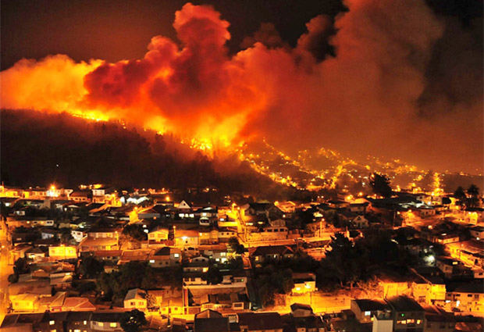
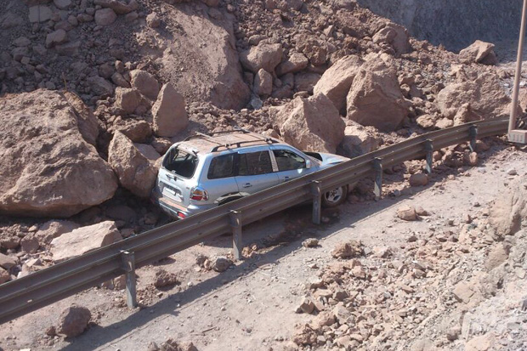
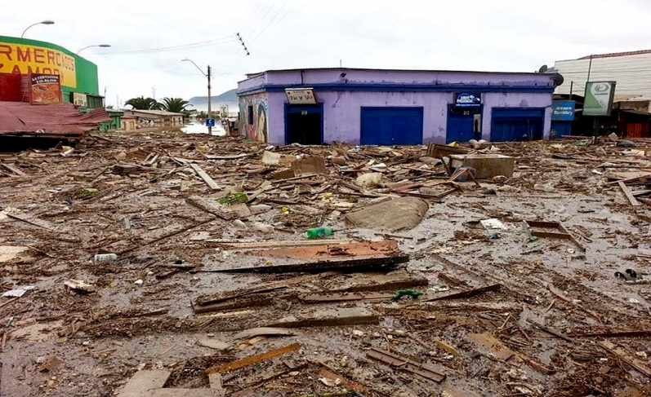
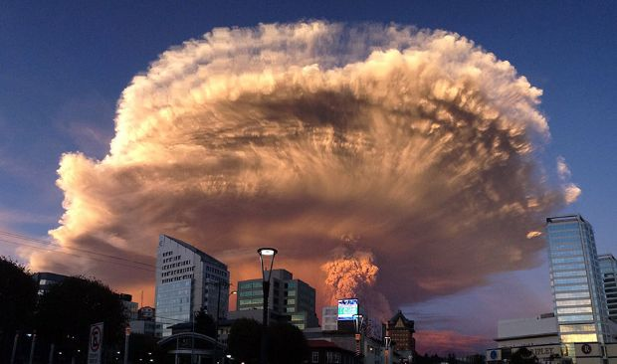
Long story of disasters
Valparaíso, 2014
Iquique,2014
Valparaíso, 1906
Valdivia, 1960
2010
Copiapó, 2015
Vn. Calbuco, 2015
2015

Slide 6
SDI Chile: geospatial information for decision making
Municipios
Seremis/Serv
Regionales
Regional
Governments
Regional
Offices
IDE - CHILE
Public Works
Cadaster
National Property
Administration
DCPR
Social Development

Slide 7
SDI Chile: geospatial information for decision making
Legal framework
Data and Information
SDIs in Ministries
Standards
Supreme Decree N°28
Ante-project of Law in process
Proposal of National Policy
140 layers of geospatial data coming from 17 ministries
60 layers able to download
Public Works
Agriculture
Energy
Environment
Geology / Mining
National Property
Housing
Social Development
Interior
Justice
Transport
Economy
Education
Health
Culture
Women Affairs
23 chilean norms for geospatial information management (ISO)
Technical documents for implementation

Slide 8
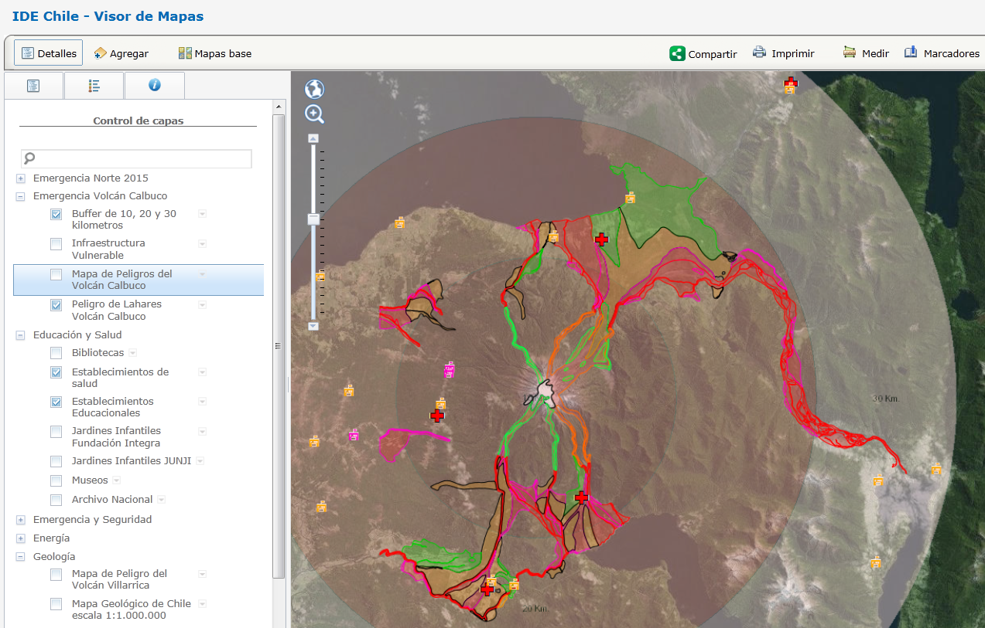
SDI Chile: geospatial information for decision making

Slide 9
International connections of the Chilean SDI for sharing geospatial information

Slide 10
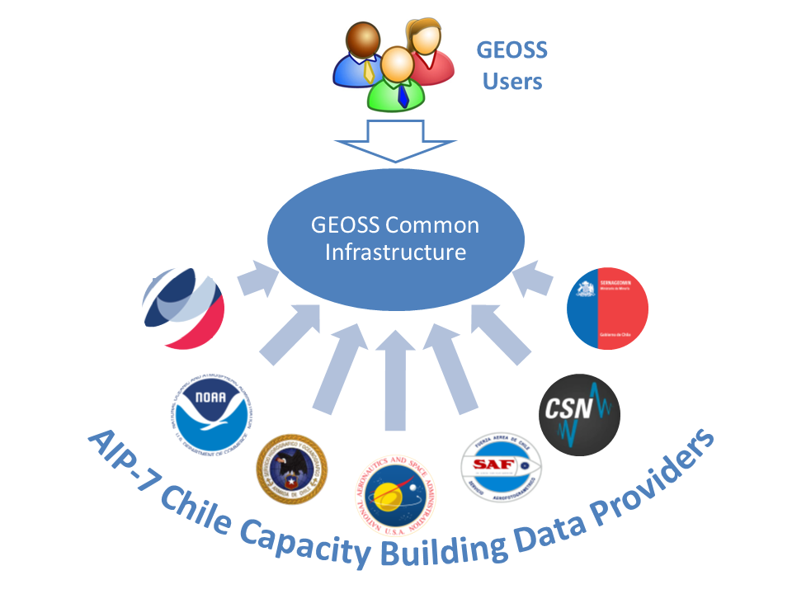
Chilean SDI working with GEO : GEOSS Architecture Implementation Pilot
International Coordination
Afriterra Foundation
National Coordination in Chile
Ministry of Foreign Affairs
International Participation
Consiglio Natzionale delle Ricerche (CNR)
National Aeronautics and Space Administration (NASA)
National Participation (Chile)
Ministry of National Property (Chilean SDI)
Aerophotogrammetric Service of the Airforce
National Emergency Office
National Service for Mining and Geology
Chilean Meteorological Direction
University Federico Santa María
Hydrographic and Oceanographic Service
National Seismological Service (University of Chile)

Slide 11
Chile Capacity Building WG for disasters
Testing metadata and data web services, developing Models, and Validation through WPS & WPCS Chaining.
Developing Best Practices to be shared and disseminated with Chilean Emergency Agency ONEMI.
Testing & developing different approaches on how to integrate referenced Big Data (Satellite Providers data with many sparse, individual ones—VGI, UAV) for disasters and other SBA.
Disseminating Environmental Variables to measure the different, distributed components.
Our goals

Slide 12
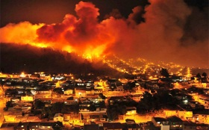
Chile Capacity Building WG for disasters
In 2015, Chile Capacity Building WG has six testing areas:
1- Copahue volcanic area.
2-Talcahuano earthquake area.
3-Valparaiso fires area.
4- Iquique earthquake area.
5- Villarrica volcanic area.
6- Calbuco volcanic area.

Slide 13
Chile Capacity Building WG for disasters
Emergency Management : National Office for Emergencies
Policy decisions, Information needs
National Data Providers:
National Service for Geology and Mining
Chilean Meteorological Direction
Aerophotogrammetric Service of the Airforce
University Federico Santa María
Hydrographic and Oceanographic Service
National Seismological Service (University of Chile)

Slide 14
Chile Capacity Building WG for disasters
National Data Discovery and Access:
Geoportal of Chile - Ministry of National Property/ SDI Chile
International Data Discovery and Access:
GEOSS - Portal
International National Data Providers:
NASA
Multiple imagery sources

Slide 15
Status of existing EVs in Chile disasters SBA
Our community developing a set of area-specific Evs.
We define EV as measures of metadata web services accessible, searchable and discoverable nationally and internationally (through geoportal in Chile and GEOSS) and variables useful to measure processes and models.
Some of our members have discussed and proposed usability matrices to measure EV.

Slide 16
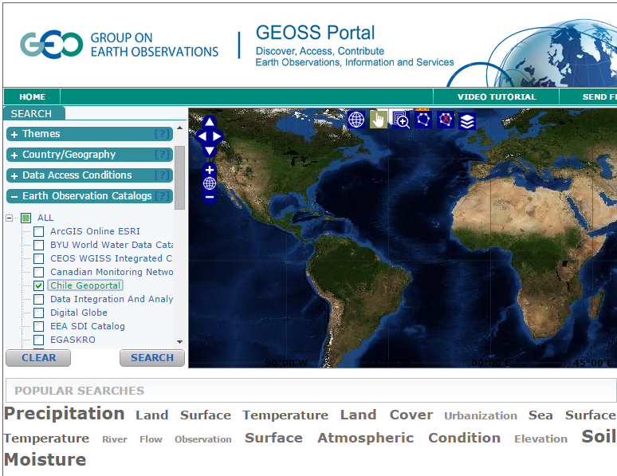
Status of existing EVs in Chile disasters SBA

Slide 17
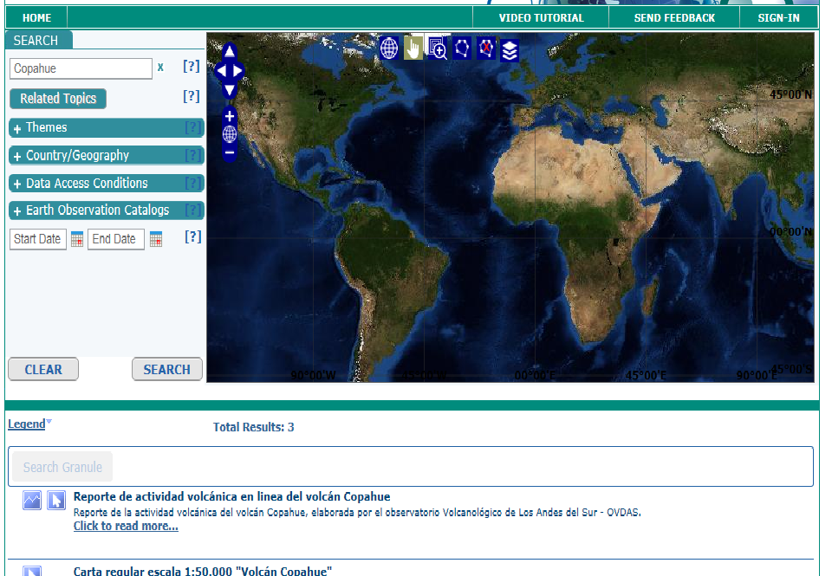
Status of existing EVs in Chile disasters SBA

Slide 18
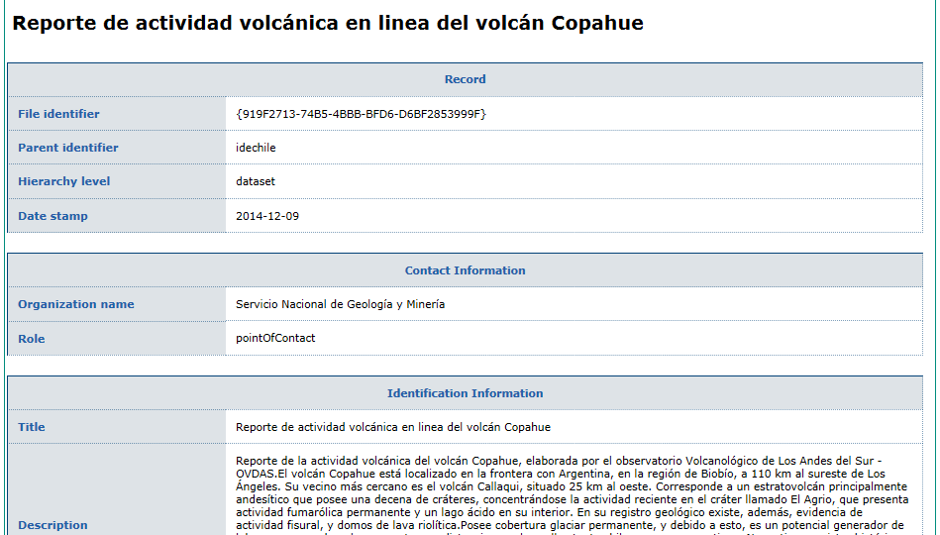
Status of existing EVs in Chile disasters SBA

Slide 19
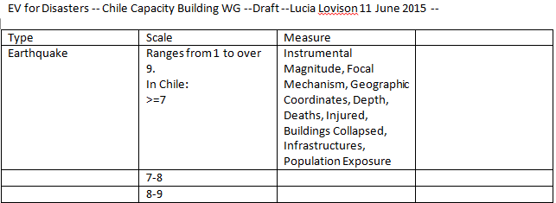
Status of existing EVs in Chile disasters SBA
Chile CB WG will develop a set of area-specific EVs.
We define EV as measures of metadata web services accessibile, searchable and discoverable nationally and internationally (though geoportal).
This a draft of EVs for our six testing areas:

Slide 20
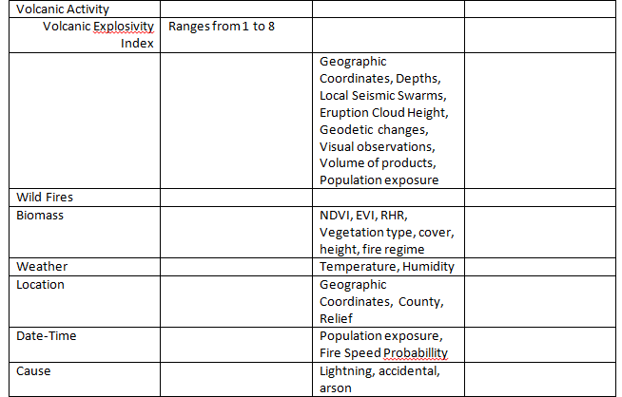
Status of existing EVs in Chile disasters SBA
Chile CB WG has developed a draft of Evs for our six testing areas:

Slide 21
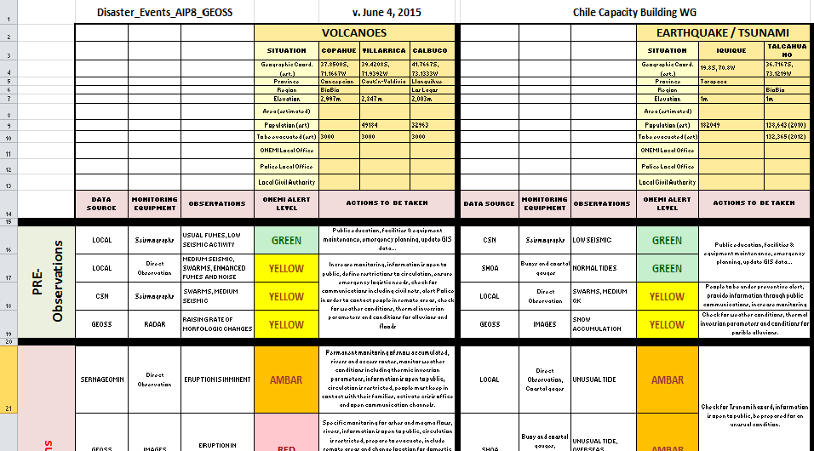
Status of existing EVs in Chile disasters SBA

Slide 22
Status of existing EVs in Chile disasters SBA
The Capacity Building WG will consider others EV, depending on the type and scale of disasters, that means, we consider it a form of validation of the data and/or model.
We are also open to hear about reference documents from other domains.
Please let us know it.

Slide 23
Conclusions
Priorities for EVs operational monitoring:
Our team will focus on the disaster events for the selected Testing Areas in Chile for the 2015. For essentially these types of events, and depending on their scale, we plan to formulate the EV as inputs to our WPS models and we look to their outputs.
We are also in the process of formulating their EVs accuracy.
Our recommendation to GEO/GEOSS will be following our work. Our Chile Capacity Building WG will suggest EVs validation processes both for the events considered and for the people involved in this project.
Future work: identifying policies to acquire common EV parameters for events in other overlapping SBA (such as geographic coordinates, depth, relief, infrastructures, population exposure); continue to refine EVs both as input and output parameters to models; work on their validation.

Slide 24
Conclusions
National Spatial Data Infrastructure providing a platform for accessing to public geospatial information
Collaborative work among State, University and International Organizations
Strengthen links with national SDI bodies, in order to connect with governmental data
Connecting new organizations, increasing metadata and web services available

Slide 25
Thank you very much amoneth@mbienes.cl

