Slide 1




Towards a sustainability process for
GEOSS Essential Variables
11-12 June 2015, Bari-Italy
Name(s): Ivette Serral
Institution: CREAF
The ConnectinGEO project
Coordinating an Observation Network of Networks EnCompassing saTellite and IN-situ to fill the Gaps in European Observations

Slide 2
ConnectinGEO in brief
H2020 funded project that will last 2 years (641538)
Coordinate and Support Action (CSA)
Formed by 15 partners
A contribution of the EU to GEOSS
A gap analysis of GEOSS
Will propose priorities
Manage an European Network of Earth Observation (ENEON).

Slide 3


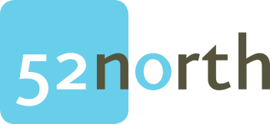



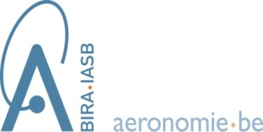







Partnership
Good balance:
Some technical people
Some thematic experts
Some networking experts

Slide 4
Summary
ConnectinGEO links existing coordinated Earth observation networks with science and technology (S&T) communities, the industry sector and the GEOSS and Copernicus stakeholders.
The emerging UN Sustainable Development Goals (SDGs) are a motivation.
Outcome:
  prioritized list of critical gaps within the European Union in observations and the models that translate observations into practice-relevant knowledge.
  It will include the research activities required to address these gaps.
  Increase coherency of European observation networks, increase the use of Earth observations and inform the planning for future observation systems.

Slide 5

ConnectinGEO methodology
First translate knowledge needs (e.g. SDG) into indicators and
then these indicators into essential variables (EV) required for the quantification of the indicators;
Ultimately, these EV are used to refine observation requirements.
In ConnectinGEO, requirements will be related to information on available observations to identify key gaps.
Society
Policy and Planning
Industry Challenge
Decisions
Impact
Knowledge base
Observation
priorities
Forecast
and
projections
Top-Down
Goals
Strategic Targets
Sustainable Development
Goals
Sustainability Indicators
Essential Variables
Remote & In-Situ Observations
Bottom-up
Observation
Observing Systems/Networks
Climate
Water
Agriculture.
Natural Res.
Carbon
Ecosystems
Energy.
Raw materiasls
Scientific Community

Slide 6
ConnectinGEO 4 major objectives
Enable a European Network of Earth Observation Networks (ENEON)
  A forum to discuss joint strategies and harmonize across the observation networks (feed a consultation process).
  Facilitate access and to share the information from EU observing systems
Provide a methodology to convert the knowledge needs in the GEO SBAs derived from
  GEOSS Strategic Targets,
  the analysis of Copernicus services and
  SDGs
into a coherent observation and measurement compendium
1
2

Slide 7
ConnectinGEO 4 major objectives
Apply the ConnectinGEO methodology to identify and assess the priority of gaps. Derived from five different threads.
  a1: Observation requirements in GEOSS Targets, SDGs, and planetary boundaries (WP 2).
  a2: International programs: Future Earth, Belmont Forum, RDA (WP6).
  b1: A consultation process in the current EO networks (WP 3).
  b2: Analysis of the Discovery and Access Broker (WP 4).
  b3: Industry-driven challenges (WP5).
Exploit the results of the project (WP7):
  By connecting to: National and regional funding agencies, GEO Work Plan, Implementation Boards, GEOSS user communities, including the S&T communities. GEOSS Showcases Portfolio, Copernicus user, Private Sector and Citizen Observatories
  A Published ConnectinGEO methodology
  A collection of best practices for observation networks and data exchange.
3
4

Slide 8
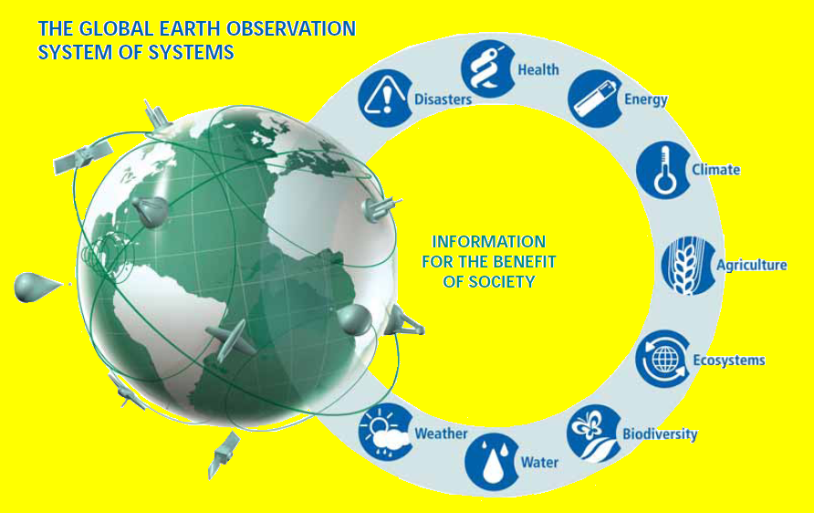
GEOSS
GEOSS is a system of systems (SoS) coordinated by GEO. This emerging public infrastructure interconnects a diverse and growing array of instruments and observations that monitors the global environment and supports forecasting as well as projections of future changes.
GEOSS supports the implementation of effective policies and planning by experts and decision-makers.
GEO targets nine SBAs and participants are organized in CoPs
The development of GEOSS is organized in the GEOSS Work Plan that is composed of Tasks and Task components.

Slide 9
Copernicus (GMES)
Is the European Programme for the establishment of a European capacity for EO aiming at monitoring the Earth.
Consists of a complex set of systems which collect data from multiple sources: EO satellites and in-situ sensors such as ground stations, airborne and sea-borne sensors.
These services address six thematic areas:
  marine, atmosphere, climate change, emergency management and security.
The GMES in-situ coordination (GISC), a FP7 funded project, carried out by the European Environment Agency (EEA) already performed a gap analysis and prioritization for in-situ data taking into account that demands will change over time. ConnectinGEO will consider GISC as a basis.

Slide 10

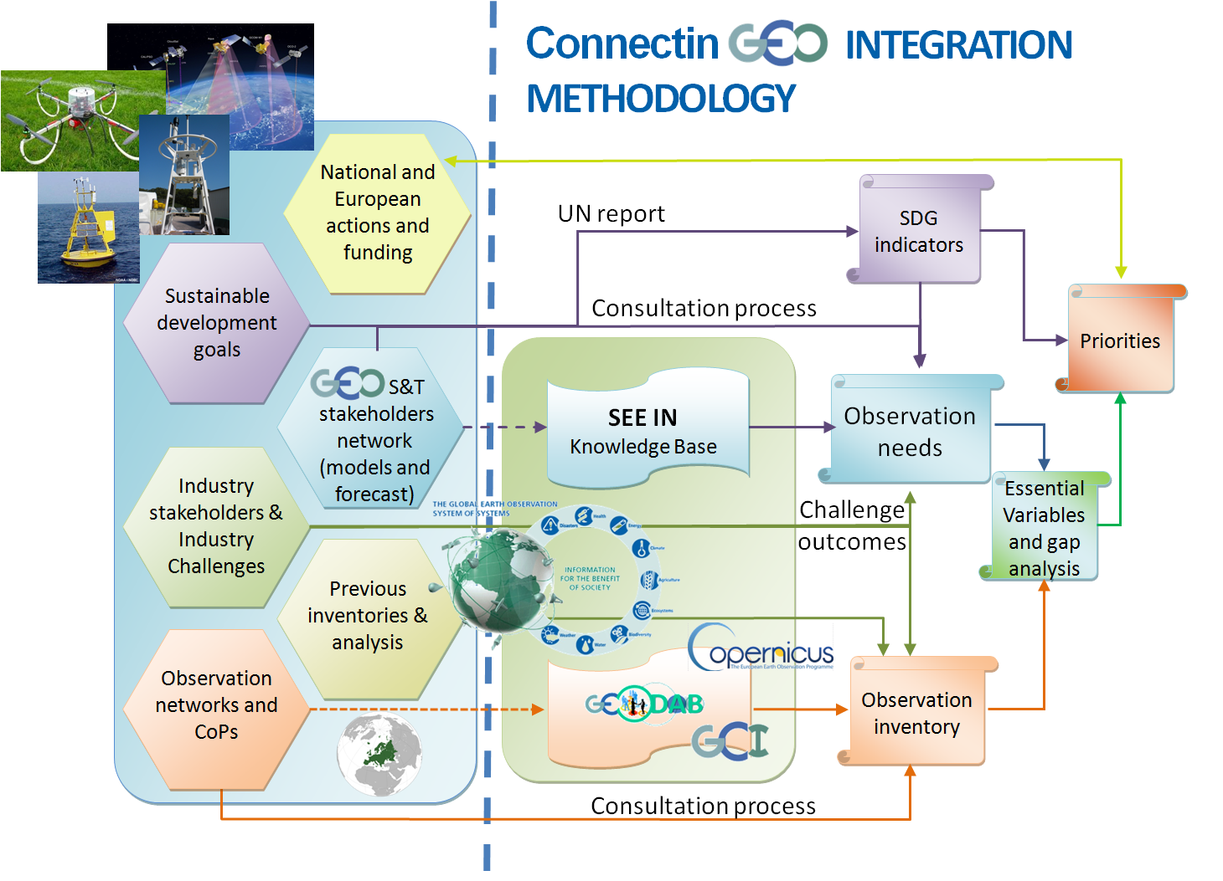
Overall approach

Slide 11
Sustainable development goals
The SDG are a universal set of goals, targets and indicators that UN member states expect to use to frame their agendas and political policies over the next 15 years.
Were build upon the Millennium Development Goals.
“In order to monitor the implementation of the SDGs, we need availability and access to data. There is a need to take urgent steps to improve the quality, coverage and availability of data.” Monitor the success of the UN Sustainable Development Goals (SDGs) is a motivation for ConnectinGEO gap analysis.
Notes:
http://www.theguardian.com/global-development/2015/jan/19/sustainable-development-goals-united-nations

Slide 12
Sustainable development goals
The ones affecting ConnectinGEO are:
  Goal 2: End hunger, achieve food security and improved nutrition and promote sustainable agriculture
  Goal 3: Ensure healthy lives and promote wellbeing for all at all ages
  Goal 6: Ensure availability and sustainable management of water and sanitation for all
  Goal 7: Ensure access to affordable, reliable, sustainable and modern energy for all,
  Goal 11: Make cities and human settlements inclusive, safe, resilient and sustainable
  Goal 13: Take urgent action to combat climate change and its impacts
  Goal 14: Conserve and sustainably use the oceans, seas and marine resources for sustainable development
  Goal 15: Protect, restore and promote sustainable use of terrestrial ecosystems, sustainably manage forests, combat desertification, and halt and reverse land degradation and halt biodiversity loss

Slide 13
ENEON: Composition
The thematic partners (that represent thematic observation networks),
The GEOSS S&T Stakeholder Network and GEOSS CoPs,
Copernicus services, Sentinel missions and in-situ support data representatives,
European networks representatives for space-based, airborne and in-situ observations (e.g. EPOS, EMSO and GROOM, etc), ENVRIplus
Representatives of the SMEs and industry sector.
European and national funding agencies and in particular the ones participating in the ERA-PLANET

Slide 14
The role of ConnectinGEO in forecasting and projections
The state of the art models used in forecast and projections rely on comprehensive set of observations and its accuracy is conditioned by the existence of the current gaps.
By including the model needs in the study, gaps will be identified.
The DAB is currently able to catalogue and discover some WPS or OpenMI models.
Also datasets can be tagged with models that can use them.
ConnectinGEO will contribute to identify more models (contributing also to incorporate them in the DAB when appropriate and possible), infer data needs and will also provide insides on how the model web can progress in GEO.
In ConnectinGEO, the needs of these models will be taken into account as criteria to set priorities for maintaining, expanding or creating new observation networks.

Slide 15


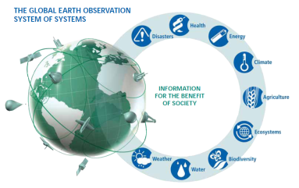


Two loop development
European Network of Earth Observation Networks (ENEON)
INPUTS
National and regional actions and funding
SDG
Observation
inventory
Gap analysis
Priorities
Outcomes
Observation
needs
SBAs & CoPs
Multiple loops
Industry stakeholders & challenges
National, regional actions & S&T feedback

Slide 16
Essential Variables

Slide 17

An example
What is the goal of a person in live?
Achieve happiness

Slide 18



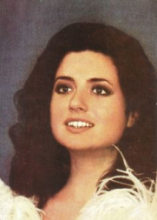
Indicators for a happiness ?
Tres cosas hay en la vida: salud, dinero y amor
el que tenga estas tres cosas, que le dé gracias a Dios.
Pues, con ellas uno vive libre de preocupaciòn,
por eso pido que aprendan el refràn de esta canciòn.
GIGLIOLA CINQUETTI 1968
Notes:
http://www.musica.com/letras.asp?letra=1354788

Slide 19






EV for a happiness
Notes:
cardiac rhythm

Slide 20
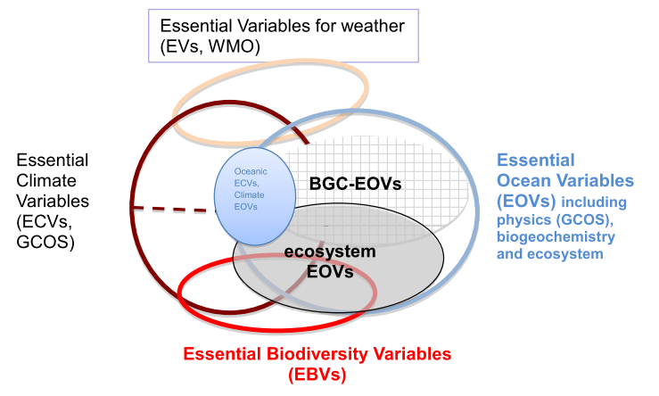
Essential Variables
The Essential Variables concept is the bases to reinforce the EO knowledge base
  Climate SBA – Global Climate Observing System;
  Biodiversity SBA – GEO BON;
  Ocean SBA – UNESCO and Southern Ocean Observing System.
  Water
ConnectinGEO will extend this concept to the following SBAs:
  Carbon (CMCC) (that has already started this process),
  Health and Pollution (CNR-IIA),
  Ecosystems (CNR-ISAC),
  Biodiversity (CNR- ISSIA),
  Energy (ARMINES),
  Disasters (TIWAH)
  Oceans (CSIC).

Slide 21
Thanks
Joan Masó. ConnectinGEO coordinator

