Slide 1




"The potential role of EV in the implementation of the MSFD and the
UNEP-MAP Ecosystem Approach".
11-12 June 2015, Bari-Italy
Societal Benefit Area: Ecosystems
Name(s):: Roberto Pastres………
Institution: Ca’ Foscari University Venice - Italy……..
Coordinating an Observation Network of Networks EnCompassing saTellite and IN-situ to fill the Gaps in European Observations
YOUR LOGO

Slide 2

Status of existing EVs in the domain
The identification of “marine” EVs, is still at a very preliminary stage.
  “Marine” EVs can be defined as the minimum subset of biological indicators which should be monitored in order to detect changes in the structure and functioning of marine ecosystems and, therefore, in ecosystem services (my point of view)
In this presentation I will:
Outline a tentative methodology for identifying marine EVs, based on the literature.
Suggest an alternative methodology
Highlight the potential role of marine EV in the implementation of EU MSFD and UNEP-MAP EcAp.
Show some tentative application of candidate EVs to the assessment of Nord African coastal marine ecosystems.

Slide 3
The process underlying EV definition
What criteria, methodology, and process are used to identify EVs?
Identifying marine EVs is a very challenging task because:
The number of candidate variables is very high, compared with oceanographic variables;
There is little consensus on recommendations provided at national and regional level, due to the fact that biological and ecological features hugely vary in space and time;
Key processes are still far from being fully understood, in particular in some habitats/ecosystems (e.g. deep sea);
The need of systematically monitoring marine ecosystems is strongly felt but, at present, there are very few large-scale long term biological time series which would allow one to test hypothesis about Pressure-Impact relationships.
A methodology for identifying marine EVs has been recently proposed by Hayes et. al., 2015*, based on the DPSIR conceptual model.
* Hayes&al. Identifying indicators and essential variables for marine ecosystems. Ecological Indicators 57 (2015) 409-419

Slide 5
Key issues: 1) predicting how variables respond to Pressure

Slide 6
Key issues: 1) predicting how variables respond to Pressure
Hayes et al. suggest to use process based models to make the DPSIR conceptual model operational:
-Qualitative loop models: directions of change of the state variables (+ or -)
-Quantitative models: estimates quantitative changes in the state variables .
In both cases uncertainty must be taken into account.

Slide 7
Key issues: 1) predicting how variables respond to Pressure
Hayes et al. used qualitative models + Monte Carlo methods to explore how «robust» are the model results in relation to different Pressure scenarios.
Models are applied to a set of ecosystem typologies, identified as relevant on the basis of the ecosystem services they provide
Candidate EVs are selected on the basis of the consistency of the output (+ or -) across a suite of pressure scenarios.

Slide 8
Key issues: 1) predicting how variables respond to Pressure

Slide 9
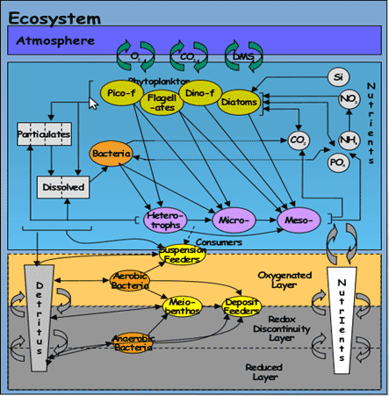
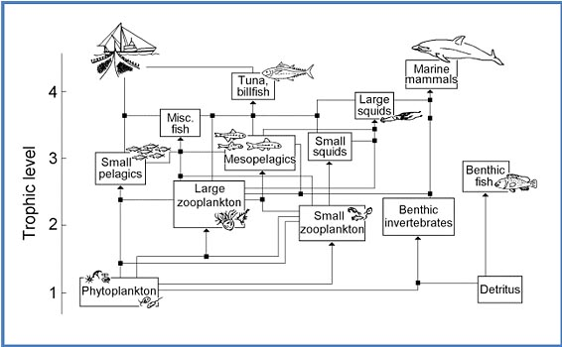
Suggestion
Perhaps, this approach could be improved by using quantitative models, for example by coupling state-of-the-art biogeochemical with food-web models (I think that it would be a very nice project!)
+

Slide 10
Key issues 2) Assessment
In fact, assessment is not addressed in Hayes et. al.
Assessment is not «time series analysis»: we need integrative assessment methodologies in order to inform decision makers.
Such methologies should be identified and tested!

Slide 11
EVs validation and use
To what extent these EVs (if any) are validated and used
As far as I know, proposed marine EV have not been validated as yet
Are the EVs linked to applications and users?
There is a strong need and a huge potential for applying Marine EVs in the implementation of the EU MSFD and of the UNEP-MAP Ecosystem Approach (EcAp): in these frameworks monitoring is mandatory.
Who the users are?
In this case, users would be national environmental agencies to which the monitoring is entrusted in the EU and MED countries
Are the EVs linked to an international body (i.e. a UN convention or similar) and is this body involved in accepting the EVs?
We need to link up with the EC and UNEP-MAP, in order to be have our say in the process of making operational the MSFD and EcAp indicators: in my view, this is a unique opportunity to obtain, in the future, time series which could improve out understanding of marine ecosystem dynamics and provide better governance.

Slide 12
Describing the monitoring networks currently operational
Do you have a database with information on the EVs?
Do you know network currently operational for medium-term/long-term monitoring?
Are the current operational networks operated by your community measuring the EVs?

Slide 13
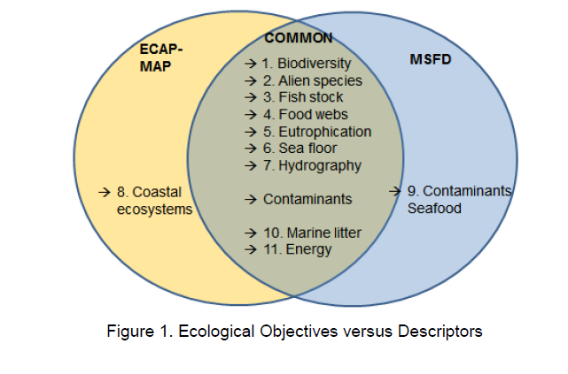
Sustained monitoring of the Mediterranean Sea up to the EEZ is mandatory for EU countries (MSFD) and contracting parties of the Barcelona Convention (UNEP-MAP EcAp)

Slide 14
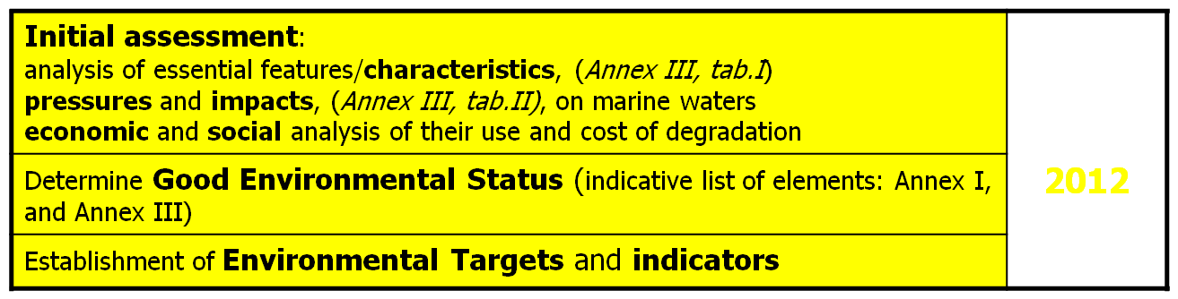

Steps for the development of National marine strategies within MSFD
2020
To achieve or maintain Good Environmental Status in the marine environment
Adaptive management , with regular review (every 6 years)

Slide 15
Steps towards the implementation of UNEP-MAP EcAp
1. Definition of an Ecological Vision for the Mediterranean
2. Setting of common Mediterranean strategic goals
3. Identification of important ecosystem properties and assessment of ecological status and pressures
4. Development of a set of Ecological Objectives (EOs)
5. Derivation of operational objectives with indicators and target levels
6. Revision of existing monitoring programmes for ongoing assessment and regular updating of targets
7. Development and review of relevant action plans and programmes

Slide 16











MEDINA: an attempt to use remotely sensed and simulated EVs as input for assessing EcAp Ecological Objectives
www.medinaproject.eu.
www.medinageoportal.eu

Slide 17
Regional assessment and contribution to the implementation of the UNEP-MAP Ecosystem Approach (EcAp)
We tried to provide methodologies for assessing the Good Environmental Status (GEnS) in relation to three « Ecological Objectives »:
EO1 Biodiversity
EO5 Eutrophication*;
EO8 Coastal Hydrography.
*Garmendia, M., Borja, Á., Breton, F., Butenschön, M., Marín, A., Miller, P.I., Morisseau, F. & Xu, W. (2015) Challenges and difficulties in assessing the environmental status under the requirements of the Ecosystem Approach in North African countries, illustrated by eutrophication assessment. Environmental Monitoring and Assessment, 187(5), 1-22. doi: 10.1007/s10661-015-4316-x

Slide 18
Ecological Objective (EO) | Operational Objectives (OO) | Indicators
Human-induced eutrophication | 5.1 Nutrients | 5.1.1 Concentration of key nutrients in the water column
 |  | 5.1.2 Nutrient ratios (silica. nitrogen and phosphorus), where appropriate
 | 5.2 Direct effects | 5.2.1 Chlorophyll-a concentration in the water column
 |  | 5.2.2 Water transparency where relevant
 |  | 5.2.3 Number and location of major events of nuisance/toxic algal blooms
 | 5.3Indirect effects | 5.3.1 Dissolved oxygen near the bottom
5.1.1, 5.2.1, 5.2.3, 5.3.1 are indicated as candidate Marine EVs, on the basis of a comprehensive literature review (Hayes et al., 2015)
Red – estimate from a biogeochemical model
Green – estimated from satellite data

Slide 19
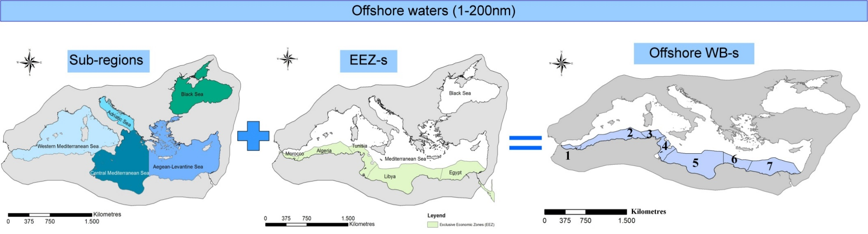
Identification of assessment units

Slide 20
From marine EVs to indicators
Yearly average concentrations of nitrate, silicate, ammonia and phosphate at the surface (first layer of the 3D biogeochemical model);
90th percentile of Chl-a concentration estimated from monthly satellite data over a period of 6 years.
Yearly average diffuse attenuation coefficient Kd490
Yearly average concentration of Dissolved Oxygen at the bottom layer

Slide 21
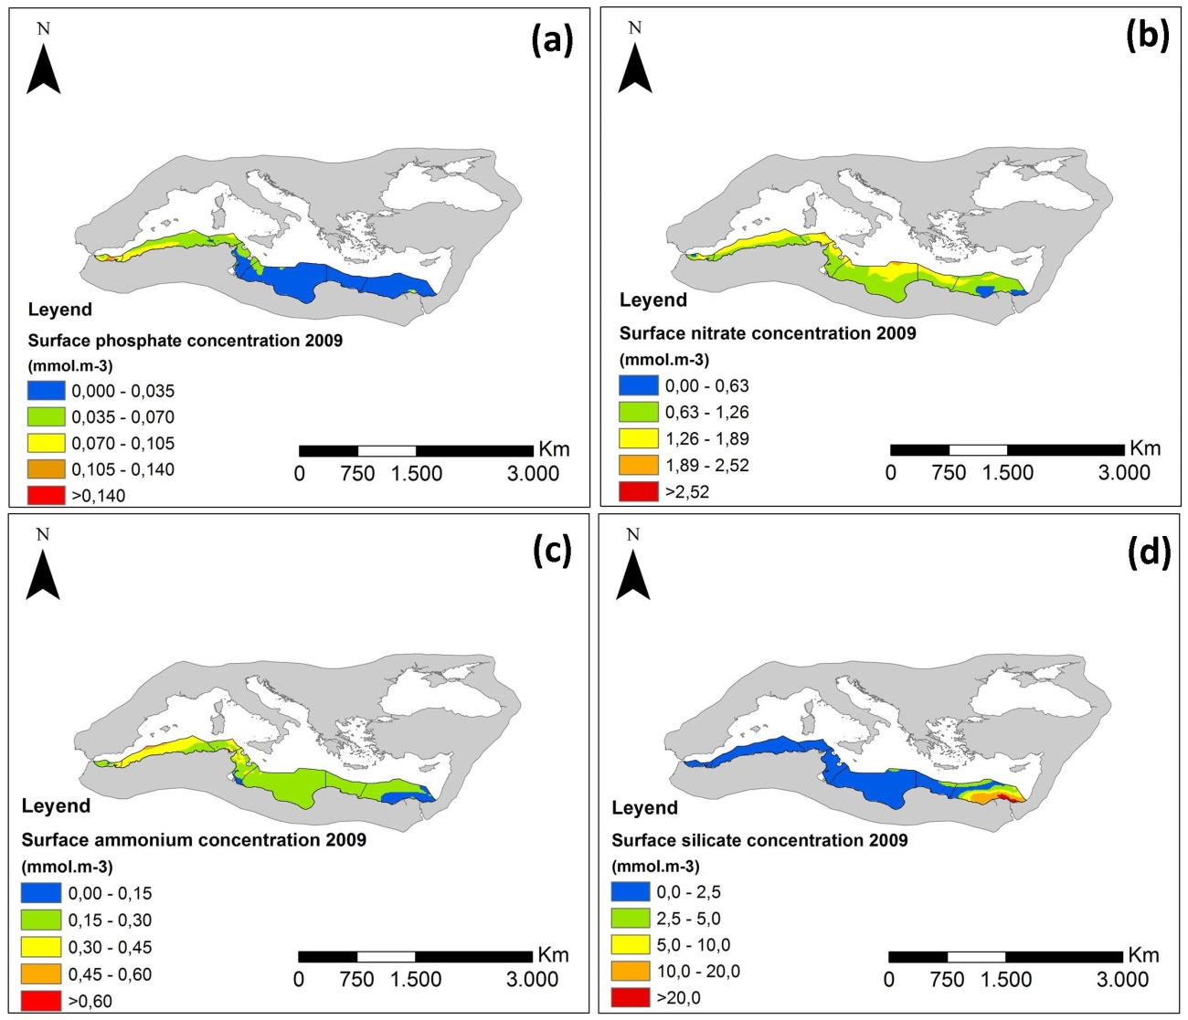

Slide 22
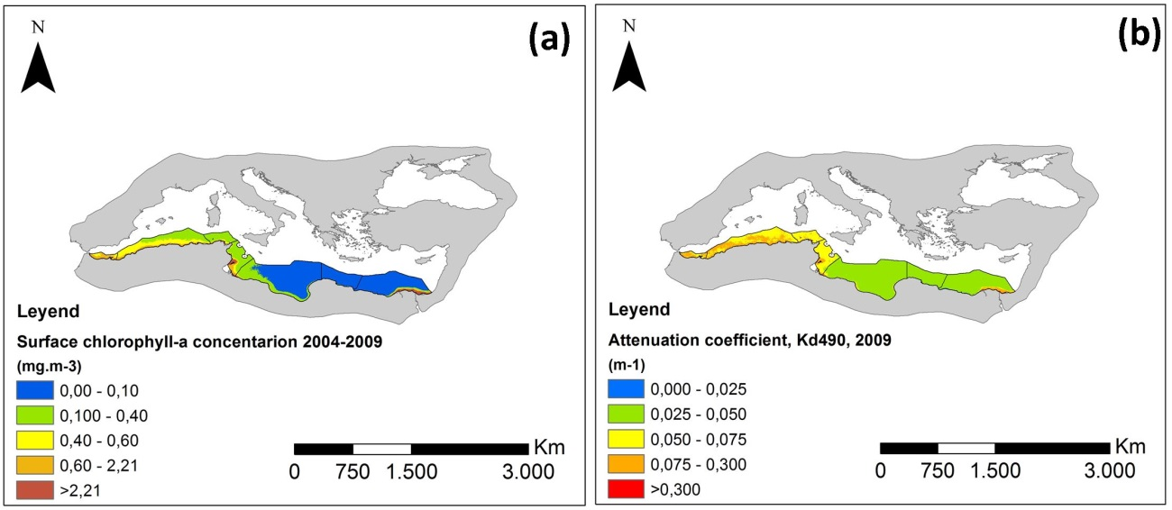
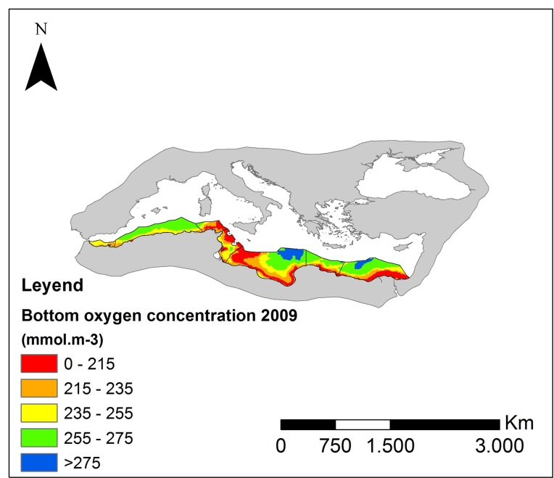

Slide 23
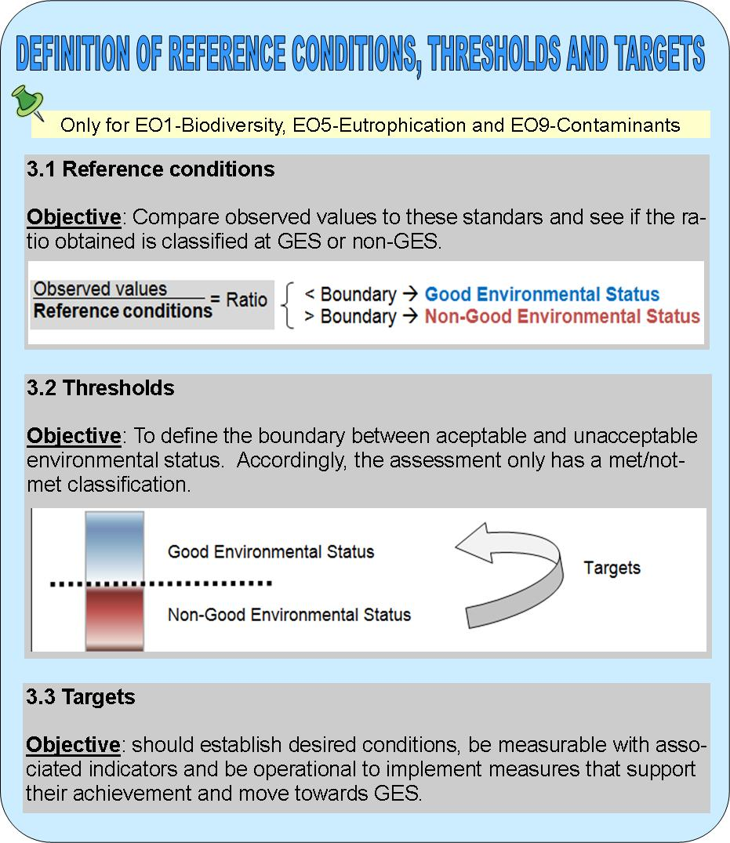
From the set of indicators to the assessment

Slide 24
Setting the reference conditions
Indicator | Western Med. (OWB1-OWB3) | Eastern Med. (OWB4-OWB7)
Phosphate conc. (mmol.m⁻³) | 0.06 | 0.02
Nitrate conc. (mmol.m⁻³) | 1.0 | 1.0
Ammonia conc. (mmol.m⁻³) | 0.3 | 0.2
Silicate conc. (mmol.m⁻³) | 1.6 | 1.6
Chlorophyll-a conc. (mg.m⁻³) | 0.45 | 0.08
Attenuation coefficient (m⁻¹) | 0.045 | 0.030
Oxygen conc. (mmol.m⁻³) | 300 | 280

Slide 25
Setting the thresholds
Nutrient concentrations, Chlorophyll a and Kd490 show a positive response to Pressure (i.e. increase in antropogenic nutrient loads: + 50% deviation from the Reference Condition.
This means that deviations within 50% can be tolerated: the ES is still GOOD
Dissolved Oxygen show a negative response to Pressure (anoxia): we set a threshold of -25%.

Slide 26
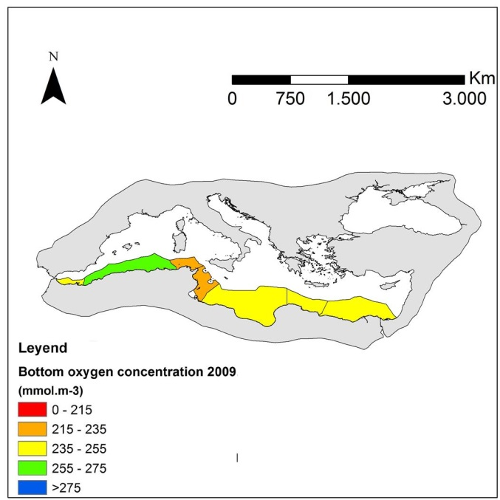
Estimating the indicators for each assessment unit
Average

Slide 27
Assessing the GEnS for each indicator
The class boundary is given by:
CB = (1+Threshold) x Reference condition
For indicators with positive response to Press.:
Average values in WB < CB means GEnS
For indicator with negative response:
Average values in WB > CB means GEnS

Slide 28
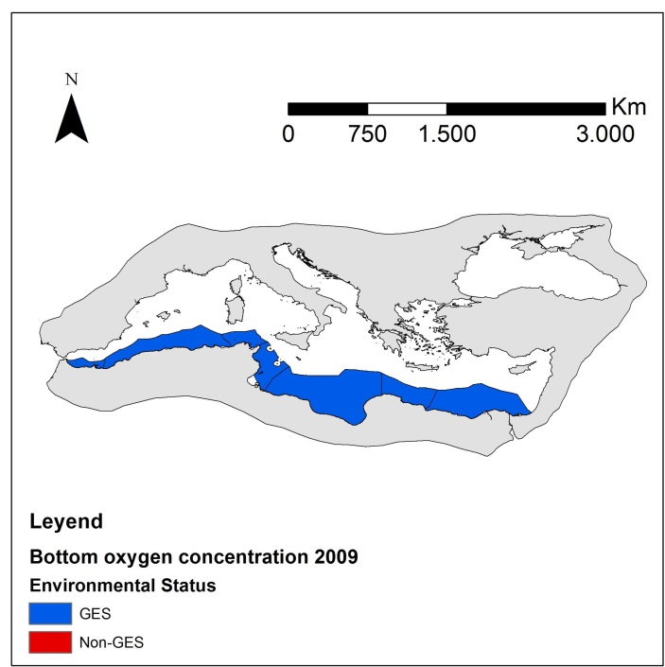
Assessing the GEnS for each indicator

Slide 29
Aggregating the indicators at OO and EO levels
We used dimensionless Ecological Quality Ratio, EQR:
For indicators with positive response to Press.:
For indicators with negative response to Press.:

Slide 30
Aggregating the indicators at OO and EO levels
Class boundaries are easily linked to EQR.
For indicators with positive response:
CB_{EQR} = 1/(1+Threshold) Threshold = 0.5
For indicators with negative response:
CB_{EQR} = 1+Threshold Threshold = -0.25
EQRs were averaged for each OO and for the EO

Slide 31
Aggregating the indicators at OO and EO levels
OWB | OO5.1 | OO5.2 | OO5.3 | EO5
OWB 1 | 0.93 (GES) | 0.6 (Non-GES) | 0.79 (GES) | 0.77 (GES)
OWB 2 | 0.86 (GES) | 0.8 (GES) | 0.86 (GES) | 0.84 (GES)
OWB 3 | 0.94 (GES) | 0.98 (GES) | 0.75 (GES) | 0.89 (GES)
OWB 4 | 0.85 (GES) | 0.23 (Non-GES) | 0.81 (GES) | 0.63 (Non-GES)
OWB 5 | 0.86 (GES) | 0.72 (GES) | 0.86 (GES) | 0.81 (GES)
OWB 6 | 0.80 (GES) | 1.01 (GES) | 0.89 (GES) | 0.9 (GES)
OWB 7 | 0.82 (GES) | 0.44 (Non-GES) | 0.88 (GES) | 0.71 (GES)

Slide 32
Conclusions
Recommendations for GEO/GEOSS:
Actively engage with national and regional institution which has the mandate to implement monitoring plans for marine ecosystems
Future work
Improve our understanding of marine ecosystem functioning;
Develop and test integrative assessment methodologies, based on identified EV

