Slide 1



Coordinating an Observation Network of Networks EnCompassing saTellite and IN-situ to fill the Gaps in European Observations
Essential Variables in ConnectinGEO and
GEO Societal Benefit Areas
Hans-Peter Plag
Tiwah UG, Germany
Comments on EV Discussion
EVs in ConnectinGEO: WPs and Deliverables
EVs in ConnectinGEO: The Methodology
Final Thoughts
EV Workshop, June 11-12, 2015, Bari, Italy

Slide 2
Comments on EV Discussion
Why do we want to know EVs?
to make sure we know what to measure: prioritizing
to make sure we measure what is needed: gap analysis
Efforts to determine EVs are not new:
Integrated Global Observing Strategy (IGOS) had the goal to ensure comprehensive monitoring of what is essential,
IGOS-Partnership (IGOSP) Themes had the main goal to determine the variables that need to be monitored to address a societally relevant issue.
EV Workshop, June 11-12, 2015, Bari, Italy

Slide 3
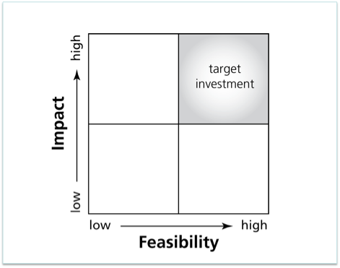

Comments on EV Discussion
Most (GEO) approaches to EVs are expert and feasibility based
Societal goals may not be captured.
Societal goals may be in the high impact, low feasibility box.
Gap analysis should identify more than missing observations …
…to Impacts
?
From Feasibility …
Gunn et al., 2015
EV Workshop, June 11-12, 2015, Bari, Italy

Slide 4
Comments on EV Discussion
Most (GEO) approaches to EVs are expert and feasibility based
ConnectinGEO wants to add a goal-based approach starting from the societal goals
EV Workshop, June 11-12, 2015, Bari, Italy

Slide 5
Comments on EV Discussion
What do we mean when we say “essential”?
adjective
1. absolutely necessary; indispensable:
2. pertaining to or constituting the essence of a thing.
3. noting or containing an essence of a plant, drug, etc.
4. being such by its very nature or in the highest sense; natural; spontaneous: (essential happiness).
5. Mathematics.
a …
b …
My preferred meanings:
“indispensable for reaching the goals” and
“pertaining to something needed to reach/supporting reach progress towards the goals”
EV Workshop, June 11-12, 2015, Bari, Italy

Slide 6
Comments on EV Discussion
How do we define an “essential variable”?
Essential Variables:
Variables that determine the system’s state and developments, are crucial for predicting system developments, and allow us to define metrics that measure the trajectory of the system.
Limited knowledge of essential variables implies limited predictive capabilities and limited means to measure where the system is heading.
EV Workshop, June 11-12, 2015, Bari, Italy

Slide 7
Comments on EV Discussion
What does “…” stand for in “The variable is essential for …”
What are the goals?
scientific disciplines: create new knowledge; monitor the environment, assess state and trends, predict;
societal disciplines: enable sustainable development
GEO: Societal Benefit Areas; Strategic Targets
Ministers to GEO: Sustainable Development Goals (SDGs)
What are the goals, targets, and indicators?
Some examples …
EV Workshop, June 11-12, 2015, Bari, Italy

Slide 8
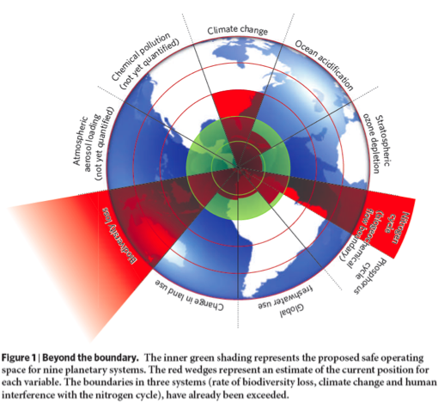
Comments on EV Discussion
What goals to be considered?
For example, “Safe operating space for humanity;”
Rockström et al. (2009)
Potential Indicators:
Planetary boundary indicators
GEOSS the planetary cockpit ...
EV Workshop, June 11-12, 2015, Bari, Italy

Slide 9
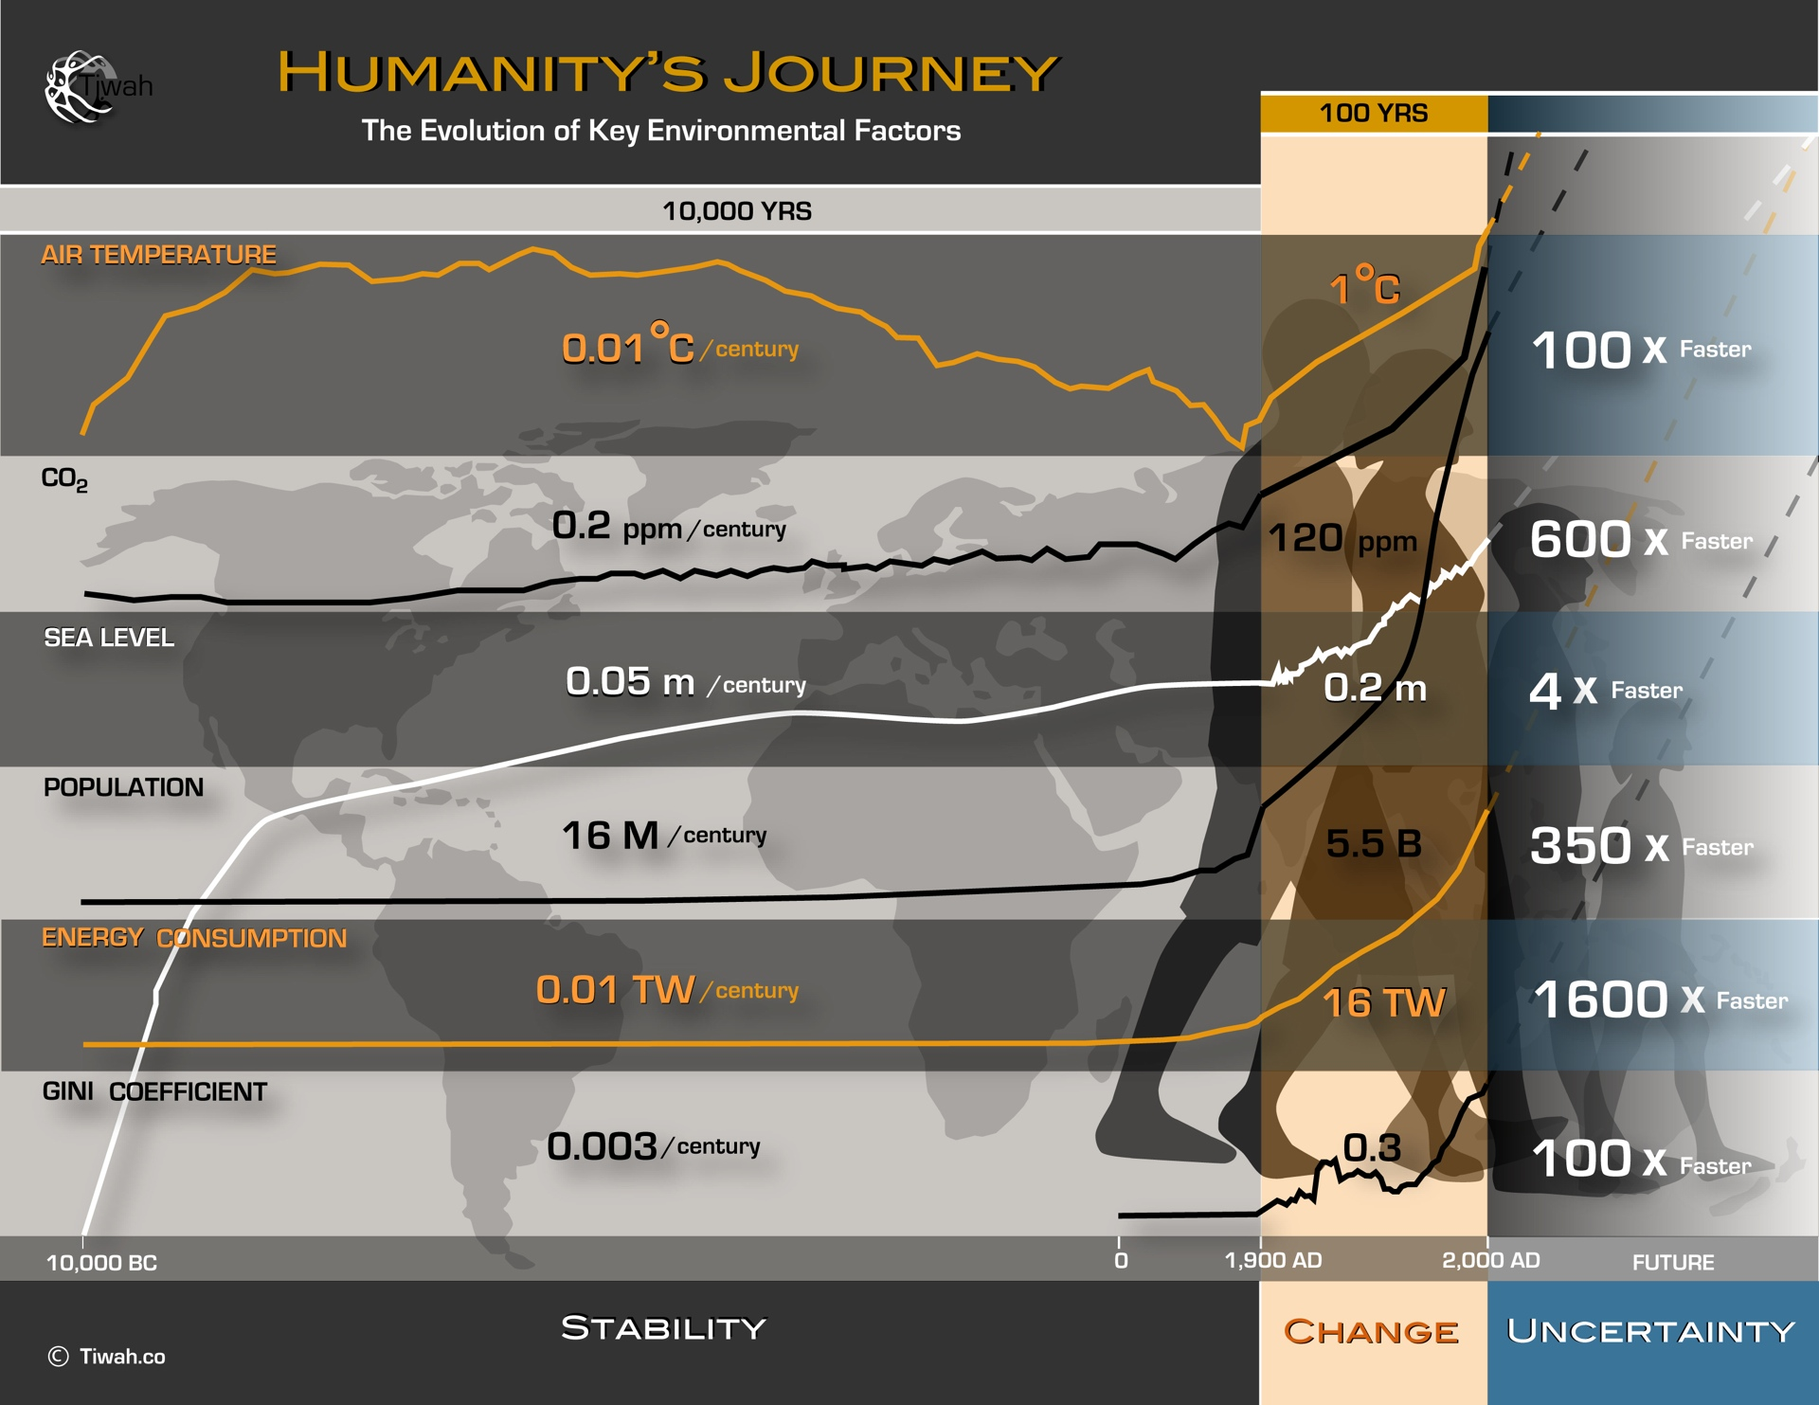
Comments on EV Discussion
What goals to be considered?
For example, Documenting “global change”
Potential Indicators:
Change indicators
GEOSS the “archive” for the future ...
EV Workshop, June 11-12, 2015, Bari, Italy

Slide 10

Comments on EV Discussion
What goals to be considered?
For example, “safeguarding Earth’s life-support system;”
based on Griggs et al. (2013): sustainable development is a “Development that meets the needs of the present while safeguarding Earth’s life-support system, on which the welfare of current and future generations depends.”
Potential Indicators:
Planetary health indicators
GEOSS the “lab” for patient Earth ...
From http://www.economy4humanity.org
EV Workshop, June 11-12, 2015, Bari, Italy

Slide 11
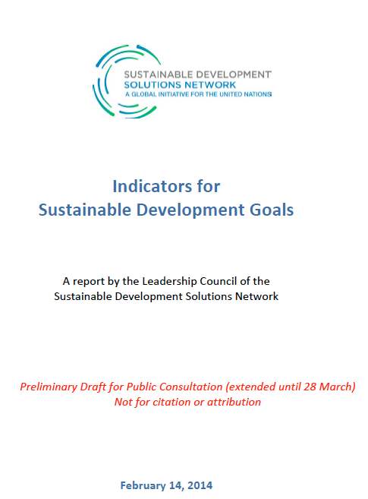
Comments on EV Discussion
What goals to be considered?
For example, following the Ministerial Guidance and supporting the Sustainable Development Goals
Potential Indicators:
SDG Indicators
GEOSS the reporting card for SDGs
EV Workshop, June 11-12, 2015, Bari, Italy

Slide 12
WPs and Deliverables
Work Package 2: Strategic Goals, Metrics, and Indicators
Three Tasks:
Task 2.1: Strategic Goals:
D2.1: Report on Goals, Targets, Indicators
MS5: WS1 has taken place, Report available: 3rd GSTSS Workshop, Norfolk, 2015
Task 2.2: Essential Variables
D2.2: Report EVs: Current status in different communities and way to move forward
MS8: Workshop has taken place, Report available: Taking place now
Task 2.3: Observation Specifications and Requirements
D2.3: Proposal for EVs (including process to specify observational requirements)
MS11: EVs defined
EV Workshop, June 11-12, 2015, Bari, Italy

Slide 13
WPs and Deliverables
Work Package 6: Gap Analysis and Priorities
Three Tasks:
Task 6.1: Definition of the Gap Analysis Methodology
D6.1: ConnectinGEO Methodology
MS6: Methodology defined
Task 6.2: Gap Analysis
D6.2: Gap Analysis Draft
Task 6.3: Priorities Determination
D6.3: Gap Analysis Final
EV Workshop, June 11-12, 2015, Bari, Italy

Slide 14
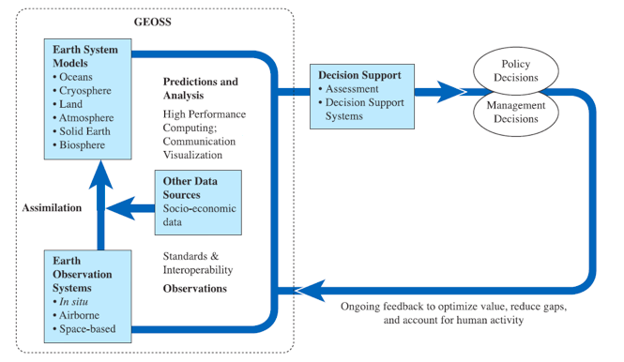


Information Needs
Defining models and tools based on information needs
Defining observations based on information needs
Stakeholder Driven GEOSS
GEO, 2005. 10-YIP Reference Document.

Slide 15
Goals
Knowledge about
Applications, Activities, Tools, ...
Defining observations
needed
Targets
- rules
- models
Knowledge about Users,
Benefits,
Indicators
- human interactions
(e.g., surveys, experts)
GEO’s Contribution
Essential Variables
(URR)
Inference Engine
SEE IN Knowledge Base
Observational Requirements
Societal Process
Societal Process with science support
3rd GEOSS S&T Stakeholder Workshop
Socio-Economic and Environmental Information Needs
Knowledge Base

Slide 16
General Blue Print for goal-based approach:
For each set of goals, we can agree on targets
For targets, we can develop a metrics based on indicators
For indicators, we can identify “essential variables” needed to quantify the indicators
For EVs, specify requirements meeting the needs of applications

Slide 17
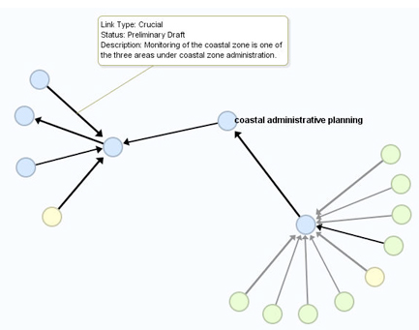
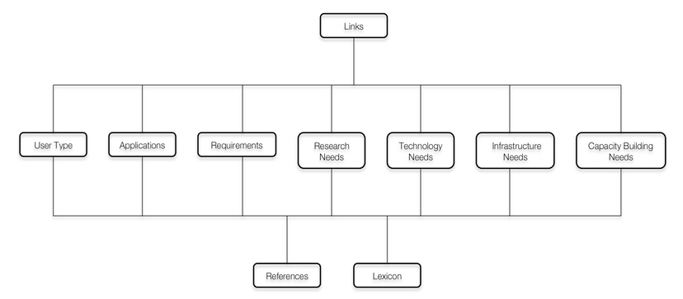
Methodology
Observation Specifications and Requirements:
Three core questions (used in the URR):
Who are the users?
What are they doing?
What do they need to do what they are doing?
EV Workshop, June 11-12, 2015, Bari, Italy

Slide 18
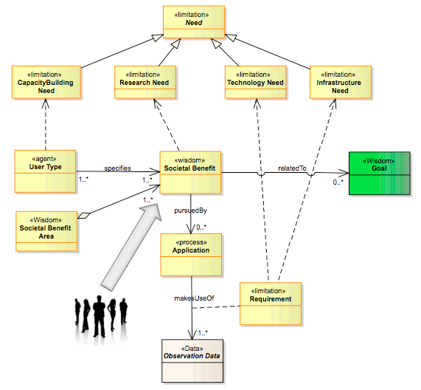
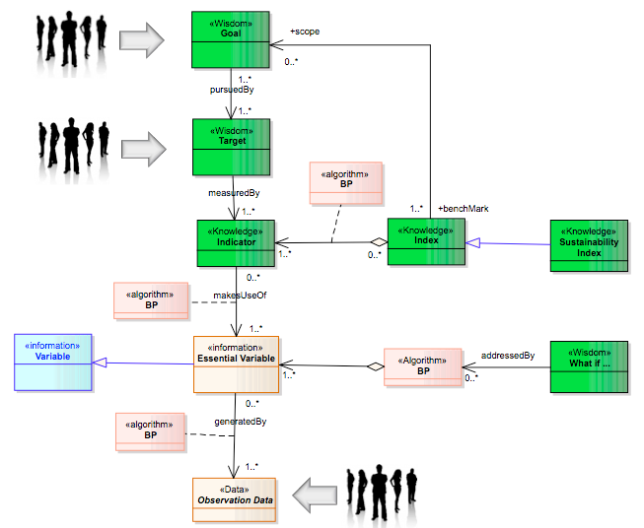
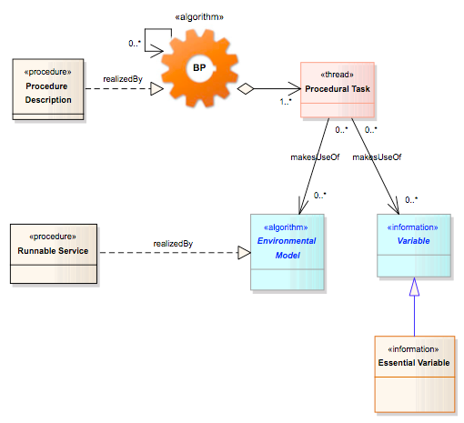
Methodology
Goals, Metrics and Essential Variables:
Implementation in SEE IN KB
Essential Variables:
Linked to metrics
Basis for management
Populate report cards
Increase predictive capabilities
Observation specifications need to be derived from these usages of EVs
EV Workshop, June 11-12, 2015, Bari, Italy

Slide 19
Methodology
Gap Analysis: Types of Gaps for ConnectinGEO:
GEO Science and Technology Committee (2011):
Geographic: Observation systems or data set has good coverage in one geographic region or country but not in others
Observational: Observation technologies or systems are not available or have not been sufficiently developed for key analytes or issues of global importance.
Structural: Structural gaps are internal to GEOSS eg. Missing tasks required to meet our targets. Tasks or products not meeting expectations from other components of GEOSS (this may be common when analysis is done across SBAs).
Qualitative/quantitative: Product exists but at insufficient timeliness, frequency or quality for use in key products or utility for other GEOSS components
Capacity: Products are available but there is insufficient technical capacity or capability to make use of such products.
EV Workshop, June 11-12, 2015, Bari, Italy

Slide 20
Methodology
Gap Analysis: Types of Gaps for ConnectinGEO:
Information and Knowledge (IK) Gap:
An information missing that is needed to make an informed decision
Capability/Technology/Tool (CTT) Gap:
An capability/technology/tool missing that is required to provide information required to achieve agreed upon societal goals.
Observation (O) Gap:
An observation (with required specifications) of an (essential) variable missing that is required to by an indicator in a relevant metric or an application generating the information needed by a user.
EV Workshop, June 11-12, 2015, Bari, Italy

Slide 21
Methodology
Gap Analysis Methodology:
Compare what is available to what is needed
Take an “layered” approach”: IK Gaps -> CTT Gaps -> O Gaps
Details being worked out
EV Workshop, June 11-12, 2015, Bari, Italy

Slide 22
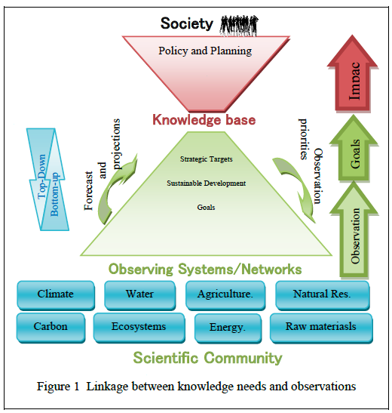
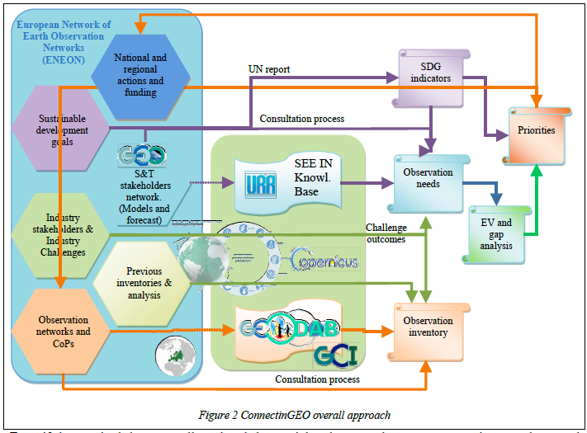
Methodology
Gap Analysis depends on:
We need IK, CTT, O needs and availability
Populated SEE IN KB accordingly
IK Gaps
Comparison algorithm needs careful consideration
CTT Gaps
IK needs and availability
CTT needs?
O availability
O Gaps
Gap analysis
Kick-Off Meeting, February 18, 2015, Barcelona, Spain

Slide 23
Methodology
Priorities Determination depends on:
Value system (economic, social, environmental benefits; progress towards goals; ...)
Algorithm development;
Populated SEE IN KB
For URR, we used a weighted number of links to assess priorities
Is a starting point for SEE IN KB;
Needs to be improved
EV Workshop, June 11-12, 2015, Bari, Italy

Slide 24
Methodology
Methodology
EV Workshop, June 11-12, 2015, Bari, Italy

Slide 25
Final Thoughts
Documenting EVs:
What does “essential” mean?
How is “essential variable” defined?
For what are the EVs essential?
How can the EVs be identified (blue print) and validated?
Principles:
List of EVs can change over time
EVs must originate in relevant communities
EVs must be validated as being essential in a well-defined framework
EV Workshop, June 11-12, 2015, Bari, Italy

