Slide 1

GEO into the Next Decade – Regional Implementation and a New Work Programme
ConnectinGEO -- European Network of Earth Observation Networks (ENEON)
Paris, France
21 September 2015
Barbara J. Ryan
Director, GEO Secretariat

Slide 2
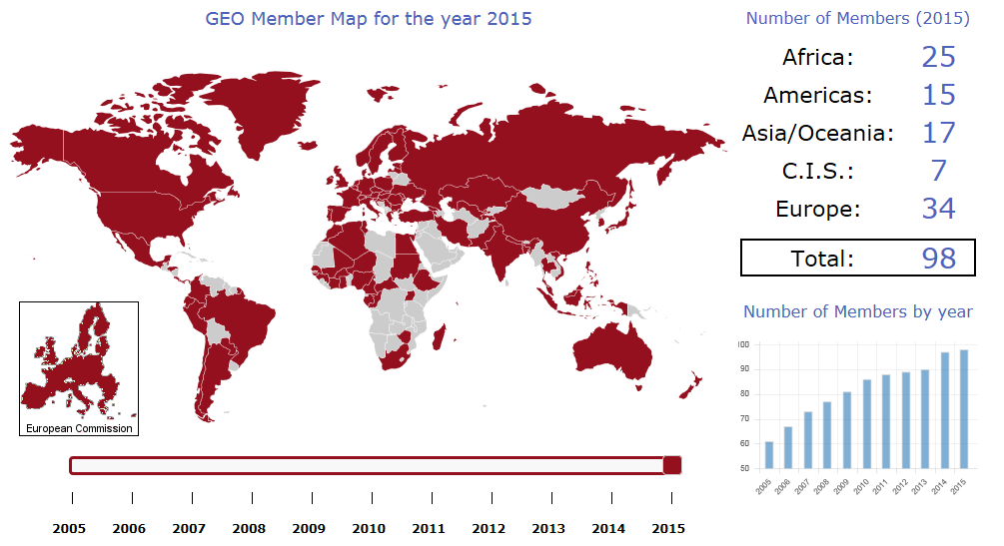
GEO Member States
Notes:
GEO is a global partnership of governments and organizations that seeks to realize its Vision of “a future wherein decisions and actions for the benefit of humankind are informed by coordinated, comprehensive and sustained Earth observations.” In support of this Vision, through collective voluntary action, the GEO community is implementing a Global Earth Observation System of Systems (GEOSS) from among a great many individual Earth observation, information and processing systems.
The Global Earth Observation System of Systems 10-Year Implementation Plan, GEO, 2005, p. 5.

Slide 3
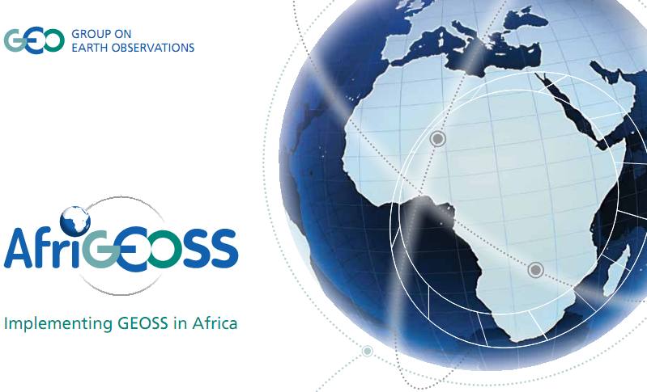
A Continental Approach for Building GEOSS

Slide 4



















































































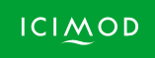




87 Participating Organizations

Slide 5
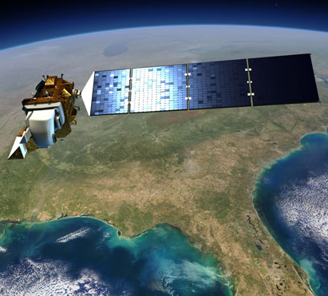
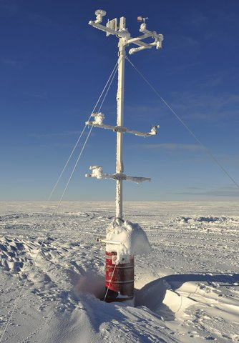
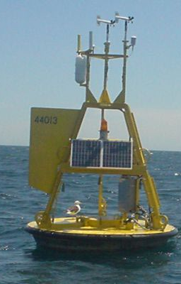
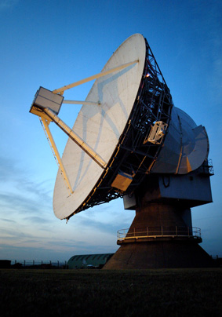
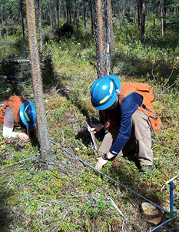
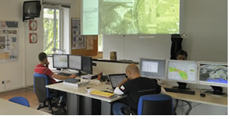
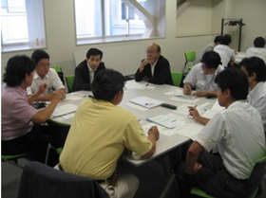
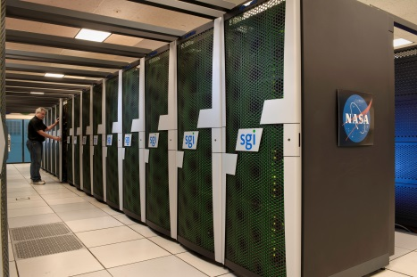
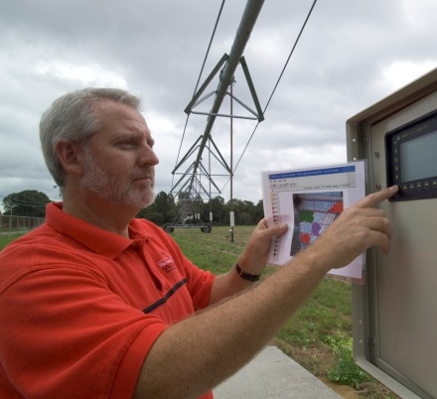
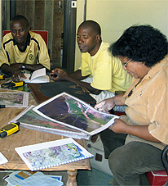
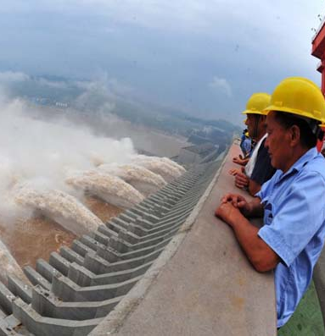
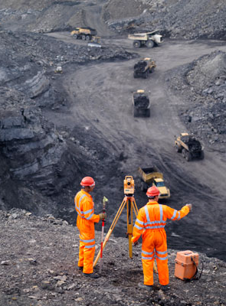
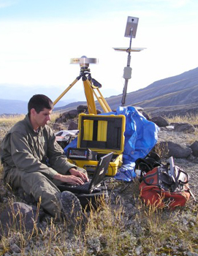
Commercial Sector Spans Information Value Chain
Data
providers
Value-Added providers
Downstream
users

Slide 6
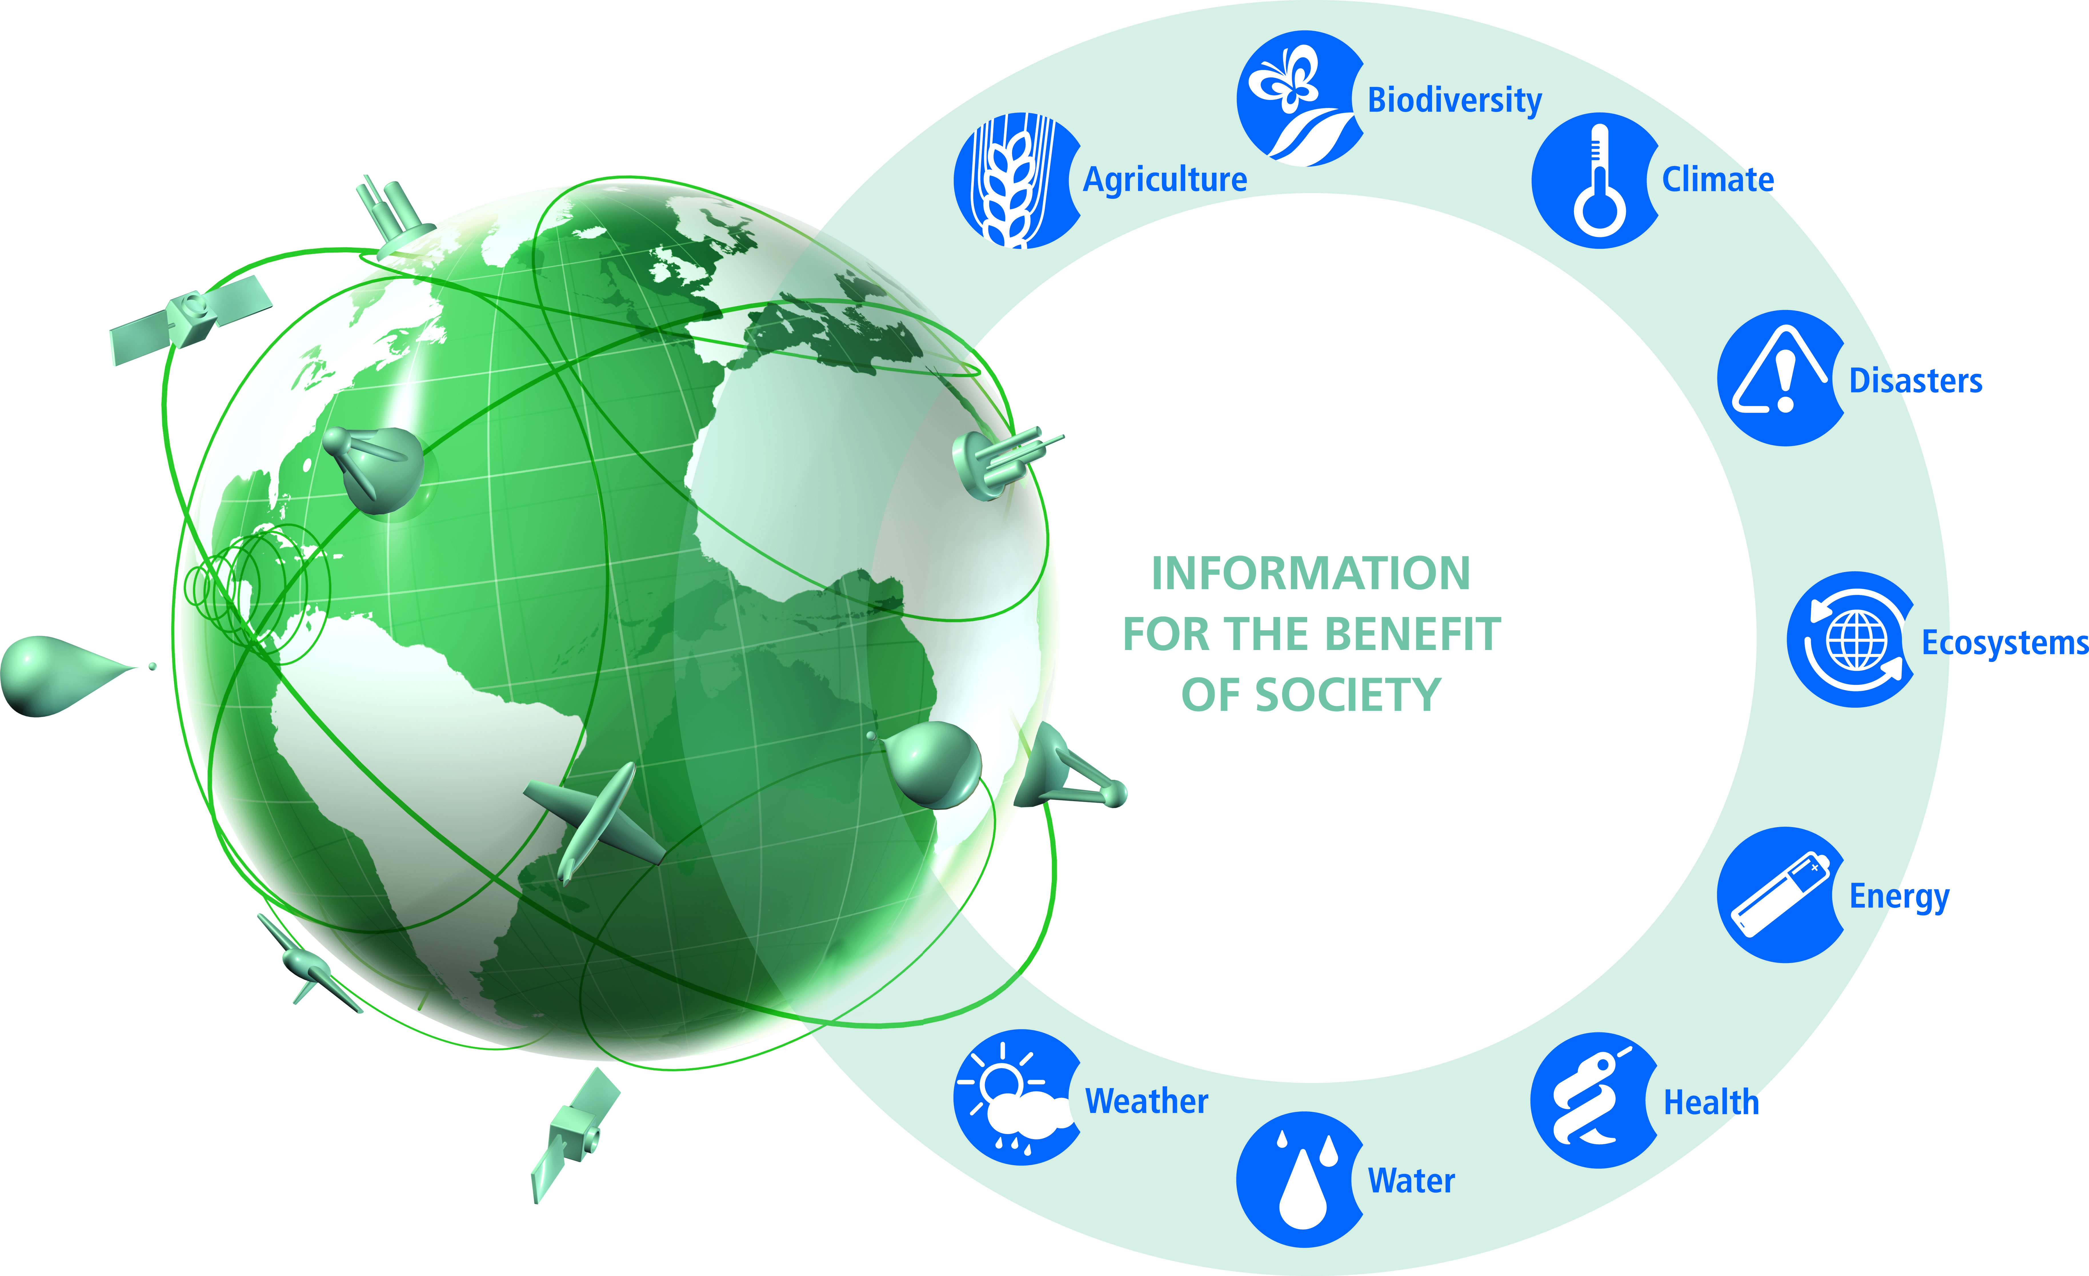
A Global System of Systems

Slide 7

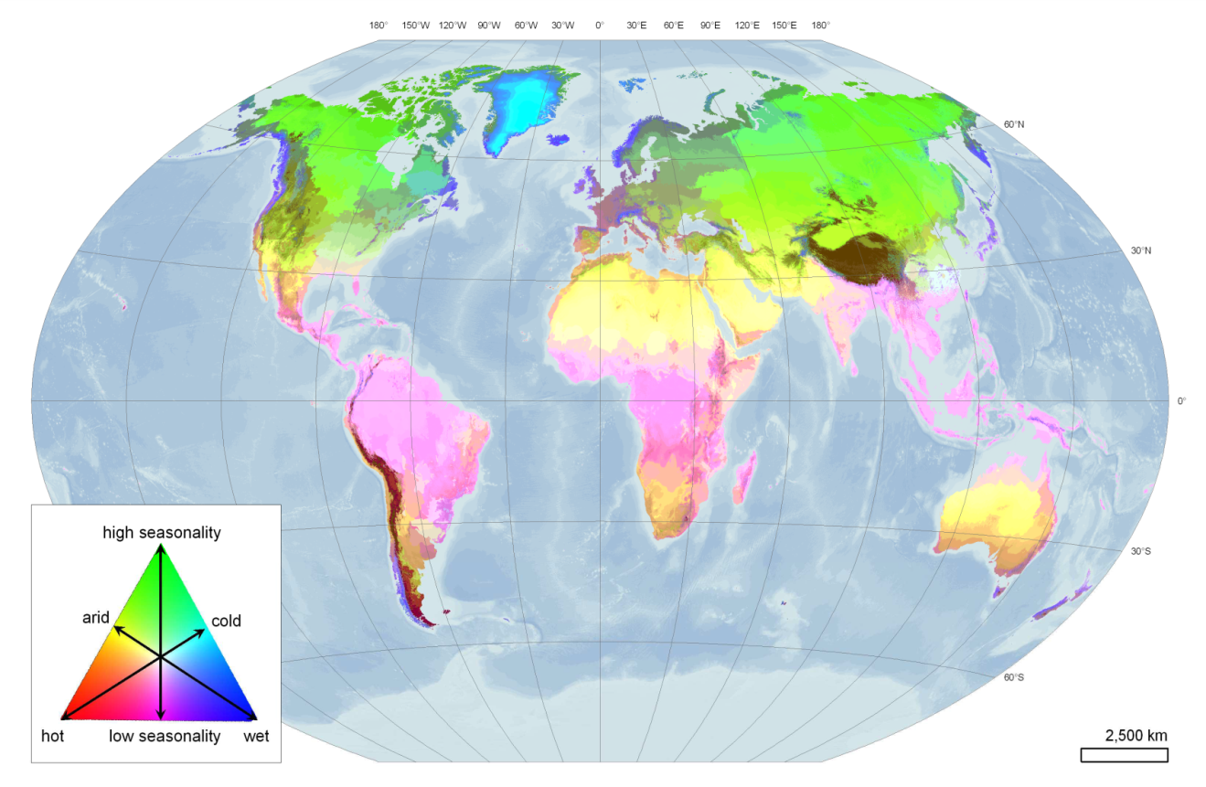

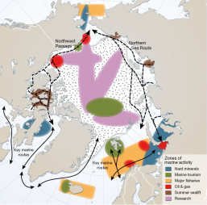
GEO Biodiversity Observation Network
(France, Germany, Japan, Netherlands, Spain, Sweden, South Africa, USA, Diversitas, GBIF, IUCN)
High-resolution bioclimatic map of the world
* Response to CBD
* Essential Biodiversity
Variables (EBVs)
* Global high-res
bio-climatic map
* Arctic and French
Biodiversity Networks
* Strong outreach
Metzger et al.- in review.

Slide 8
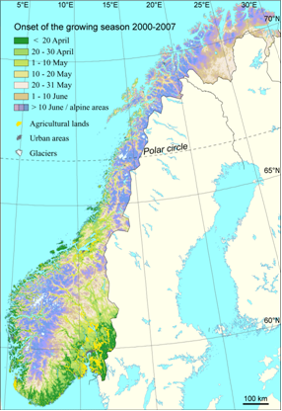
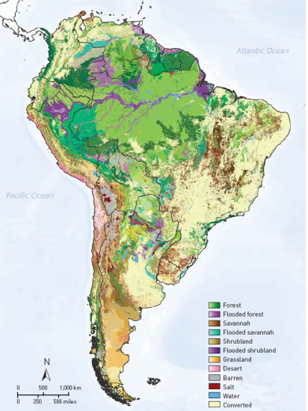

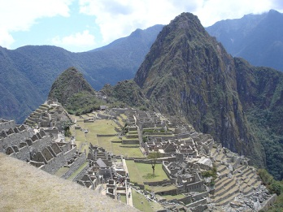
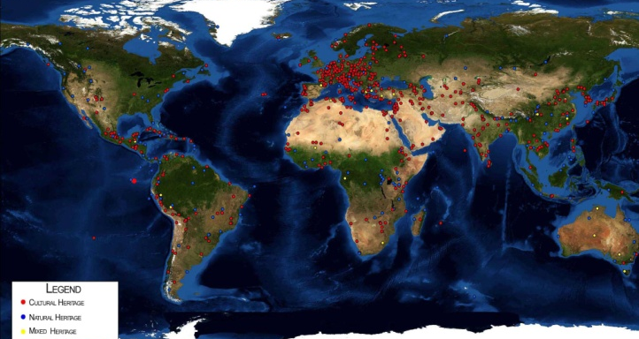




Ecosystem Classification & Mapping
(Australia, Austria, Brazil, Canada, China, EC,
Italy, Paraguay, USA, RCMRD, UNESCO)
* SHARE mountain stations
operational
* All ecosystem mapping
data available; DataCORE
* New maps of growing
season
* Atlas of 40 Chinese
World Heritage Sites
* Decision-making support:
ABCC program

Slide 9
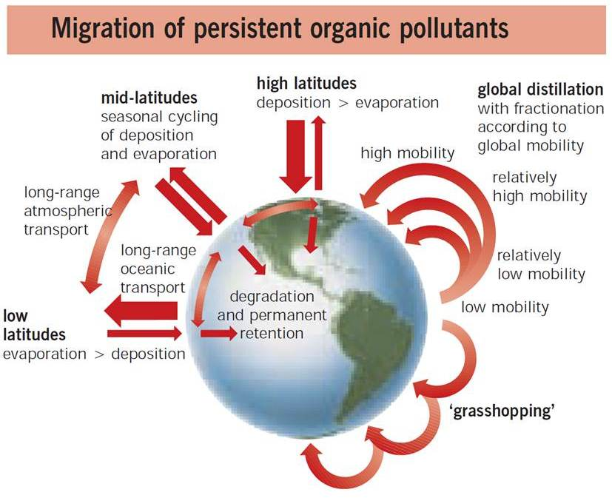
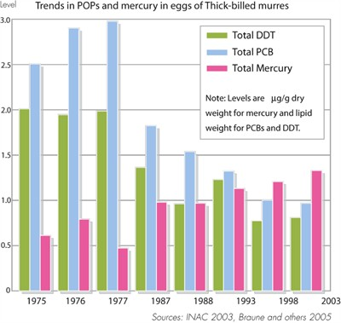

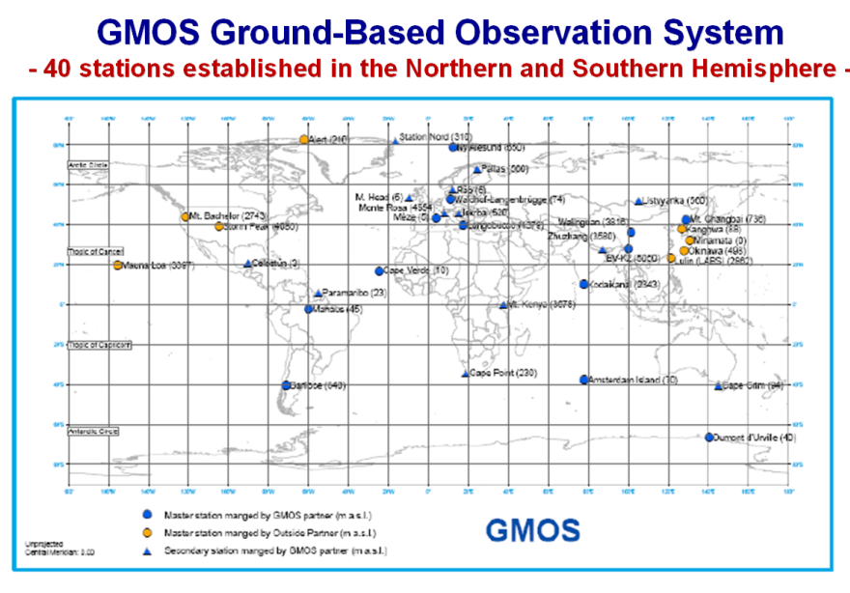
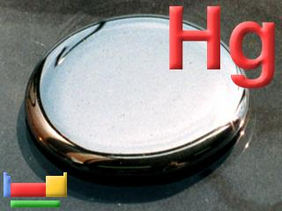
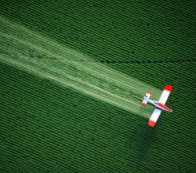

Tracking Pollutants
(Canada, Czech Republic, EC, Germany, Italy,
Japan, South Africa, USA, UNEP)
* Mercury ground-based
observing system
* Campaigns performed over
Mediterranean and Atlantic
* Spatial Data Infrastructure
* Capacity, instrumentation
and system design
* Baseline data for 10 new
Persistent Organic Pollutants
(POPs)

Slide 10
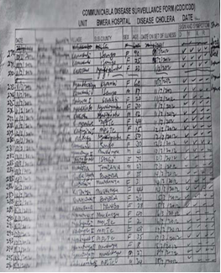
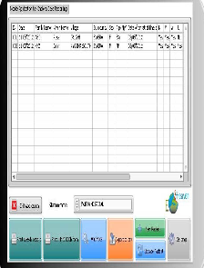
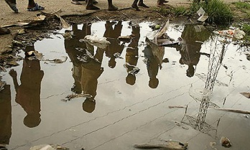
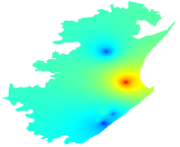
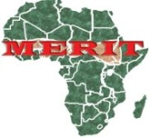
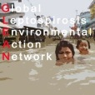
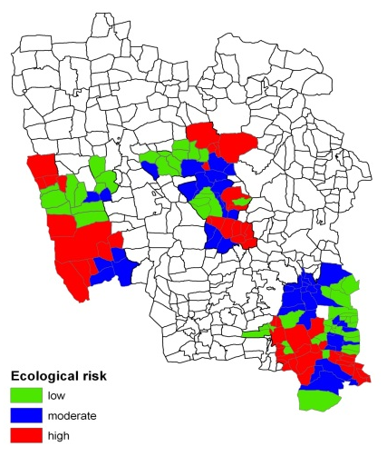
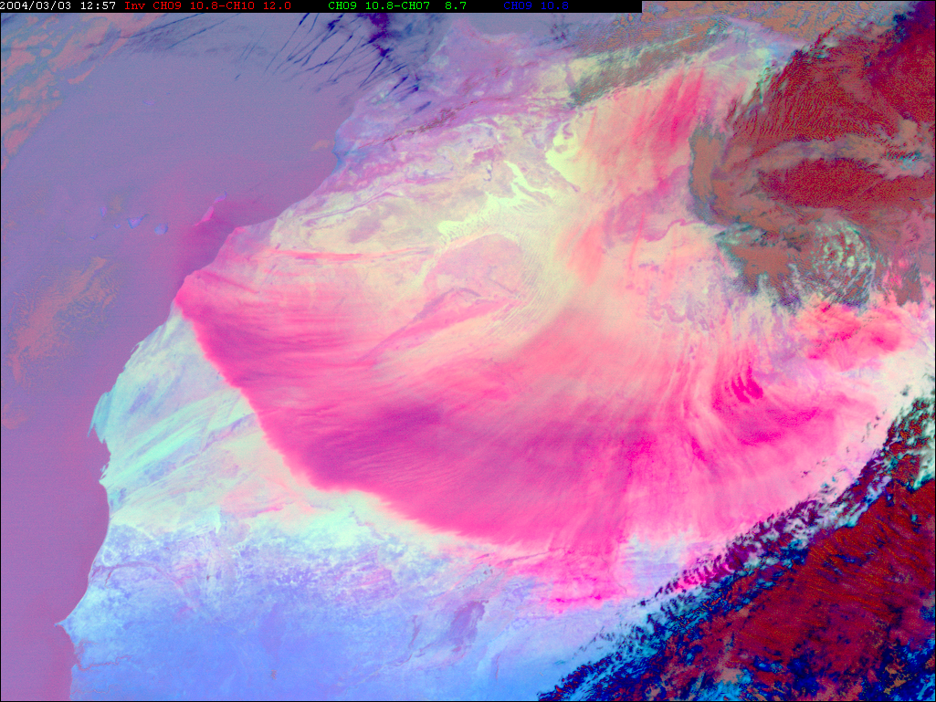


Tools for Health Decision-Making
(Brazil, EC, France, India, Germany, USA,
ACMAD, WHO, WMO)
* Mobile phone App for
cholera-patient tracking
* High-risk zones
* Sand & dust forecasts
* Meningitis predictive model
* Tests in Benin, Togo, Nigeria
* Reactive and preventive
vaccination
Cholera (Uganda)
Malaria (India)
Dust Storm, IR (Sahara)

Slide 11
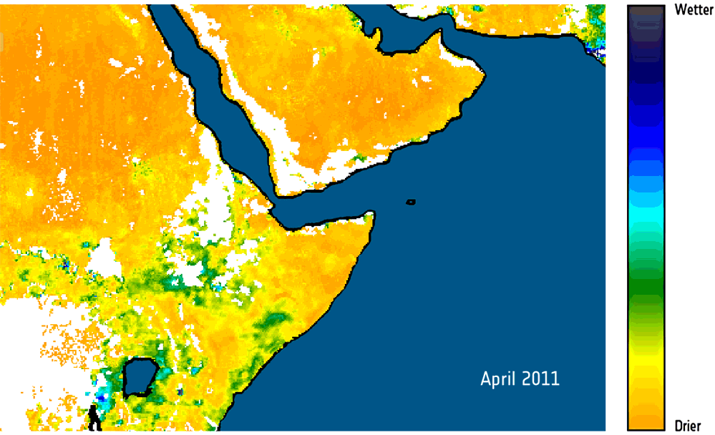
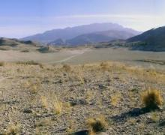
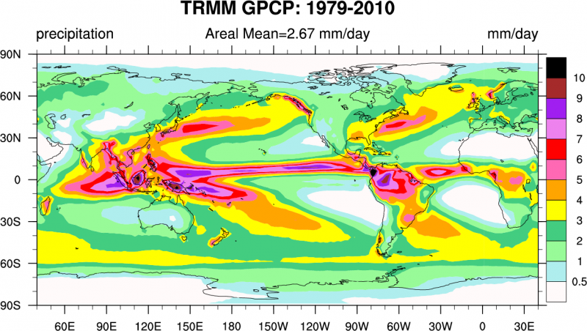
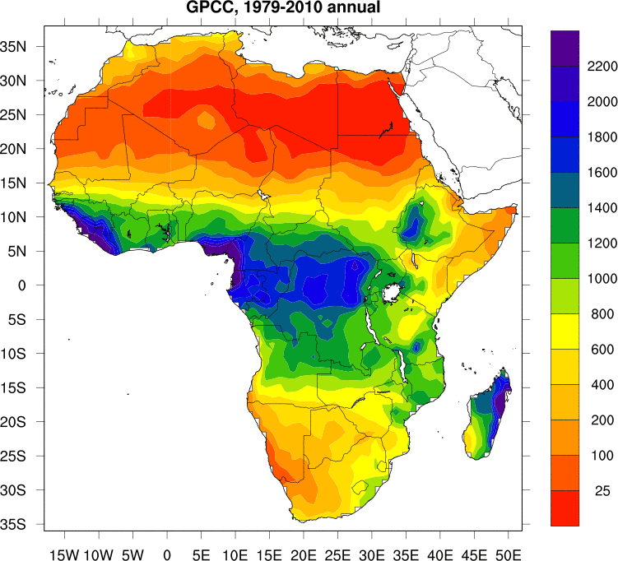
More Water Information
(Austria, EC, Germany, Japan, USA,
CEOS, ESA, WCRP, WMO)
Soil Moisture (SMOS, ESA)
* Global high-res precipitation
datasets 1979-2010
* New SMOS products & soil
moisture datasets 1978-2010
* Satellite data validation
* Global Drought Information
System underway
* Asian/African Water Cycle
Initiative
Precip

Slide 12
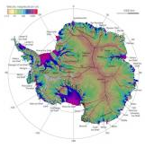
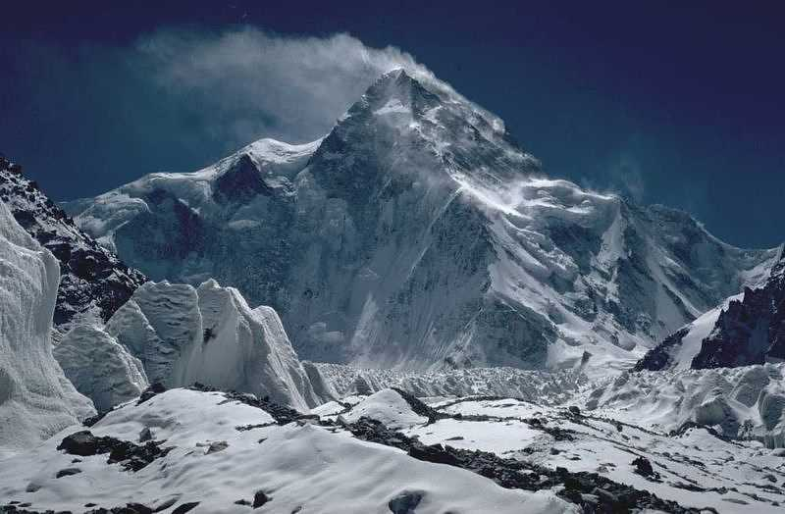
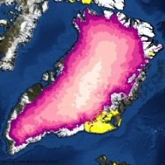
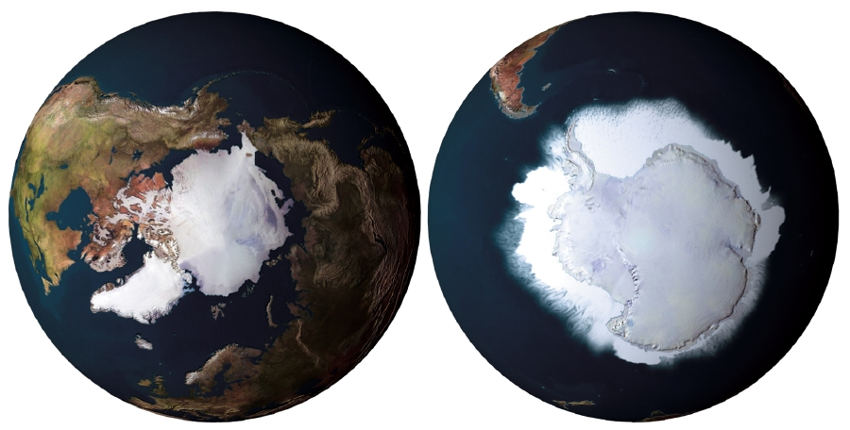







Cold Regions Monitoring
(Canada, China, Denmark, Germany, Norway, India, Italy, Japan, Spain, USA, ICIMOD, IEEE, WCRP, WMO)
* CryoClim climate
monitoring service
* Svalbard Integrated Arctic
Earth Observing System
* Sea-ice ECV for Arctic/
Antarctic snow-cover
* Focus on Tibetan Plateau
* Glacier dynamics mapping

Slide 13

GEOSS Implementation Requires:
Data Sharing Principles
Full and Open Exchange of Data
Data and Products at Minimum Time Delay and at Minimum Cost
Free of Charge or Cost of Reproduction
Notes:
See slide text

Slide 14
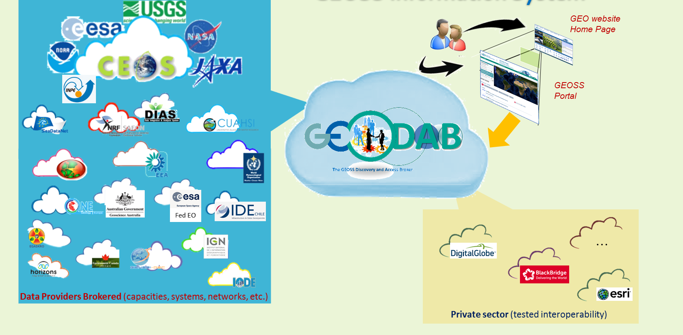
GEOSS Common Infrastructure

Slide 15










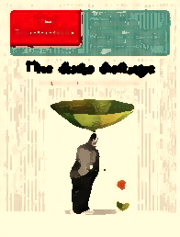
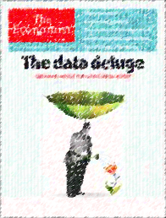
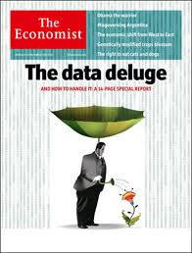
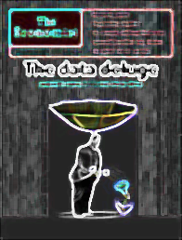
GEOSS Resources
About 45 brokered data providers
.. .
Publish
More than 50 Million accessible resources (mix of data collections
and datasets)
.. .
Contain
.. .
More than 174 Million assets
(mix of satellite scenes, raingage, streamgage records, etc.)
Notes:
It will be important to demonstrate the accuracy of these numbers. We have had difficulty tracking the source of large reported numbers in the past and verifying that they were actually accessible. The phrase “potentially Discoverable” should be defended in the demo.
15

Slide 16
GEO Activities -- Number by Category
Community Activities | 33
GEO Initiatives | 20
Foundational Tasks | 18
TOTAL | 71
All Current Societal Benefit Areas are addressed

Slide 17
GEO Initiatives – Current List
GI-01 | GEOGLAM-Global Agricultural Monitoring and Early Warning
GI-02 | GEOBON-Global Biodiversity Observation (GEO BON)
GI-03 | GFOI Global Forest Observation Initiative
GI-04 | Global Observing System for Mercury and Persistent Pollutants
GI-05 | Global Carbon Observation and Analysis System
GI-06 | Reinforcing engagement at regional level: AfriGEOSS for Africa
GI-07 | Ocean and society - Blue Planet
GI-08 | GEO Geohazard Supersites and Natural Laboratories (GSNL)
GI-09 | Global Wildfire Information System
GI-10 | EO data and renewable energies
GI-11 | Information Services for Cold Regions
GI-12 | Integrated Information Systems for Health (Cholera, Heat waves)
GI-13 | Integration of Methods for Air Quality and Health Data, Remote Sensed and In-Situ with Disease Estimate Techniques (new US)
GI-14 | GECO: the GEO Global Ecosystem Initiative
GI-15 | GEO-GNOME Initiative: GEO Global Network for Observation and information in Mountain Environments
GI-16 | GEO-DARMA = Data Access for Risk Management (new-CEOS)
GI-17a | Global Urban Observation and Information
GI-17b | Global Human Settlement indicators for post-2015 international frameworks
GI-18 | GEO and SDGs. EOs role in providing support to countries in achieving SDGs and in defining and monitoring the associated indicators.
GI-19 | AmeriGEOSS (new)
GI-20 | GEO Global Water Security (GEOGLOWS) new-US

Slide 18
GEO Initiatives Description
Overview: General description, with overall objectives and medium/long term perspectives;
2016 Activities: Summary description of the activities to be performed in 2016 and definition of associated outputs, as well as the contributors;
2016 Resources: Needed (associated with the 2016 Activities;
Additional Activities for 2016: Recommended if additional resources are being sought – allows GEO Principals to confirm (increase) contributions.

Slide 19

Mexico City Ministerial Summit
and GEO-XII
GEO Week
9-13 November 2015
Mexico City
Barbara Ryan – bryan@geosec.org
www.earthobservations.org

Slide 20
Back-Up Slides

Slide 21
“Uncertainty is the enemy of investment; shared information is the antidote to uncertainty.”
              Dylan Ratigan
              Co-Founder, Helical Outposts

Slide 22
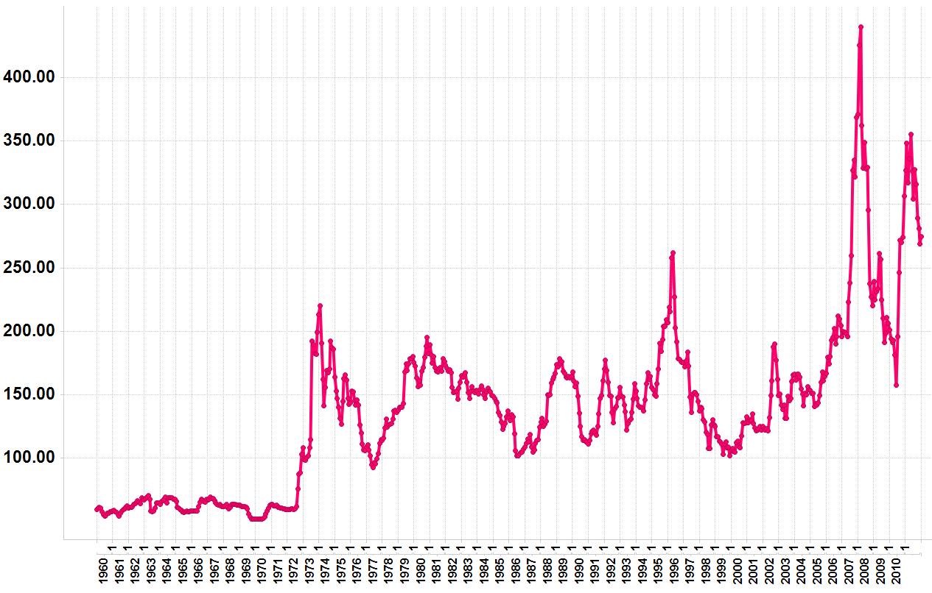
Leveraging Earth Observations for Reducing Price Volatility
2008 Price hike
Droughts:
Australia & Ukraine
Monthly Wheat Prices 1960-2011
($/Metric Ton) Source: World Bank
2010/11 Price hikes
Droughts:
Russia & USA
1971/2 Price hikes
1996 Price hike
Nominal wheat price in US $/metric Ton
Notes:
Example #2/Food price hikes/scarcity
Certain crops – maize, wheat, rice and soybeans, are the underpinnings of the world’s food supply
In some societies, these crops ARE the food supply
Historical price volatility – effected by weather, climate, market forces
2008 – particularly severe conditions – resulting in hoarding, extreme market volatility; social unrest
22

Slide 23




Crop Information for Decision-Making
(Canada, China, EC, France, Japan, Kazakhstan, India, Mexico, Russia, USA, CEOS, FAO, WMO)
* GEOGLAM part
of G20 Action
Plan on Food
Price Volatility
* New crop outlook
* Rice crop
monitoring
Notes:
NASS,
China crop watch system
Use of Multi-spatial resolution data for crop rotation mapping at varying scales and coverage in Indo-Gangetic Plains Region of India.
250 m Argentina – crop group map (summer/winter crops, perennial crops)
1km – 56 m Brazil – crop group map (summer/winter crops, perennial crops)
1 km MARS-FOOD - arable land mask for growth monitoring
56 m – 25 m US–NAS – crop type map supported by field survey
1- 5 m + 60 m FEWS – national area estimate for major crops
250 m NASA/USDA/SDSU – croplands area likelihood map

