Slide 1
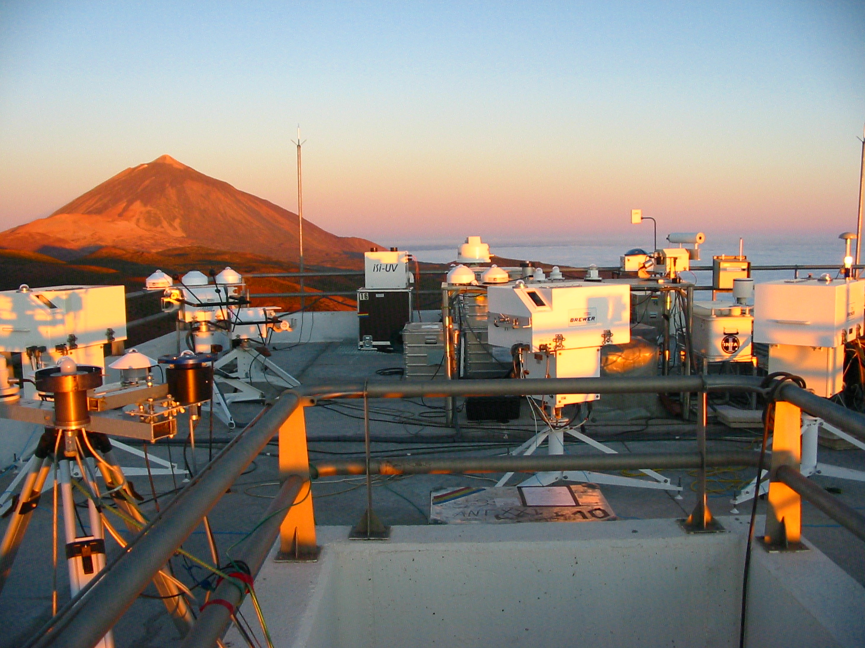
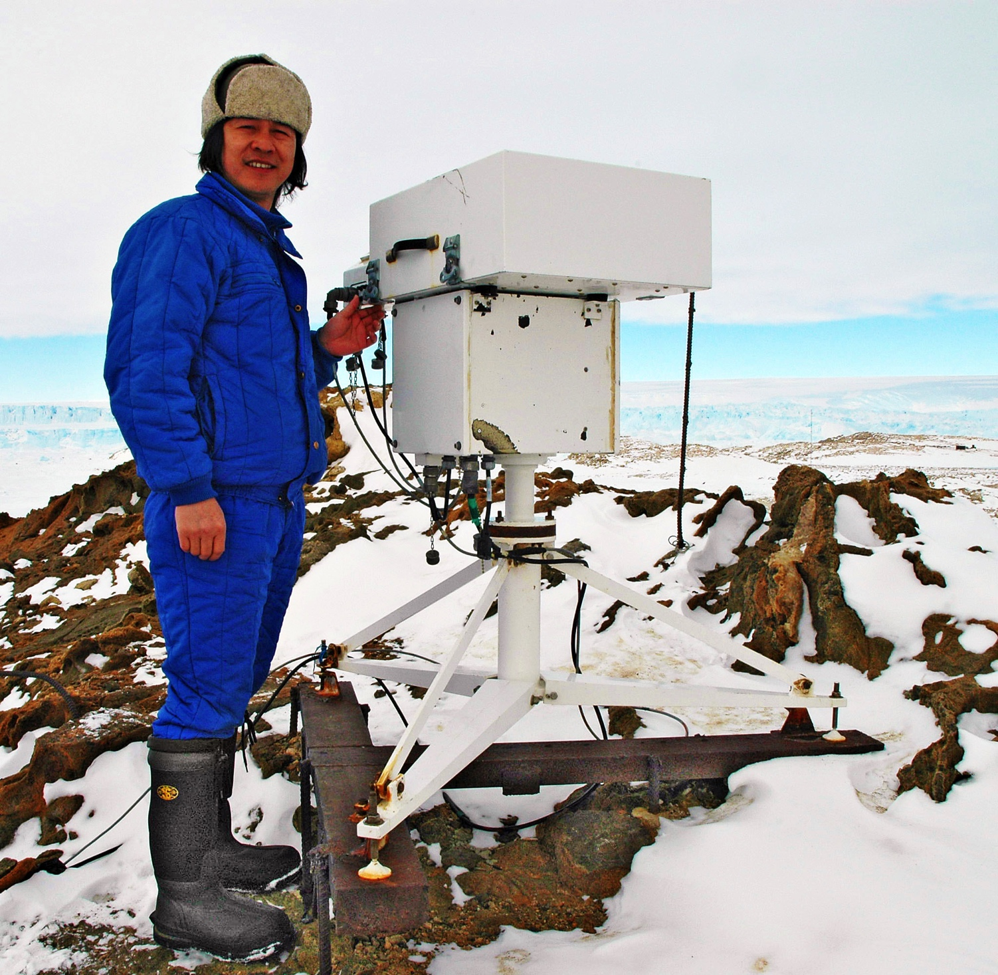
WMO Networks with emphasis on
Global Atmosphere Watch
Geir Braathen, WMO’s Research Dept.

Slide 2



The WMO Family of
Observational Networks
GAW
GOOS
GTOS
WIGOS
WHyCOS
GCOS
GOS
ENEON first workshop
Observing Europe: Networking the Earth Observation Networks in Europe
21-22 September, Paris

Slide 3
Some history
GO₃OS
1957
1989
BAPMoN
1967
ENEON first workshop
Observing Europe: Networking the Earth Observation Networks in Europe
21-22 September, Paris

Slide 4
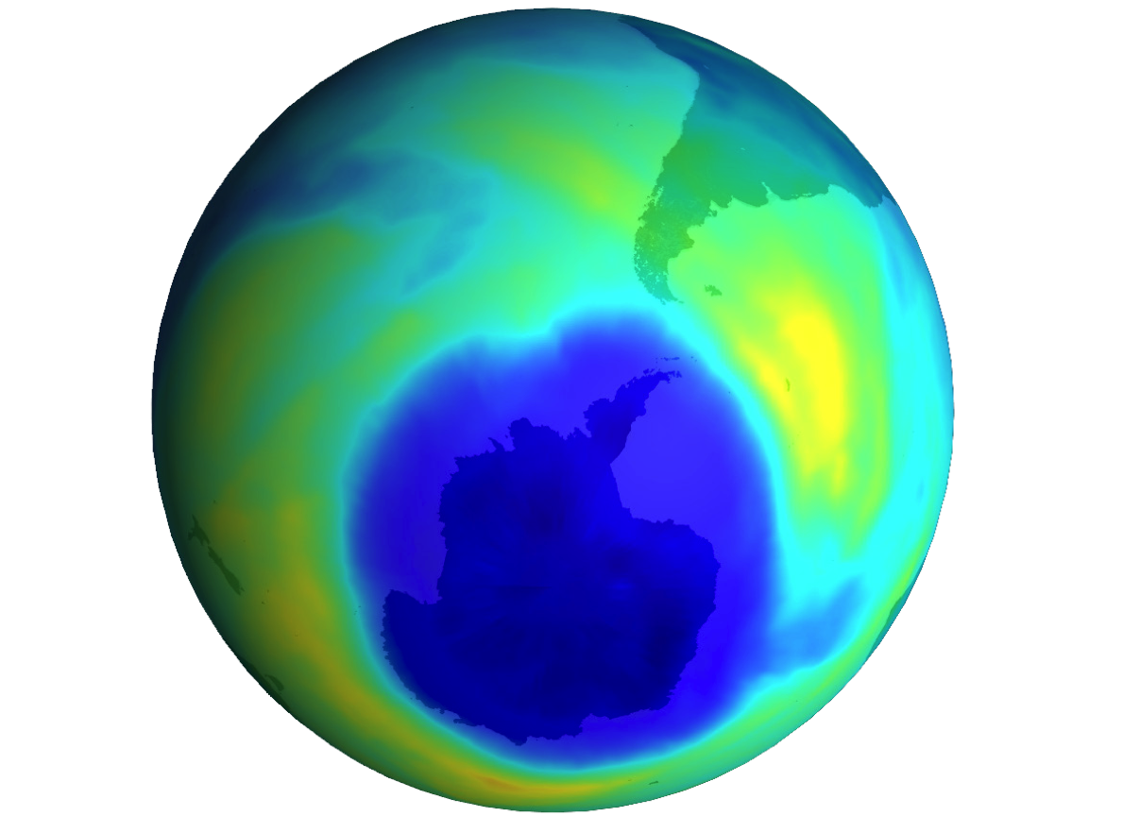
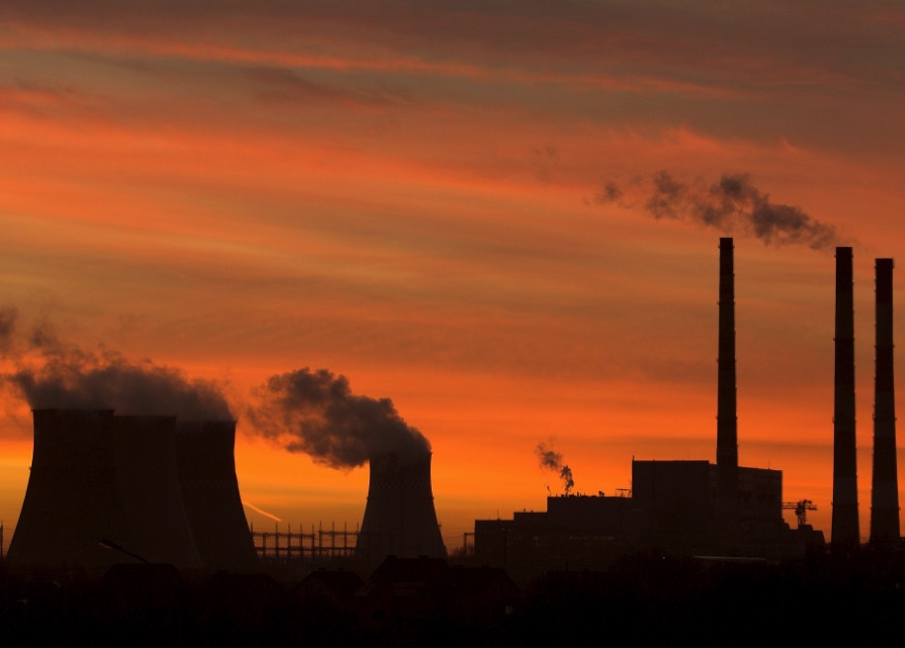
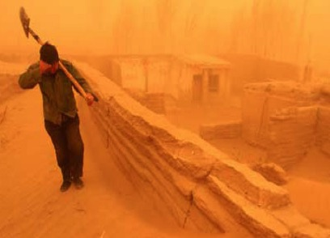
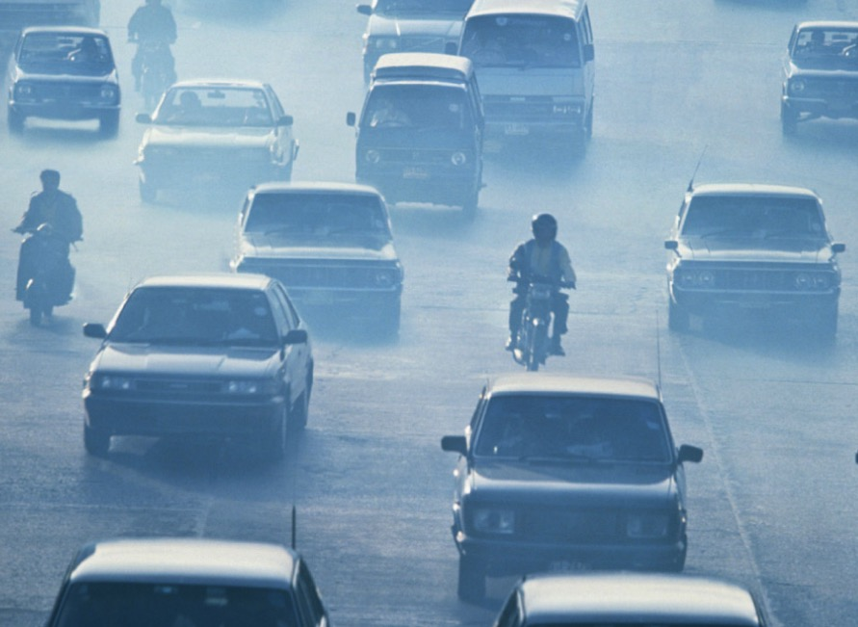

Six categories of variables
Stratospheric Ozone
Greenhouse Gases
Aerosols
CH₄
SF₆
CO₂
N₂O
Reactive Gases
Precipitation Chemistry
Solar UV Radiation
NO_{x}
O₃
CO
VOC
SO₂
ENEON first workshop
Observing Europe: Networking the Earth Observation Networks in Europe
21-22 September, Paris

Slide 5
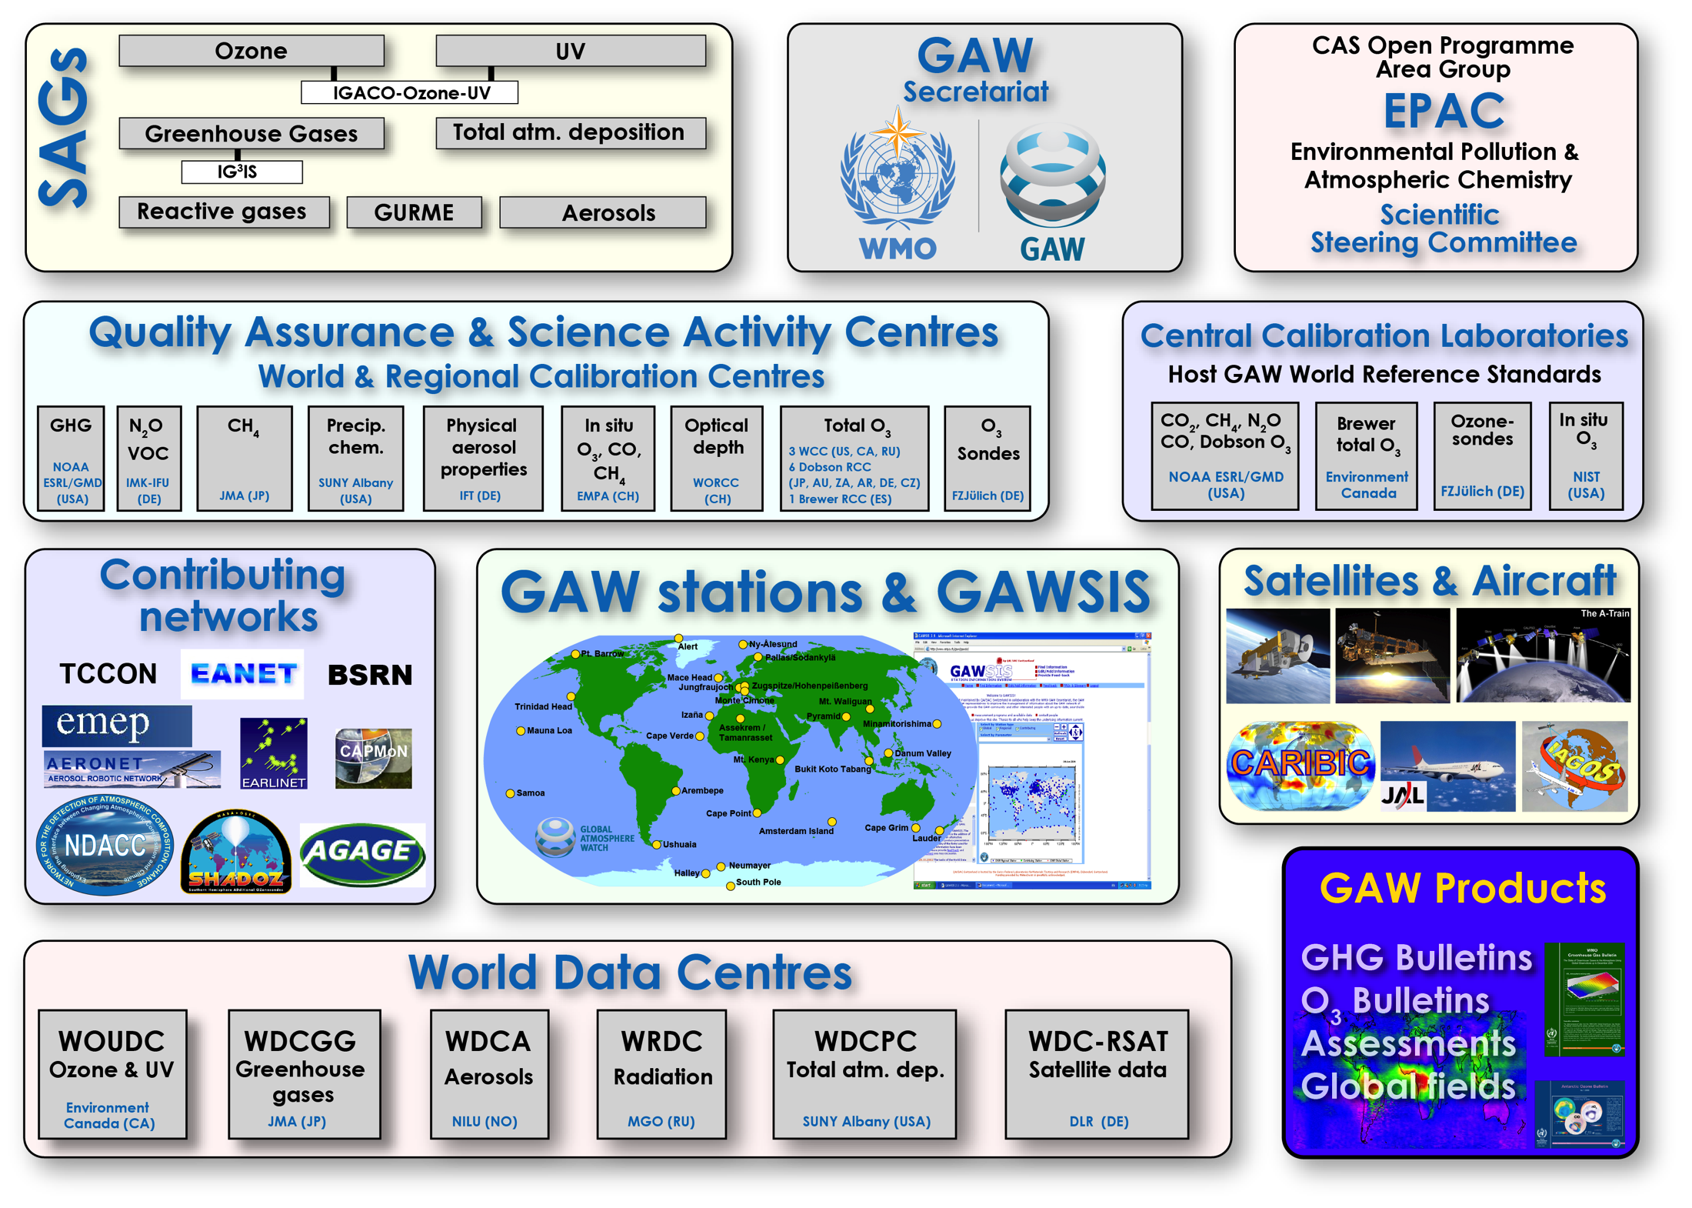

Slide 6
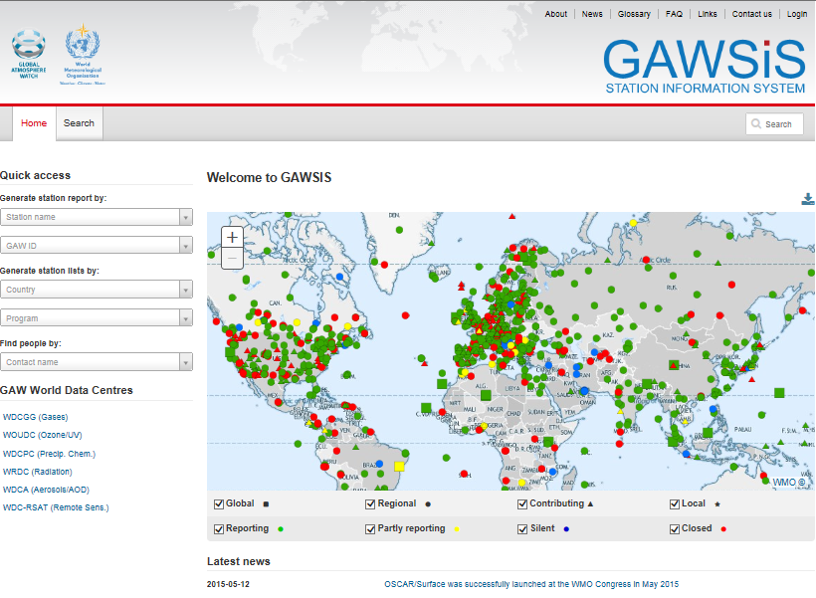
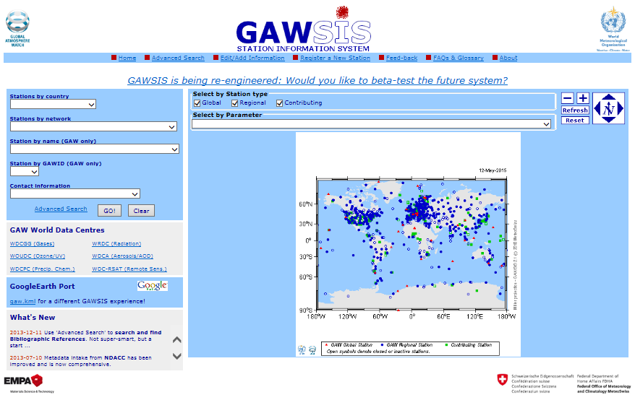
GAW Station Information System

Slide 7
Answers to the Questions
About your network
  1.1 What network are you representing and what is your role in this network?
    Network = Global Atmosphere Watch, a network and end to end research programme
    coordinated by the World Meteorological Organization (WMO)
  1.2 What are the main objectives of the network?
    Systematic Global Monitoring of the Chemical Composition of the Atmosphere.
    Analysis and Assessment in Support of International Conventions.
    Development of Air Pollution and Climate Predictive Capability
  1.3 Who are the main contributors to your network?
  100 countries have registered 800 stations. Funding comes from many sources.
  1.4 What form of commitment do you have for the maintenance your network?
  GAW is well established in the WMO system through various resolutions, but funding
  is usually quite insecure for the long term.
  1.5 How large is your user base and who are your users?
  Hundreds, if not thousands, of users: Scientists, NHMSs,
  environmental agencies, conventions and protocols (UNFCCC, Vienna Conv.,
  Montreal Protocol).
ENEON first workshop
Observing Europe: Networking the Earth Observation Networks in Europe
21-22 September, Paris

Slide 8
Answers to the Questions
About your network
  1.6 Do you maintain a database of user needs and observational requirements?
  Yes: OSCAR = Observation System Capability Analysis and Review Tool. This tool constitutes a building block of WIGOS (WMO Integrated Global Observing System) and more specifically, the so-called Rolling Requirements Review process.
  Comparison of requirements with capabilities → Gap Analysis
  1.7 What are the costs and efforts of maintaining the network?
  With 800 stations, several tens of central facilities (data centres, calibration centres, central calibration laboratories), the cost has never been calculated.
  1.8 What are your main funding sources?
  In-kind contributions from many institutions (NHMSs and research institutes) secure the operation of the network.
  The GAW secretariat at WMO consists of 3.5 full-time employees.
  In addition, a budget of a few hundred thousand Euro is spent on various activities, such as intercomparisons, calibrations, workshops, conferences, training. The WMO budget comes from the Members (185 Member states and 6 territories).
  Trust Funds provide ear-marked funding for various specific purposes.
  1.9 What are the key issues for sustainability of your network running?
  Like many other networks there is a constant danger of station closure.
ENEON first workshop
Observing Europe: Networking the Earth Observation Networks in Europe
21-22 September, Paris

Slide 9
Answers to the Questions
2. About data
  2.1 What observations does your network collect and what products are produced?
  Observations: Time series of atmospheric composition and other relevant parameters
  Products: Global averages, trends, bulletins, assessments, scientific publications
  2.2 What are the spatial and temporal characteristics and limits of your network?
  Spatial: Global coverage. Three categories of stations: Global, Regional and Local
  Temporal: Depending on the measurement technique: Data points every minute, hour, day, week
  2.3 How is the data archived and made accessible to users?
  Data is stored in dedicated data centres and are available to users online (ftp or web folders)
  2.4 Do you address data quality in some way?
  Yes, through intercomparisons, calibrations, round-robin exercises and audits
  There are central calibration laboratories, and world and regional calibration centres
ENEON first workshop
Observing Europe: Networking the Earth Observation Networks in Europe
21-22 September, Paris

Slide 10
Answers to the Questions
2. About data
  2.5 Are there risks for data continuity and how are data preservation and network continuity addressed?
  There are several risks for data continuity:
    Station closure
    Data gaps due to technical problems
    Instrument drift and lack of calibration
  2.6 What are the conditions (licenses) for sharing your data and products with users?
  Data is open access and available for free. If there is substantial use of data in a publication, co-authorship should be offered. In all cases, acknowledgements should be given to the data originator.
  2.7 What key interface standards are used in making data and products available?
  Depends on the data centre: FTP or web interface
ENEON first workshop
Observing Europe: Networking the Earth Observation Networks in Europe
21-22 September, Paris

Slide 11
Answers to the Questions
2. About data
  2.8 Are there known observational requirements that your network is not meeting?
  2.9 Are there observations that are needed but not captured by your network or by other networks that you have access to or products that are not generated?
  Challenges for GAW:
  Integrated Global Greenhouse Gas Information System (IG³IS): Sources, sinks, protocol verification
  Services related to volcanic ash
  Better coverage of aerosol measurements.
  Environmental information for urban planning and safe functioning of cities
  Use of commercial aircraft for data sampling (IAGOS)
  New focus on atmospheric water vapour (troposphere, stratosphere). This will be in cooperation with existing networks that already do measure water vapour (NDACC, GRUAN)
ENEON first workshop
Observing Europe: Networking the Earth Observation Networks in Europe
21-22 September, Paris

Slide 12
Answers to questions
3. About a network of networks
  3.1 What coordination and collaboration interfaces do you have with other networks?
  Collaboration and agreements with several networks, in some cases via a Memorandum of Understanding
  3.2 Is your network contributing to GEO(SS) and if so, what is this contribution? Could ConnectinGEO help to enhance your contribution to GEOSS?
  GAW is registered in the GEOSS Registries
  3.3 Are there additional interfaces that would be desired and what would be the main benefits of these interfaces?
  A better coordination (meta data, naming conventions, vocabularies etc.) of all the networks would be beneficial to all.
  3.4 Do you think that your network could benefit from the existence of an ENEON or a similar network?
  Yes, for harmonisation of metadata, data search and discovery, and data exchange. The synergy would be in both directions. ENEON could also help to increase visibility of the participating networks.
  3.5 From you point of view, how should an ENEON be organized and managed?
  ENEON could help to harmonise data formats, data exchange, metadata, naming conventions (vocabularies). ENEON could have representatives from major networks on board.
ENEON first workshop
Observing Europe: Networking the Earth Observation Networks in Europe
21-22 September, Paris

Slide 13
Missing Questions
4. Capacity Development
If we want a network to have global coverage we need to have a system for technology transfer and capacity development
  4.1 What does your network do to develop capacity among the data providers and users?
  GAW Training and Education Programme (GAWTEC, supported by Germany)
  Twinning (developed countries help developing countries).
  Instrument intercomparisons
  Data analysis workshops
  4.2 Does your network have a fellowship programme?
  GAW does not have a fellowship programme, but WMO does, and about 150 people benefit from WMO-funded fellowships of various duration and at various levels, up to PhD level.
ENEON first workshop
Observing Europe: Networking the Earth Observation Networks in Europe
21-22 September, Paris

