Slide 1


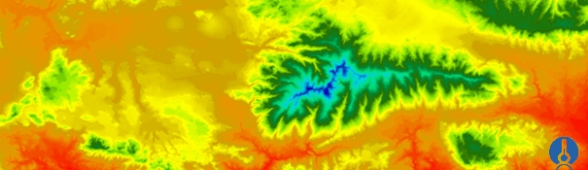


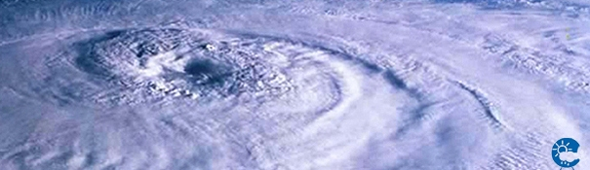
ENEON first workshop
21-22 September, Paris
Defining user needs and essential variables to support GEOSS objectives
CNR_ISSIA, Bari-Italy
Palma Blonda,
blonda@ba.issia.cnr.it

Slide 2
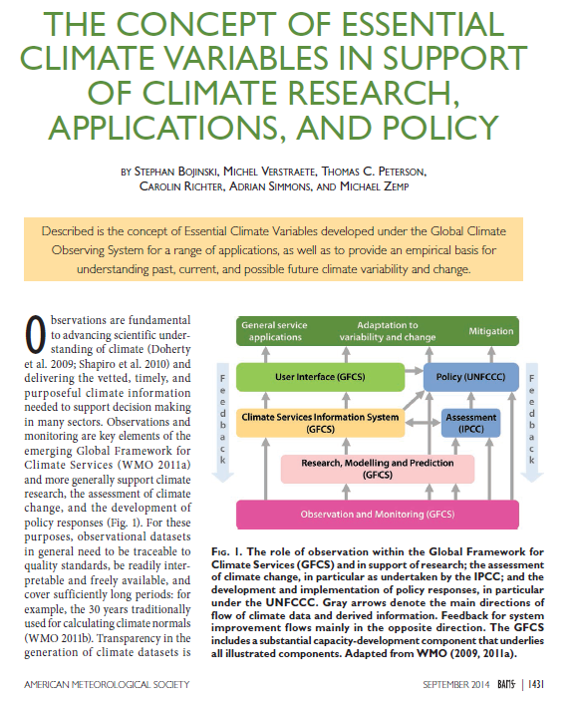
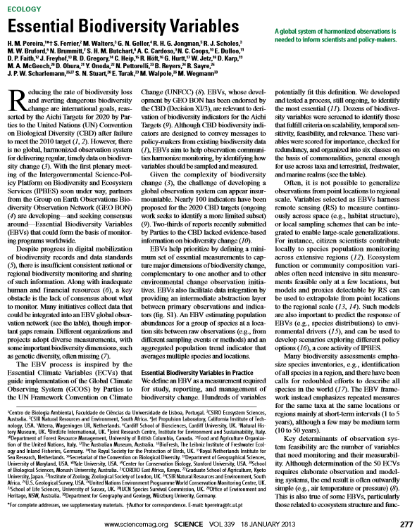
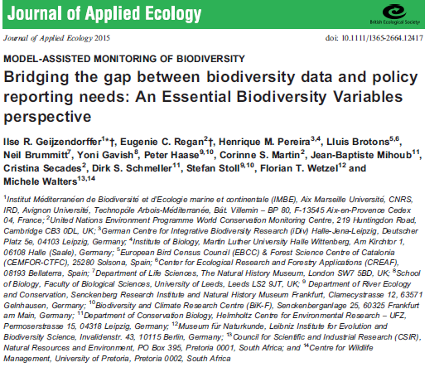
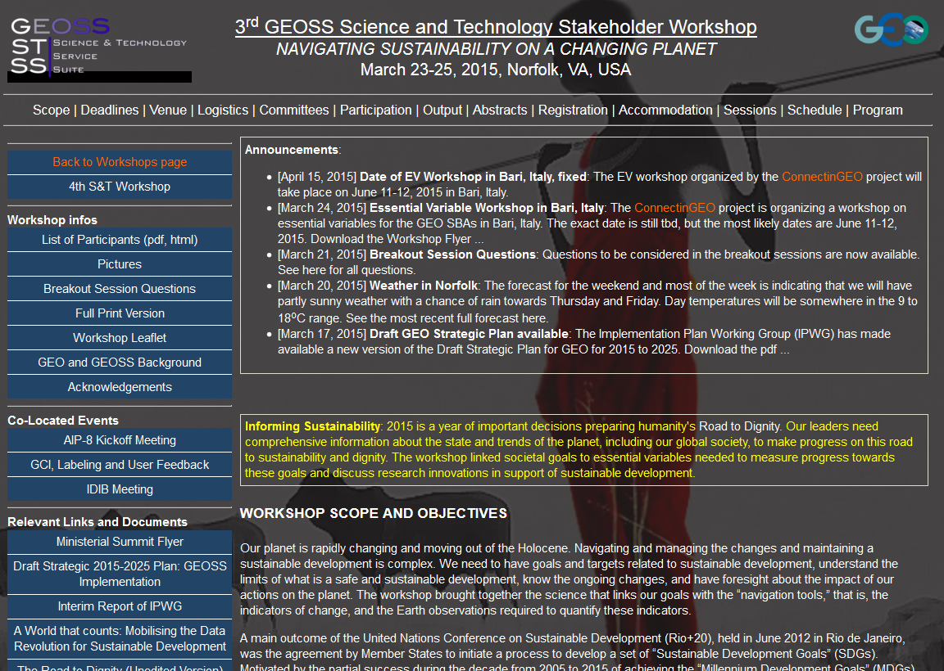
GCOS activities
GEO_BON activities
2013
2015
2014

Slide 3
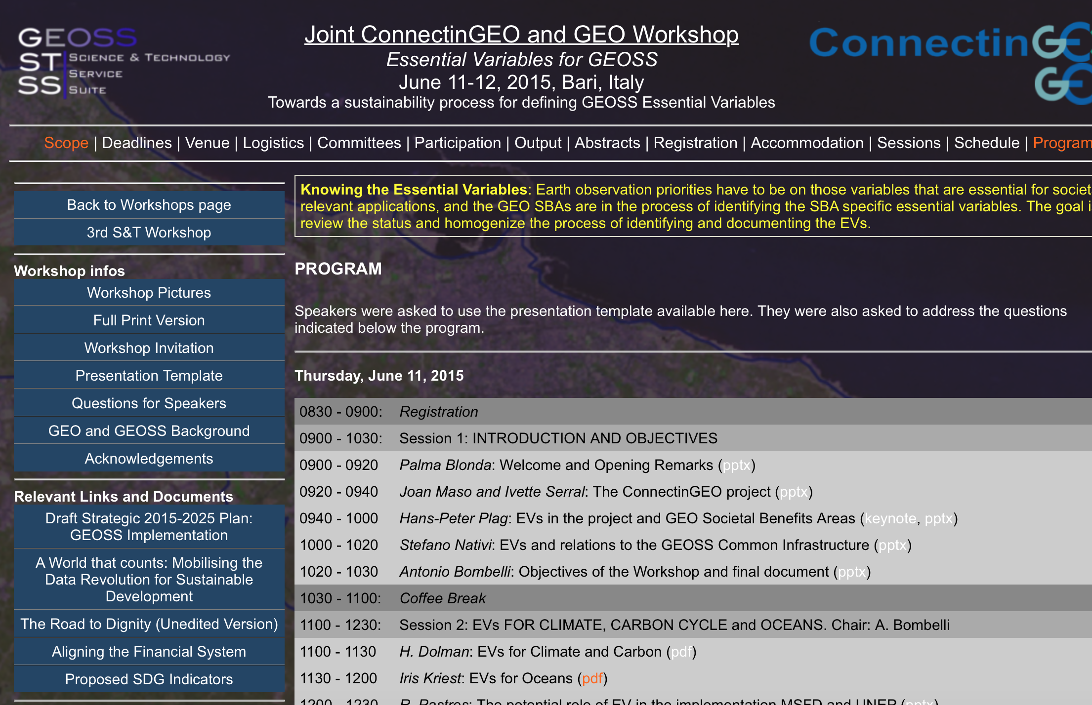
The Bari workshop on Essential Variables http://www.gstss.org/2015_Bari/index.php
Date: June 11-12, 2015. Location: the Dip. Interateneo di Fisica, Univ. of Bari-Italy
About 60 participants in the two days workshop
5 dissemination talks about EVs definition in the project and GEOSS framework, by the organizers
6 sessions focusing on 9 SBs and thematic areas:
  1. Climate (and specifically, Carbon Cycle, Atmospheric composition), and the thematic areas related to Oceans (and Marine Ecosystems) *
  2. Water (and River discharge), and Weather*,
  3. Energy and Disasters (including Volcanology),
  4. Biodiversity* and Ecosystems,
  5. Health and the emerging thematic area Human Settlements
  6. Agriculture and the emerging thematic area related to Socio–Economics
one additional session on some case studies (soil moisture, habitat maps, and phylogenetic diversity as WPS contributions to the web model)
20 speakers (of 70 invited speakers) accepted to give a presentation.
4 of 20 presentations in remote mode (go-tomeeting)

Slide 4
The Bari workshop on EVs: the questions
Status of existing EVs in the domain:
    * * advanced: climate, weather, water;
    * quite advanced: biodiversity, agriculture, ocean biochemistry
    ° just started and/or consider EVs from other SBAs (energy, disaster, ecosystems)
The process underlying EV definition: top-downs or bottom-up
EVs validation and use
Describing the monitoring networks currently operational
Assessing EV observational needs and readiness
Gaps and requirements
Recommendations for GEO/GEOSS

Slide 5
1. What is an EV?
From the participants to the Bari workshop
  Climate ** (by Bojinski et al. 2015; H. Dolman, Univ. Amsterdan)
    An ECV is a physical, or biological variable or a group of linked variables that critically contributes to the characterization of Earth's climate. ECVs provide the empirical evidence to understand and predict the evolution of climate. Criteria:
    relevance for characterizing the climate system and its changes;
    feasibility on a global scale;
    cost effectiveness
  Biodiversity* (by Jorg Freyhof, GEO_BON)
    Essential is what needs to be monitored to describe and analyse the different dimensions of biodiversity change
  Marine ° (by Roberto Pastres, Univ. Venice, Italy)
    “Marine” EVs can be defined as the minimum subset of biological indicators which should be monitored in order to detect changes in the structure and functioning of marine ecosystems and, therefore, in ecosystem services (my point of view)
  Ocean Biogeochemistry* (by Iris Kriest and Toste Tanhua, GEOMAR)
    Relevant variables able to address topics/questions identified on a social and scientific basis and balance impact against feasibility

Slide 6
1. What is an EV?
From the participants to the Bari workshop
  Water river discharge ** (by Ulrich Looser, Global Runoff Data Centre at the BfG )
    EVs should support the work of the UNFCCC, the IPCC and other international conventions and bodies. EV is technically and economically feasible for systematic observation. International exchange is required for both current and historical observations. (GCOS)
  Energy° (by T. Ranchin, Jorg Freyhof, GEO_BON)
    The observations that meet important requirements from Energy stakeholders and are technically and economically feasible for systematic observation and global implementation

Slide 7
2. Process underlying EV definition
Relevance
Strategic Goals, Programmes
Goal-based
Expertise-based
EVs
Observations, Measurements
Feasability
Figure credits: Nativi, 2015

Slide 8
2.1) Process: top-down (goal-based)approach
  User needs related to environment legislation and convention:
  Habitats Directive (Council Directive 92/43/EEC) and Birds Directive (Council Directive 79/409/EEC)
  Marine Strategy Framework Directive (Council Directive 2008/56/EC)
  Urban Waste Water Directive (Council Directive 91/271/EEC)
  Waste framework Directive (Council Directive 2008/98/EC)
  Landfill Directive (Council Directive 1999/31/EC
  Floods Directive (Council Directive 2007/60/EC)
  The GEO Carbon Strategy
  CBD, IPBES, RAMSAR Conventions
  Scientific user needs:
  what quantitative predictive modelling requires as inputs to the selection of the most appropriate sensors?
  2.2) Process: bottom-up approach
Prior expert knowledge: from what EO data can provide for the specific domain

Slide 9
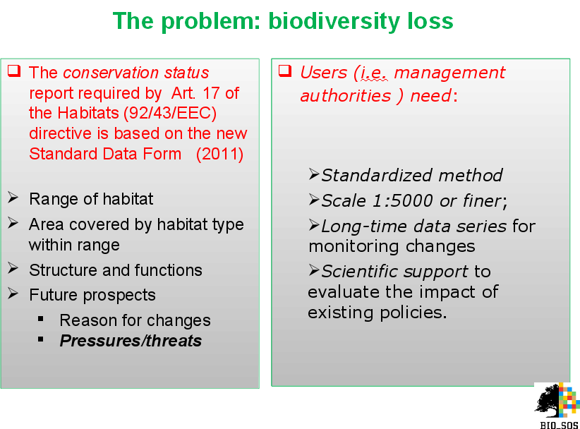
Use case: the Habitat Directive

Slide 10
2. Process underlying EV definition
For Climate biogeochemistry (by I. Kriest and T. Tanhua, GEOMAR)
  Defining EVs (2009-2014):
    Three thematic panels (physics, biology/ecology and carbon/biochemistry)
    In-person meetings and workshops for
    Identifying the relevant topics / questions on a societal and scientific basis
      The role of ocean biogeochemistry in climate
      Human impacts on ocean biogeochemistry
      Ocean ecosystem health
    Finding the relevant variables addressing such questions by
    Balancing Impact and Feasibility to assess EOVs observational needs and readiness Top 8 candidates
    Defining derived products, temporal and spatial scales
  Validation: acceptance by international bodies (FOO, GOOS, IOCCP, IOC)
How is the ocean carbon content changing?
How large are the dead zones and fast are their changing?
Is the biomass of the ocean changing?

Slide 11
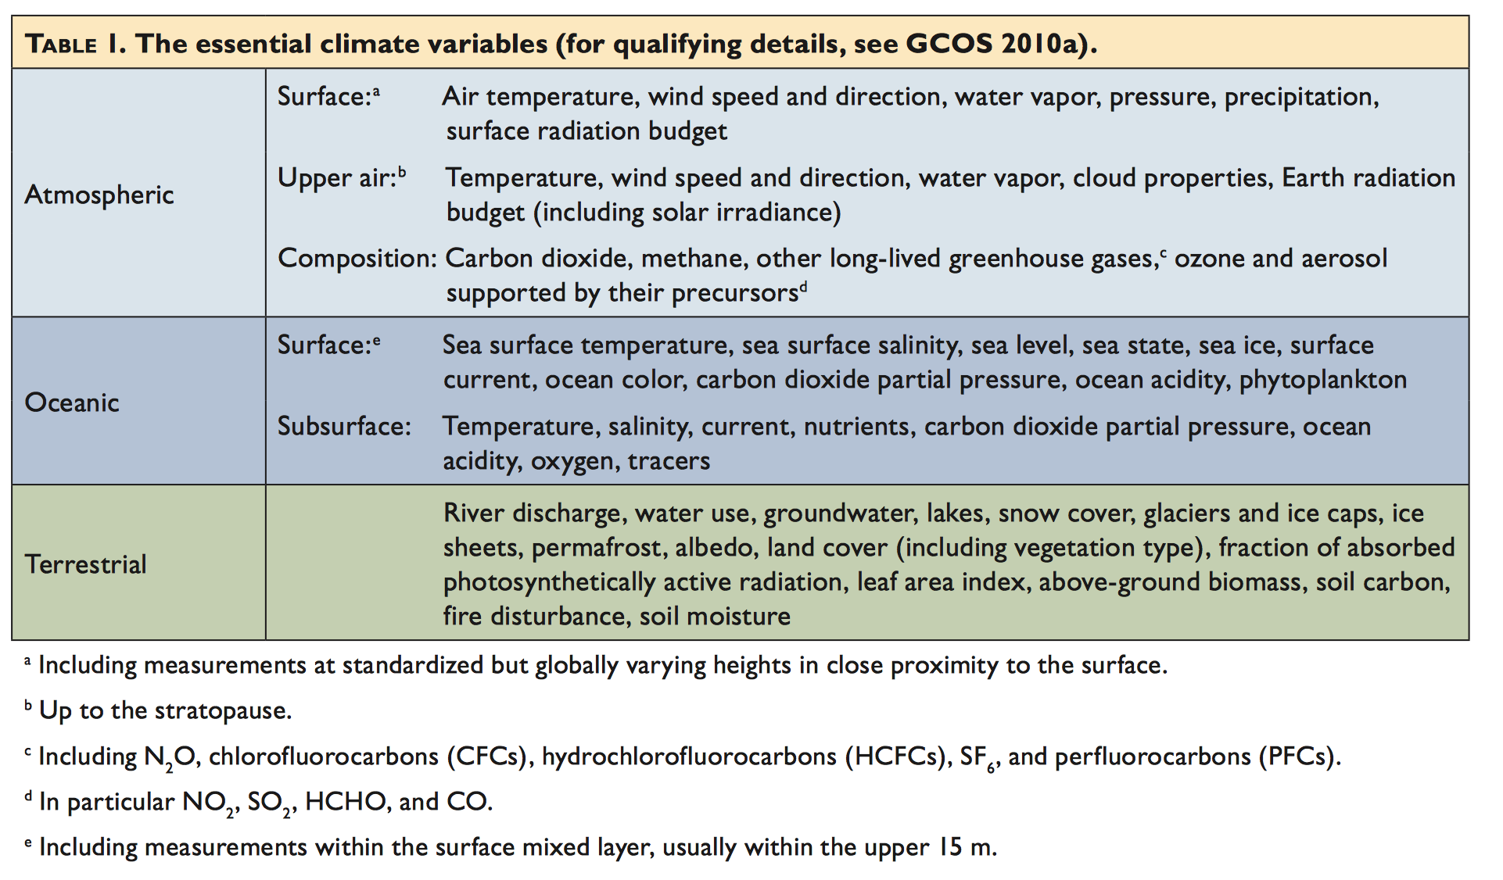
2. Evs, approved: Climate
(. by Bojinski et al. 2015 2015

Slide 12
2. Candidate EVs
For Ocean biogeochemistry (by I. Kriest and T. Tanhua. GEOMAR):
  Oxygen
  Macro Nutrients
  Carbonate System
  Transient Tracers
  Suspended Particulates
    Particulate Matter transport
  Nitrous Oxide
  Carbon-13
  Dissolved Organic Matter

Slide 13
2. Process underlying EV definition
For Biodiversity (1) (by Gary Geller, GEO secretariat)
  Defining EVs (GEO-BON framework):
    Identify the users and specific types of user needs (e.g., CBD document)
    Select variables that respond to user needs
    Adopt the GCOS criteria: relevance, technical feasibility, cost effectiveness. He introduce also readiness of algorithm and data
    Utilize an on-line development approach:
      Each EBV proposer gets their own page
      EBV information is shown there
      Others can comment
      Proposer follow specific criteria , in a checklist, that must be addressed
  Community endorsement and validation:
    Submit to peer-reviewed journal
    If paper is accepted, then the proposed EBV is endorsed by GEO_BON
    Additional comments/issues possible
  This process is being updated

Slide 14
2. Process underlying EV definition
For Biodiversity (2 ) A Big Picture Perspective
(by Gary Geller, GEO secretariat)
  Develop EVs in conjunction with end user organization
    UNFCCC; CBD
    Converge, get approval
  End user org inserts need for EVs in formal documents
    GEO can point to those docs in discussions with members
  And
    Request that CEOS respond
    Consider developing “Satellite Supplement”
    (GCOS did this, CEOS responded…)

Slide 15
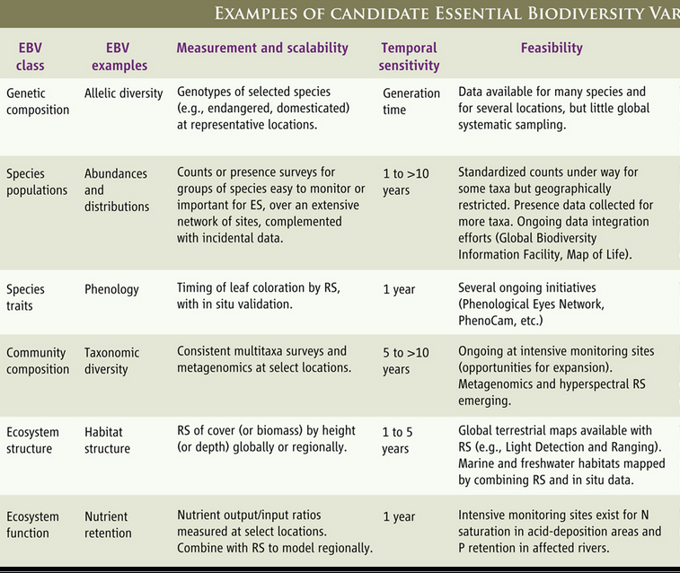
Habitats as proxies
Habitat maps and LC/LU as EBV.
LC/LU maps and LIDAR
Bio-physical indices
Kick off meeting. February 18th, 2015. Barcelona
15

Slide 16
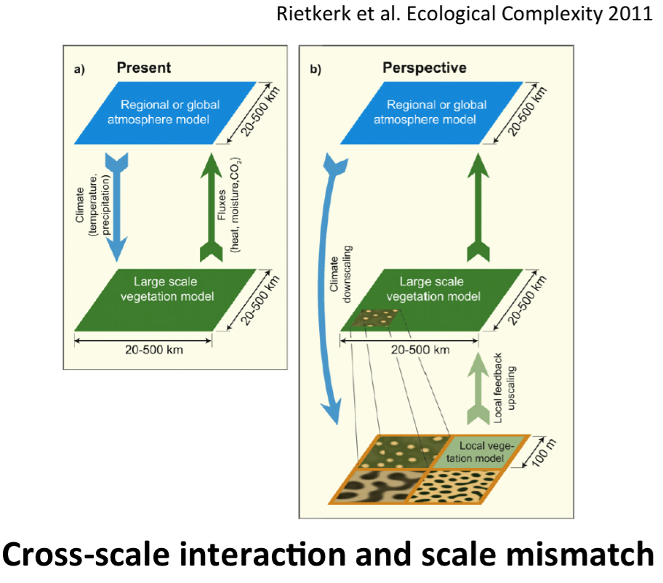
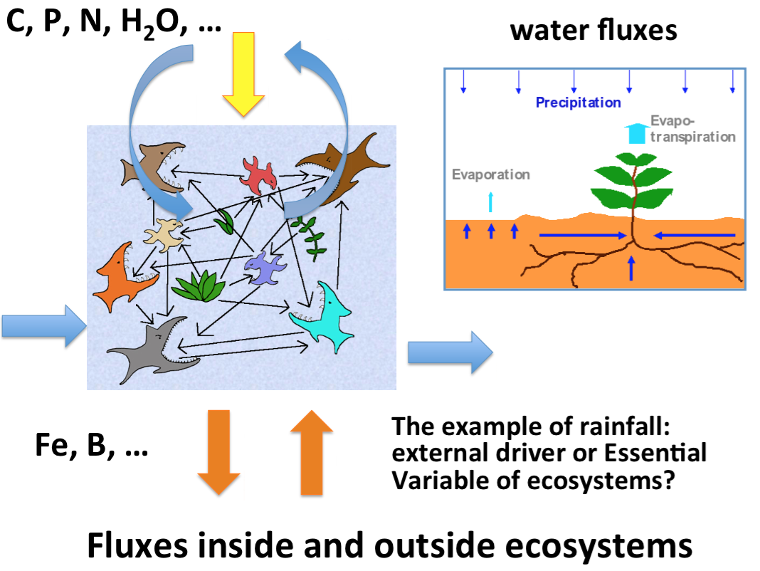
2. Process underlying EV definition
For Ecosystems° (by Antonello Provenzale, CNR.Italy)
  Defining EVs (2009-2014):
    Candidate EVESs are based on other Evs (ECVs, EOVs, EBVs…) and will be selected on the basis of monitoring and modelling needs
    May be the ECOPOTENTIAL project would need to define/develop specific EVESs by using and integrating existing EVs: meetings and workshops within the current project will be considered
    Cross-scale analysis is mandatory for ES and ES Services monitoring

Slide 17
2. Process underlying EV definition
For Agriculture* (by I. Iarvis, Agri-Environmental Data Agriculture and Agri-Food Canada)
  Defining EVs in advanced process, supported by the GEOGLAM initiative (since 2011) by in-kind resources , based on users needs (policy makers, programs, including commodity markets (AMIS) :
    Top-Down and Bottom-Up
    Joint Experiments for Crop Assessment and Monitoring (JECAM) project, provides the R&D to support GEOGLAM operational implementation
    EV’s are broken down into 4-5 spatial-temporal scale classes and provides spatial, temporal and accuracy requirements (see Defourny diagram)
    They use a template
  Validation: acceptance by users

Slide 18
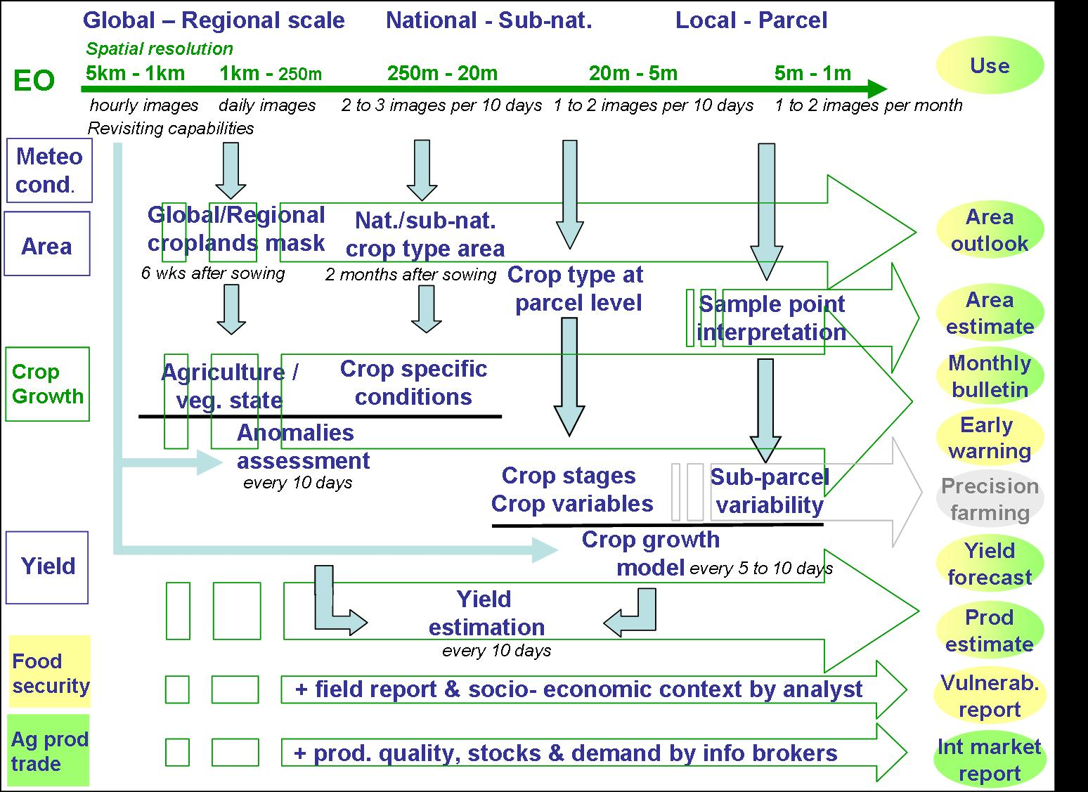
Proposed EVs for Agriculture
(by I. Iarvis, Agri-Environmental Data Agriculture and Agri-Food Canada)
Crop Area
Crop Type
Crop Condition
Crop Phenology
Crop Yield (forecast)
Crop Management
  Tillage
  Residue
All across multiple time and space scales
From Defourny, 2011

Slide 19
2. Additional contribution°
  Human settlement° EVs (by T. kemper, JRC)
  Defining EVs is in its early stage:
    Definition of user needs: today there is no adequate operational network for settlement information, such as:
      Regional landuse/landcover (e.g. CORINE for Europe)
      Singular data sets (e.g. Global Urban Footprint by German Aerospace (DLR))
      population data (1km, annually updated)
  Citizen Science° (by Ian McCallum, IASA)
    Citizen Science can help across most SBAs (biodiversity and ecosystems, agriculture…)
    Citizen Science can be used for validation of EVs
    Citizen Science could address data needs where feasibility has been limiting
    Citizen Science has reduced costs
  Disasters ° (by G. Puglisi, INGV-Italy)

Slide 20
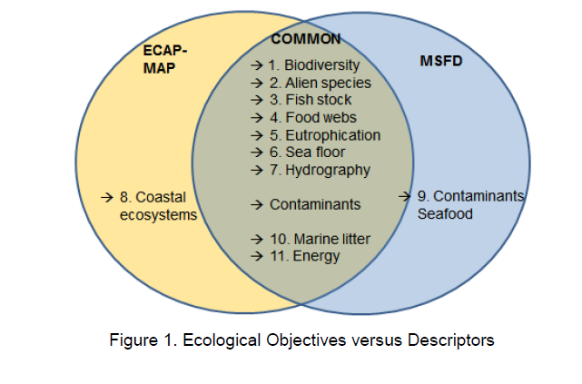
Preliminary state
Marine EVs
PROCESS TO IDENTIFY EVS
IN PROGRESS (meetings, bibliography)
( Hayes, et al. 2015)
Requirement for
Uncertainty;
Long term monitoring
APPLICATIONS/INITIATIVES/DIRECTIVES
* EU MARINE STRATEGY FRAMEWORK DIRECTIVE (MSFD)
* UNEP-MAP
Medit. Action Plan;
Ecos- Approach (EcAp-MED):
LINKS TO:
BIODIVERSITY
USERS:
National Envir. Agencies
Credits: R. Pastres, 2015, Bari workshop

Slide 21
Open Challenges for GEOSS
Different maturity levels
  Processes defined by more mature SBAs
  Need to focus on EVs’ features:
    temporal frequency, spatial resolution, accuracy
  Gap analysis still open
  Data sharing obstacles (data policy, technical, administrative, institutional, sustainability)
Different spatial/ temporal scales: global to Local
Harmonization across existing SBA and thematic areas
Linkages between ConnectinGEO and other projects (ECOPOTENTIAL, EU_BON) and observation networks

Slide 22
Reccomendations
1. Provide requirements for ECVs with application in mind (Dolman, 2015, Bari workshop)
  process, budget and climate trend studies have different requirements but we need measurements to cover all applications
  ECV need to be (re) evaluated against their use
  GCOS monitoring principles support investigation of complex relations

