Slide 1

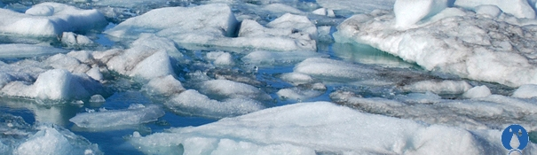
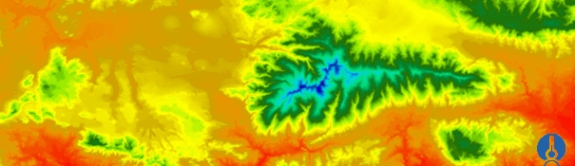


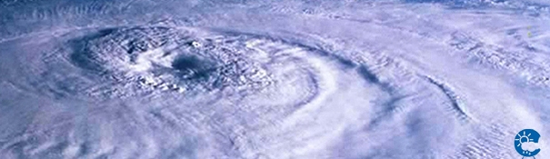
ENEON
Observing Europe: Networking the Earth Observation Networks in Europe
21-22 September, Paris
IIASA
Ian McCallum

Slide 2
ENEON
Establish a European Network of Earth Observation Networks (ENEON) that can provide opinions and evidence of gaps in observation networks.
Engage with this Network on various fronts.
Collect, synthesize and disseminate this information.

Slide 3
Vision
ENEON is a instrument that will bring together Networks involved in research and Innovation relevant to GEOSS, with a particular focus on the in-Situ segment
ENEON also addresses the emerging European networks and sensor development projects to provide future provisions which may not yet be part of GEOSS or Copernicus Services

Slide 4
European Commission
Kick-off
Thoughts on what EC expect from ConnectinGEO…
- Coordination and support actions are instruments supporting our policy agenda – in this case, in the field of EO in the EU context and in GEO.
- The resulting network (ENEON) should consist of a wide spectrum of European stakeholders, ideally laying down the foundations for a forum outlasting ConnectinGEO.
- Private sector involvement leveraging previous EC efforts
Notes:
- The ConnectinGEO methodology should bring a leverage effect to the EU contribution to achieving SDGs
- The Observation inventory to be proposed as a GCI component reinforcing the GEOSS knowledge base

Slide 5
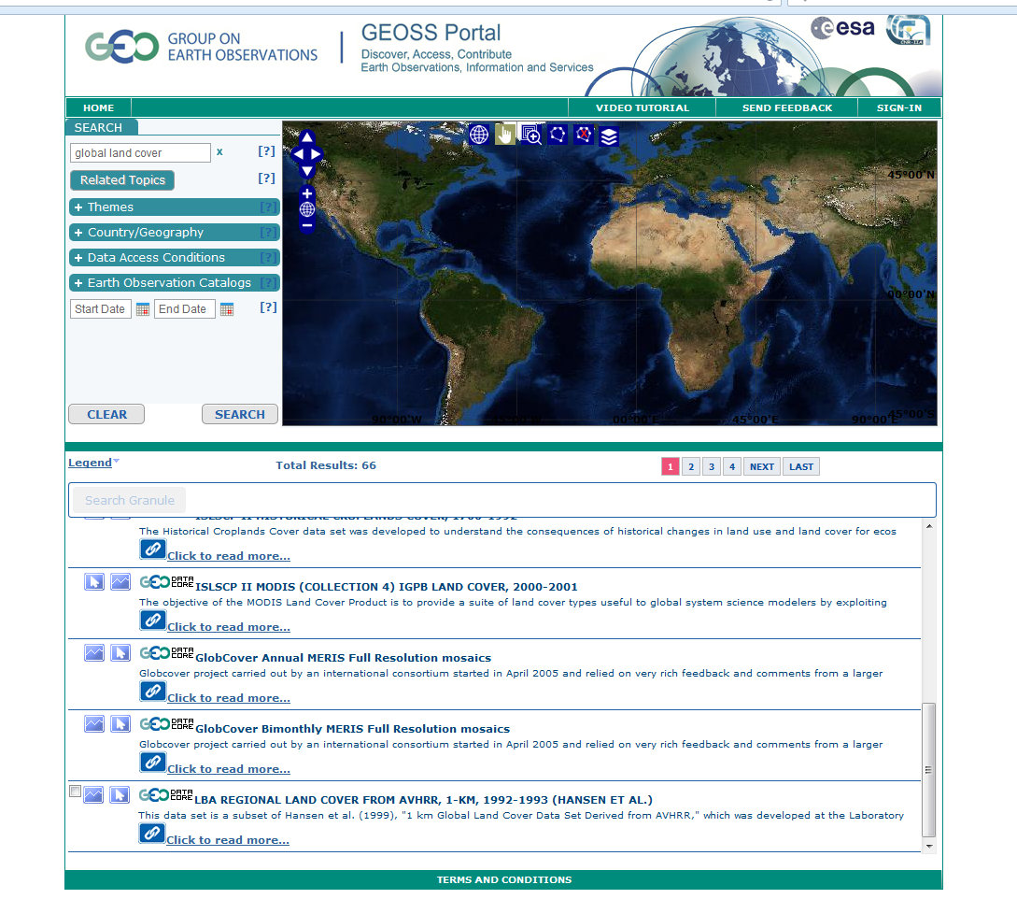
GEOSS Portal
Motivation
Global, all servers, all dates
4.12.15

Slide 6
Goal
The goal is to increase coordination and collaboration between networks, the processing, and the generation and dissemination of products to better serve the growing societal needs for environmental intelligence.
Fragmentation of efforts hinders a full exploitation of the integrated observations.

Slide 7
Objectives
Incorporate to ENEON all EO networks members currently active in Europe
Consider in ENEON as many thematic areas as possible, considering all SBAs (SDGs?)
Connect ENEON with gap analysis studies, in particular with the ConnectinGEO methodology
Spatial harmonization of EO in – situ data
Harmonization among EVs,
Spatio-temporal continuity of the observations
Harmonization among standards ( sensorML , etc)

Slide 8
Possible Tasks/Discussion Issues
Survey ENEON members, collect generated knowledge and generate debate on future observational needs in Europe
Feed a consultation process that will be complemented by a systematic analysis of the available data and metadata
Interaction with the Copernicus program [both infrastructure and services] (overlapping scope, future needs for observation, etc.)
Relevant expertise is already with external actors (e.g. Copernicus services). How will ENEON entice their inputs?
ENEON needs to keep track of/integrate innovative EO use based on “free and open” data-driven initiatives outside the network of networks… [long term sustainability]
ENEON must address implementation issues as well (e.g. academia vs. industry, centralized vs. collaborative, capacity building)
Discuss a more formal organizational structure and a possible legal status of the ENEON

Slide 9
Composition
Thematic partners in ConnectinGEO (that represent thematic observation networks)
GEOSS S&T Stakeholder Network and GEOSS CoPs
Copernicus services, Sentinel missions and other Eureopean programms
European networks representatives for
  space-based
  airborne
  in-situ observations (e.g. EPOS, EMSO, GROOM, etc)
Representatives of the SMEs and industry sector.
European and national funding agencies.

Slide 10

Potential Benefits
Link to GEO/GEOSS
Infrastructure/hosting (via GEOSS)
Link to SDGs via GPSDD
Dissemination
Recognition
Data
Support
A discussion forum
Connectivity between users and producers (marketplace?)
Business opportunities
International Visibility

Slide 11
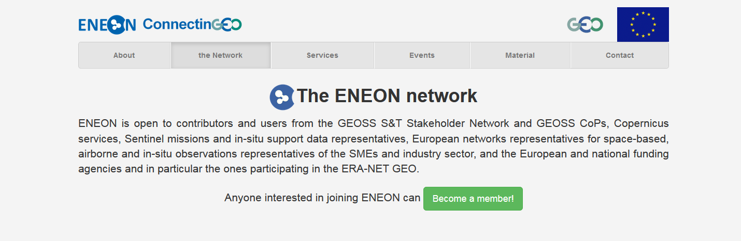
Thank You
www.eneon.net

Slide 12
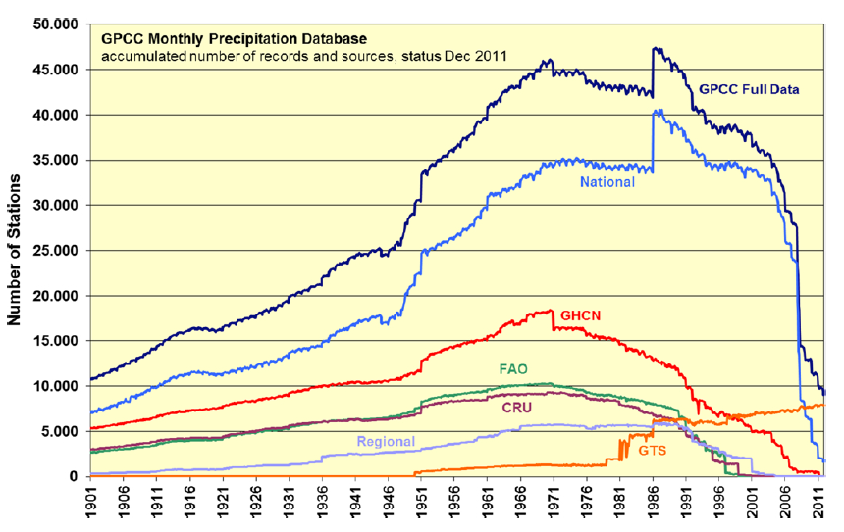
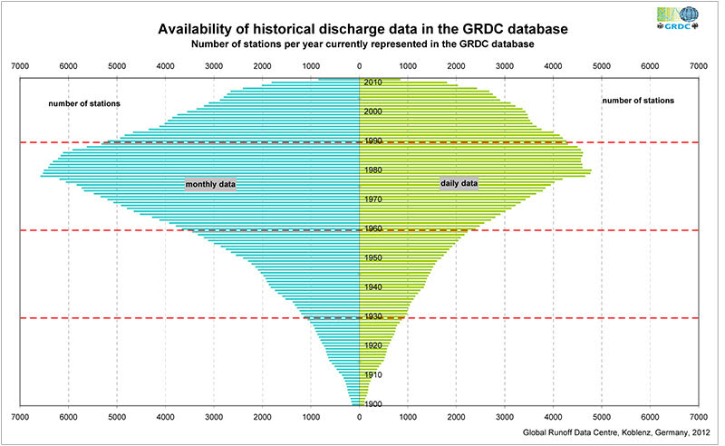
Issues with in-situ data… in some cases on the decrease
Precipitation Global Runoff

Slide 13
What ENEON has to be
European Network of Earth Observation Networks (ENEON) including space-based, airborne and in-situ observation networks
ENEON contributes to the development of GEOSS and Copernicus by extending them to all relevant European EO networks
ENEON will be used to bring together networks involved in research and innovation relevant to GEOSS, with particular focus on in-situ segment

Slide 14
Next Steps
  Review earlier attempts (eg FEON); NEON, OOI; EarthCube CDF – analyze what worked and what did not…
Make explicit information models for each participating observation network
  Map them to a common framework (O&M)
  Examine mapping results and gaps
Interaction with the Copernicus program [both infrastructure and services] is required (overlapping scope, future needs for observation, etc.)
Relevant expertise is already with external actors (e.g. Copernicus services). How will ENEON entice their inputs?
ENEON needs to keep track of/integrate innovative EO use based on “free and open” data-driven initiatives outside the network of networks… [long term sustainability]
ENEON must address implementation issues as well (e.g. academia vs. industry, centralized vs. collaborative, capacity building)

Slide 15
The review of the GEOSS DAB ensures that all the networks are contributing valuable resources to GEOSS based on the GEOSS GCI information, the GEOSS DAB and Copernicus services catalogues.

Slide 16
SDGs, MDGs, EVs
A world in which timely, accurate, and high quality data (official statistics, big data, open data, citizen-generated data, and more) is harnessed to significantly contribute to achieving and measuring sustainable development - leaving no one behind…
A world in which statistics and data are rigorously produced, organized, shared, and used in an environment of trust, inclusiveness, creativity, and efficacy…
A world in which “the right data is available to right people at the right time for the right outcomes”.

Slide 17
Questions to be answered by your network (1/3)
1. About your network
  1.1 What network are you representing and what is your role in this network?
  1.2 What are the main objectives of the network?
  1.3 Who are the main contributors to your network?
  1.4 What form of commitment do you have for the maintainance your network?
  1.5 How large is your user base and who are your users?

Slide 18
Questions to be answered by your network (1/3)
About your network
  1.6 Do you maintain a database of user needs and observational requirements?
  1.7 What are the costs and efforts of maintaining the network?
  1.8 What are your main funding sources?
  1.9 What are the key issues for sustainability of your network running?

Slide 19
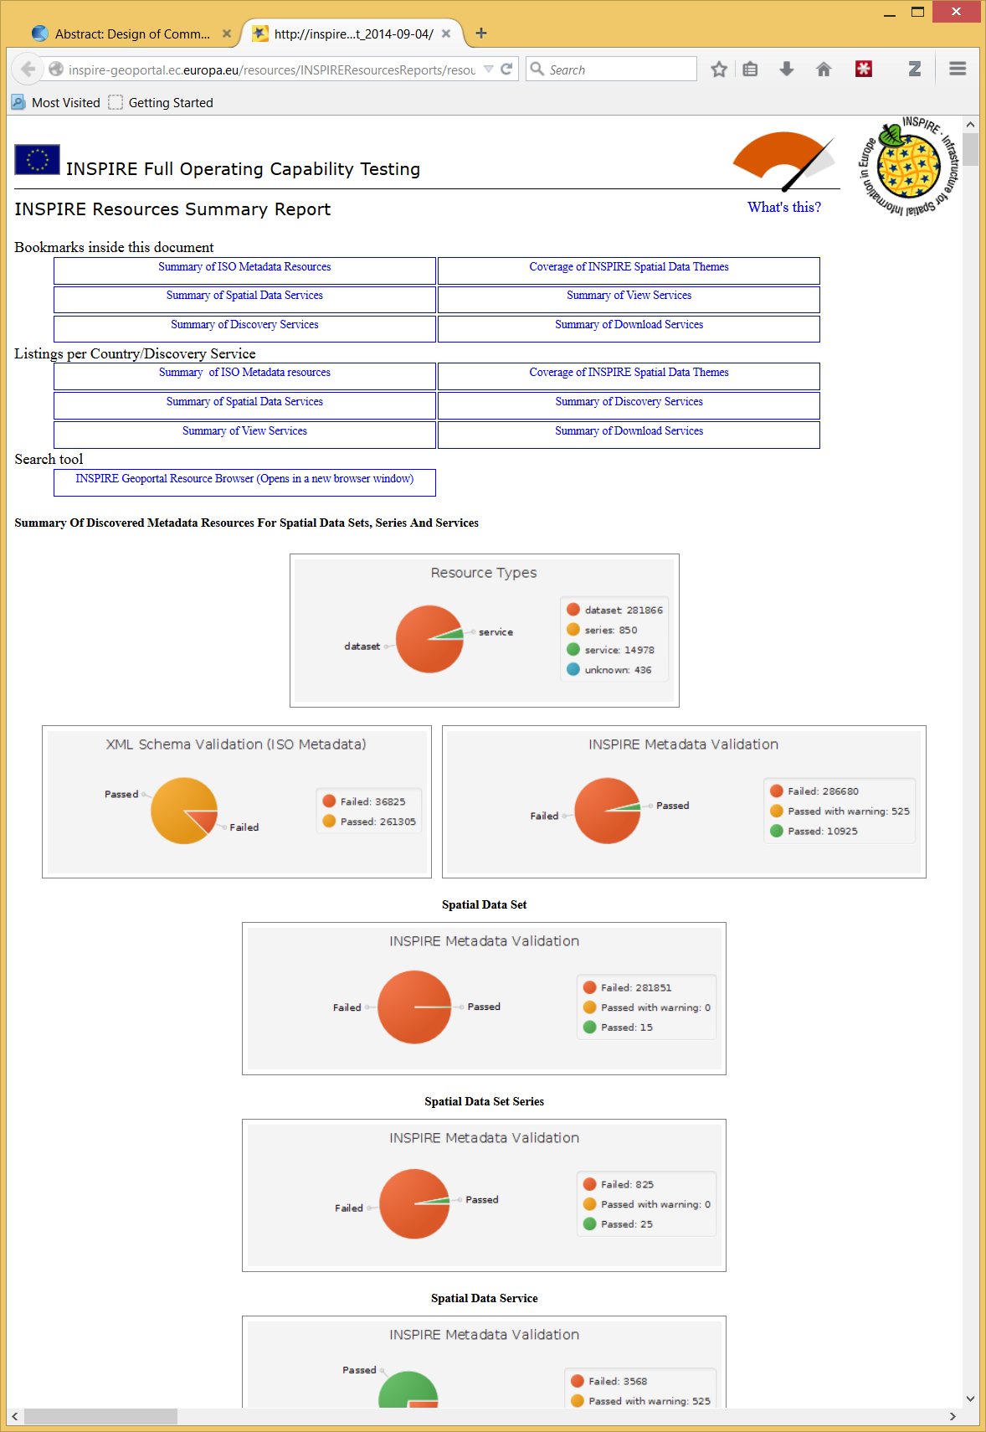
ISSUES
FROM: http://inspire-geoportal.ec.europa.eu/resources/INSPIREResourcesReports/resourcesReport_2014-09-04/

Slide 20
Questions to be answered by your network (2/3)
2. About data
  2.1 What observations does your network collect and what products are produced?
  2.2 What are the spatial and temporal characteristics and limits of your network?
  2.3 How is the data archived and made accesible to users?
  2.4 Do you address data quality in some way?
  2.5 Are there risk for data continuity and how are data preservation and network continuity addressed?

Slide 21
Questions to be answered by your network (2/3)
2. About data
  2.6 What are the conditions (licenses) for sharing your data and products with users?
  2.7 What key interface standards are used in making data and products available?
  2.8 Are there known observational requirements that your network is not meeting?
  2.9 Are there observations that are needed but not captured by your network or by other networks that you have access to or products that are not generated?

Slide 22
Questions to be answered by your network (3/3)
3. About a network of networks
  3.1 What coordination and collaboration interfaces do you have with other networks?
  3.2 Is your network contributing to GEO(SS) and if so, what is this contribution? Could ConnectinGEO help to enhance your contribution to GEOSS?
  3.3 Are there additional interfaces that would be desired and what would be the main benefits of these interfaces?
  3.4 Do you think that your network could benefit from the existence of an ENEON or a similar network?
  3.5 From you point of view, how should an ENEON be organized and managed?

