Slide 1

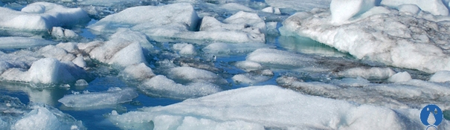
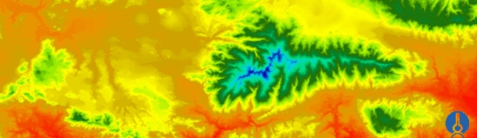


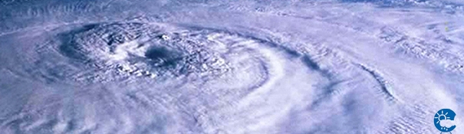
ENEON first workshop
Observing Europe: Networking the Earth Observation Networks in Europe
21-22 September, Paris
[EMEP,ACTRIS,HELCOM,CAMP and more/NILU]
[Wenche Aas and Kjetil Tørseth /waa@nilu.no and kt@nilu.no]

Slide 2
The main objective of EMEP
Provide governments with information of the deposition and concentration of air pollutants, as well as the quantity and significance of the long-range transmission of air pollutants and their fluxes across boundaries.
Regional backround observations include measurements of species linked to acidification, eutrophication, photochemical oxidants, heavy metals, persistent organic pollutants, and particulate matter.
Most of the substances included in the EMEP monitoring program are also fundamental for improving the knowledge of climate change and both local and urban air quality

Slide 3


About the network, EMEP
Level 1
Main ions in precipitation and in air
heavy metals in precipitations
ozone
gas particle nitrogen ratios (low cost)
PM₁₀ and PM_{2.5} mass
meteorology
at ca 125 sites
Level 2, supersite (joint EMEP/GAW)
PM composition (EC/OC, mineral dust)
Aerosol physical and optical properties
CH₄
Tracers (CO and halocarbons)
POPs
Heavy metals in air and aerosols
VOC
+ all level 1 activities
20-30 sites

Slide 4
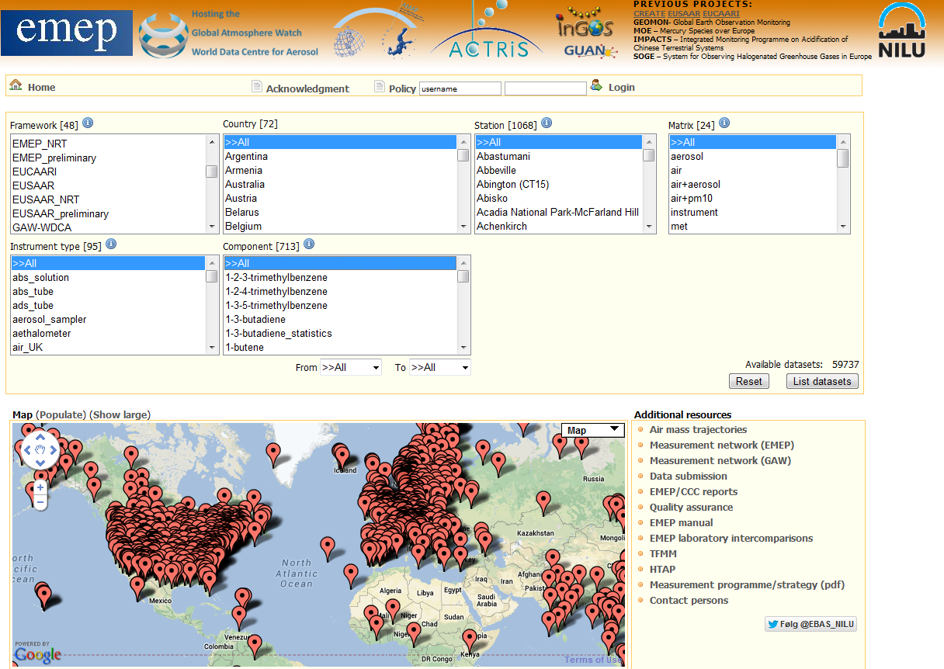
EBAS -http://ebas.nilu.no/

Slide 5
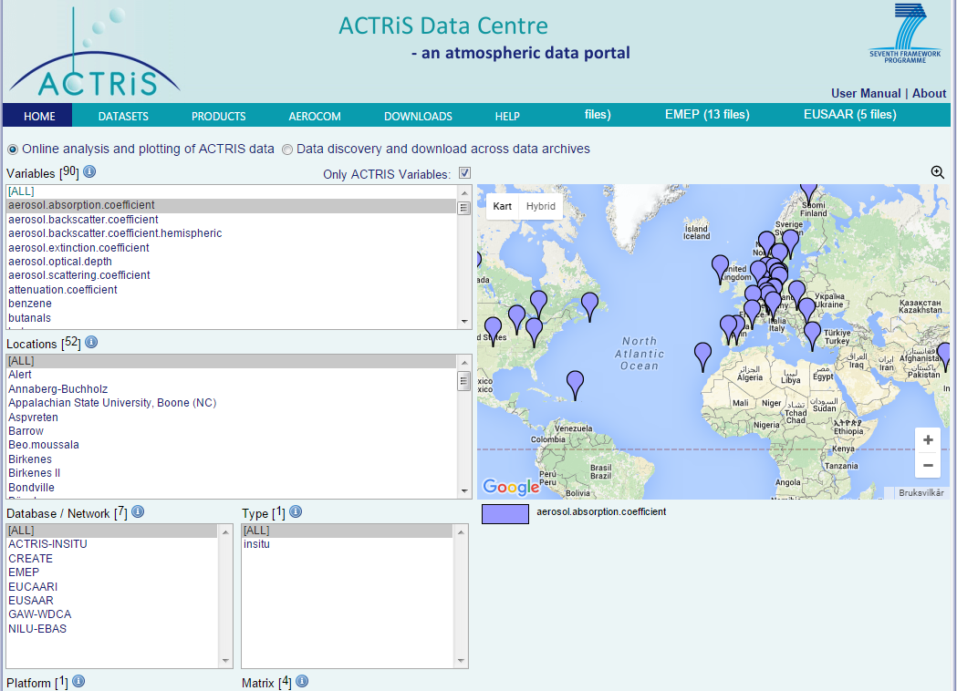
About the network, ACTRIS
http://actris.nilu.no

Slide 6



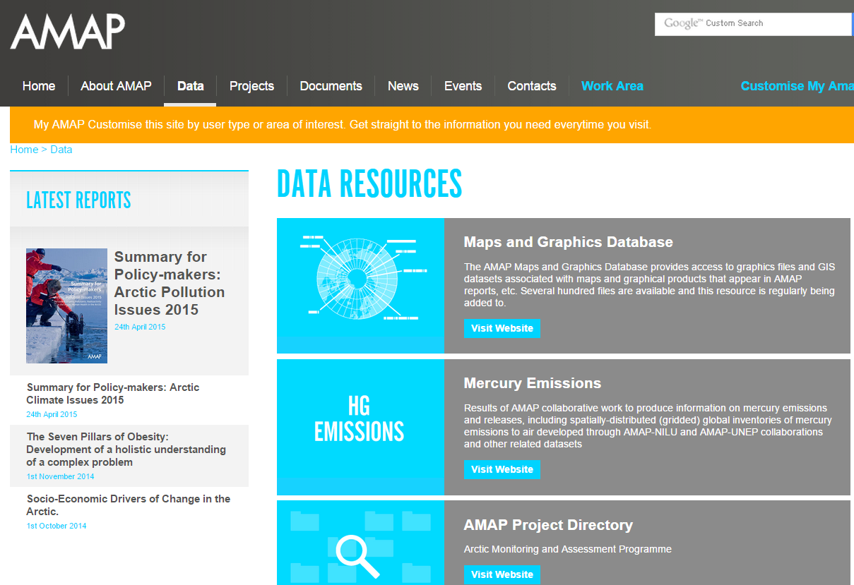

Slide 7
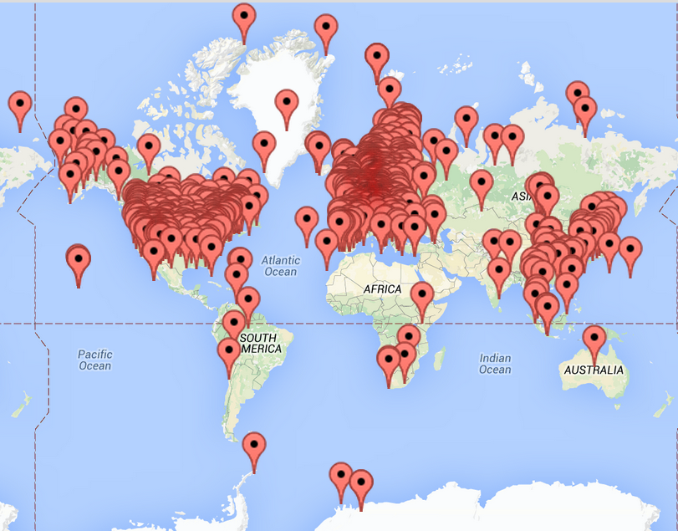
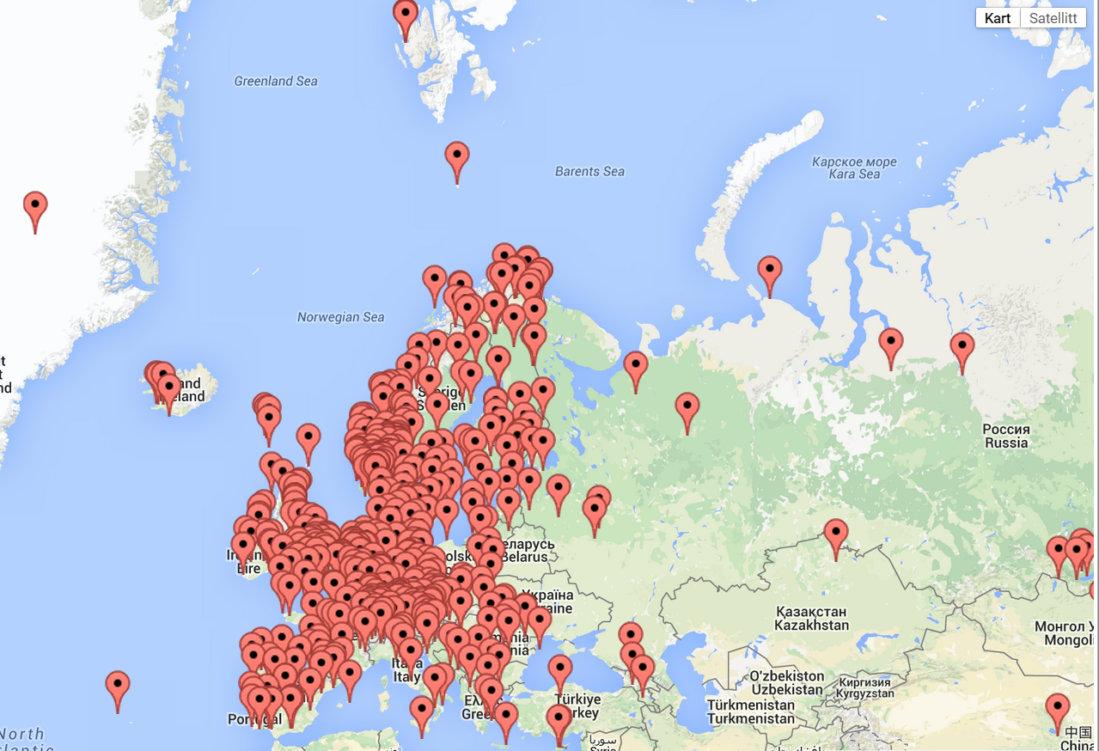
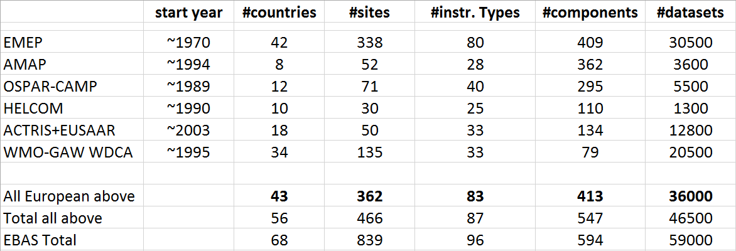
Available data

Slide 8
EMEP data management
Nearly any atmospheric variable is covered
  gases, particles, precipitation, reactive and long-lived
In operation since 1972
Mainly a primary archive
About 2500 + 3000 man hours per year (management + development)

Slide 9
Tasks of the EMEP Chemical Coordinating Centre
Develop and coordinate the observation activities required to assess air pollution across the EMEP geographical domain
Secure and improve quality and representativeness of observations
Quality assurance and quality control of data submitted by Parties
Archival and dissemination of observation data and associated meta-data.
Serve the interest of EMEP monitoring activities with respect to relevant activities under other frameworks to ensure harmonization, efficient use of resources and multiple usage of data.
Assessment of data and provide information to stakeholders about results from monitoring activities

Slide 10
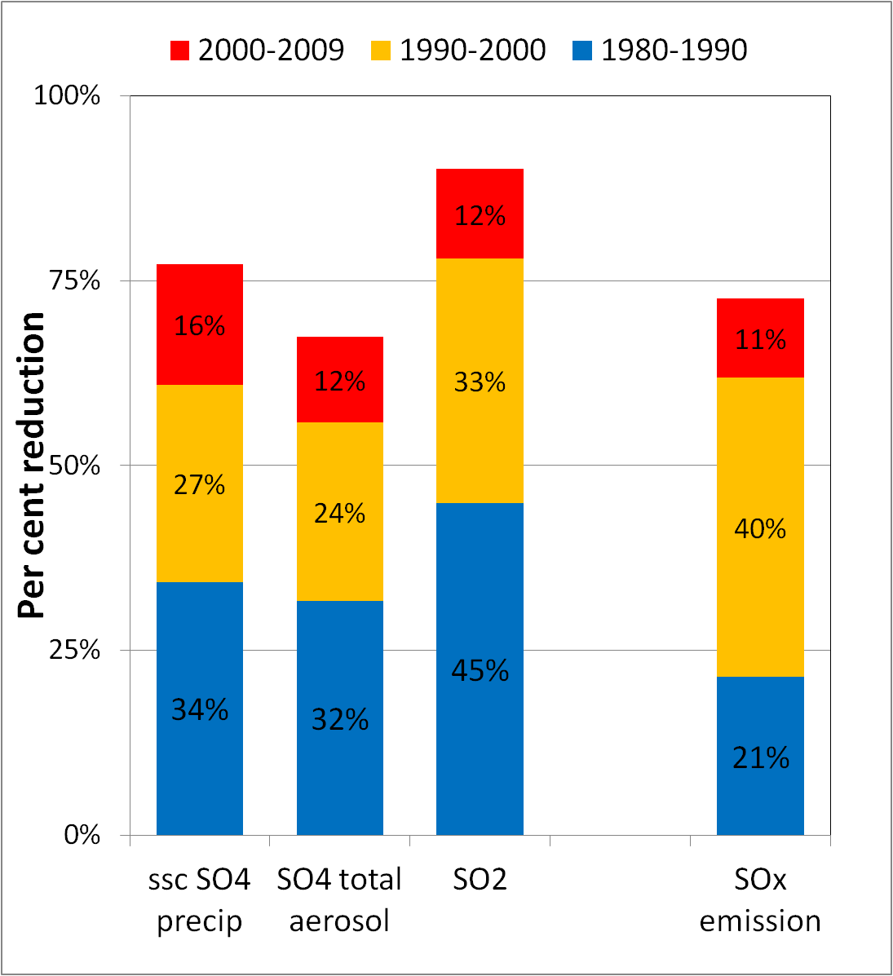
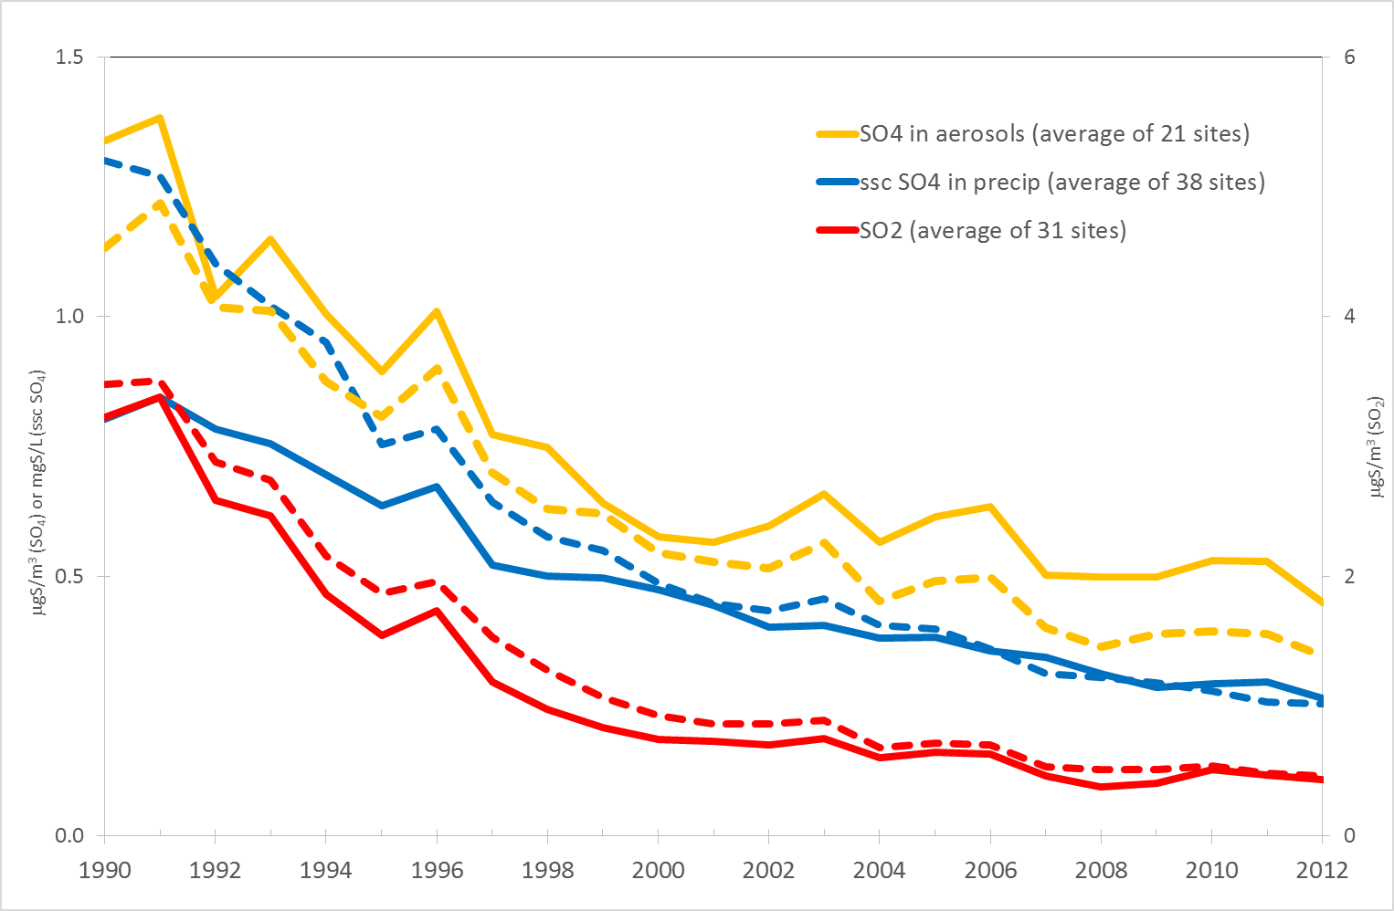
Trends in sulphur in Europe
Ref: Tørseth et al, ACP, 2012

Slide 11
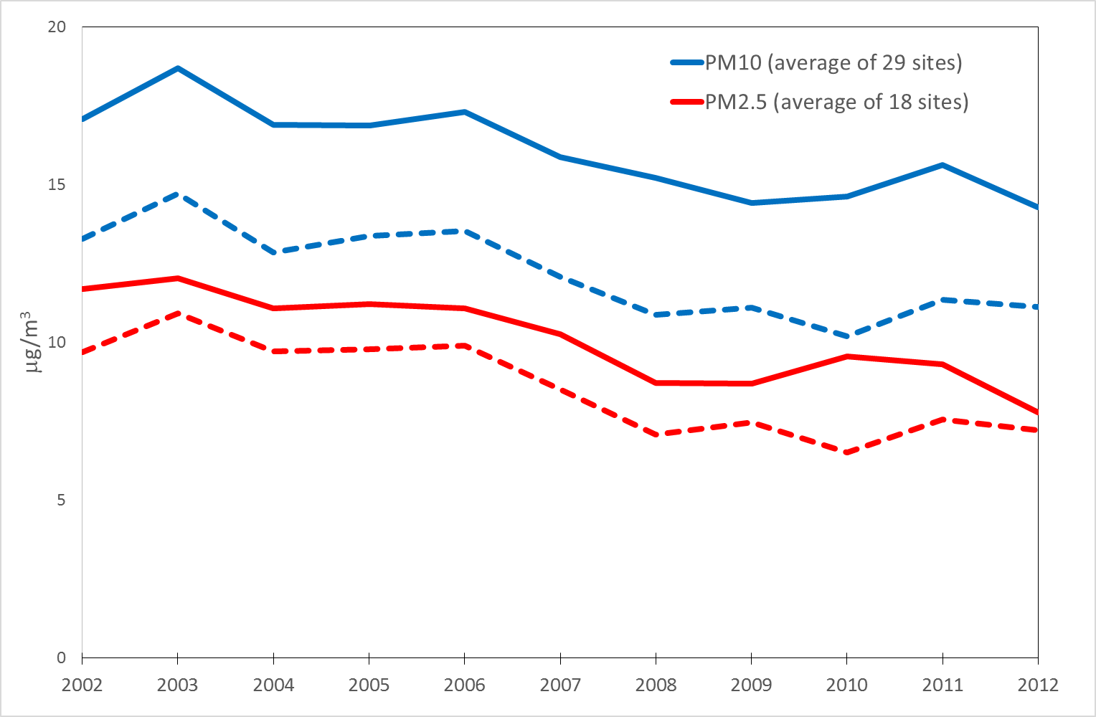
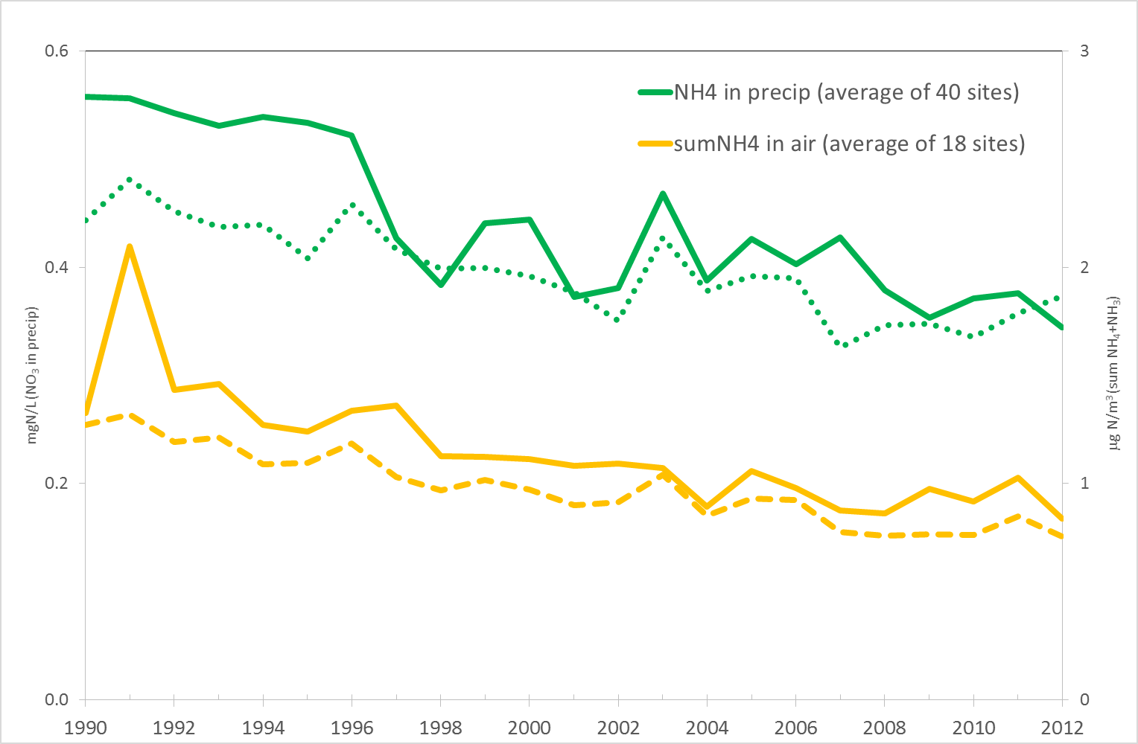
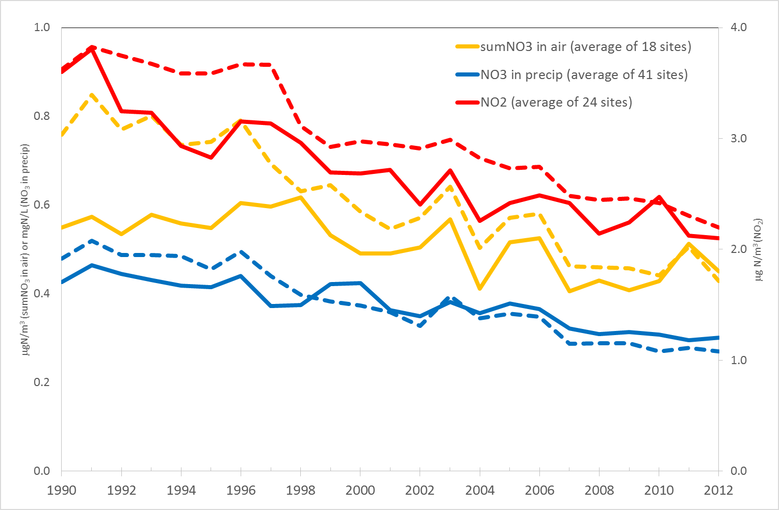
EMEP Trend assessment
( to be published spring 2016):
PM
PM concentrations in background areas shows a clear decrease (2002-2012) of ca 2.5% for PM₁₀ and ca 3% for PM_{2.5}
The mean annual reduction of SO₂ is ca 4% from 1990-2012
The mean annual reduction of NO₂ is ca 1.3% from 1990-2012
Complex trends for ozone. Peak ozone is generally decreasing, but increasing hemispheric background ozone
Nred
Nox

Slide 12
Communities
Air pollution research and abatement community (LRTAP).
Climate research and abatement community.
Operational data sharing with EMEP modelling groups, HTAP, AEROCOM, Stockholm Convention on POPs, (CAMS)
National environmental agencies, NHMSs and research groups provide the data

Slide 13
Data policy and sustainability
Data policy defined by “framework” (we recommend the EMEP/GAW open data policy)
Largely funded by EMEP, but with important contributions from research projects (EUSAAR, ACTRIS, GEOMON)
Basic operations are expected to be sustainable. Special requirements depend on additional resources.

Slide 14
Financial mechanisms for EMEP
All the Parties signed the EMEP protocol are obliged to:
pay annually a contribution to UN ECE.
  The amounts differ between countries dependent on size, development etc
  These resources are used by centers for the central work of EMEP (modeling, data base, QA, assessments etc)
Monitoring in accordance to the criteria set by the monitoring strategy
  sites, components, frequency
  Harmonized methodology

Slide 15
Combining research funding with national budgets related to international conventions
National environment agencies have often strong limitations wrt to funding
However, important for long-term funding and is conservative
Compliance to international agreements takes priority
«Top down» strategic priorities have strong impact
Often difficult to bridge gaps wrt national agencies and their responsibilities

Slide 16
Research funding can by far be exceeding thoose of national environment agencies
Typically «highly competitive», with emphasis on academic excellence
Difficult for national agencies to get a role, the same for research groups not member to the team
Project funding is short-term, emphasis of sustaining effort for later calls
A variety of «funding instruments», makes it very difficult to build a rational and cost efficient system

Slide 17
What is special with atmospheric composition observations
Data originate from a large number of data originators (many not IT-experts) and affiliate data to many networks and programmes
IPR and compliance issues – openness vs restrictions
Quality and representativity is highly variable
Often significant efforts are required in generate data (processing)
Large number of parameters reported
Complex data formats to accommodate meta data provision
Data handling requires in house scientific expertise
Data provision serves as a major documentation of investments made
Provides visibility to institutions and policy bodies

Slide 18
Future directions
Accept the fact that proper data management is very resource demanding
No one really want to fund basic operations
Avoid duplicating data in several databases
Aim towards sentralized steering and funding (monitoring or research ambitions?)
Harmonize when ever possible
How to deal with secondary “portals”?

