Slide 1
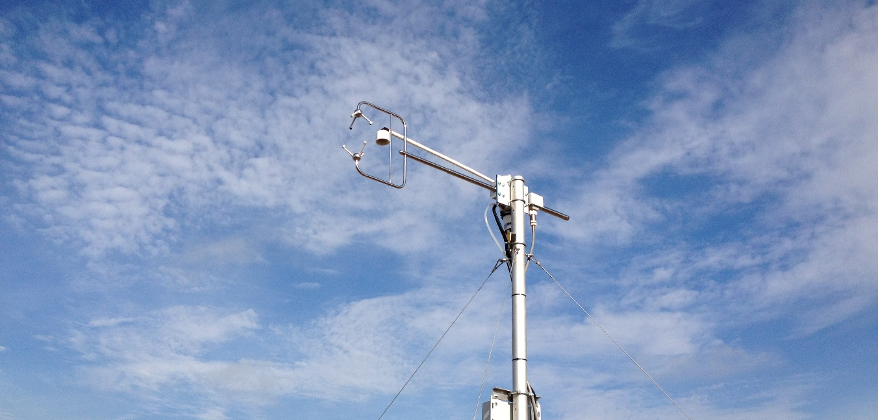

The Integrated Carbon Observation System
A European Research Infrastructure on greenhouse gases and the global carbon cycle
Werner L. Kutsch, Director General of ICOS RI, Helsinki, Europe
A. Vermeulen, T. Johannessen, I.Levin, D. Papale, L. Rivier, A. Watson
Paris, 21.9.2015

Slide 2
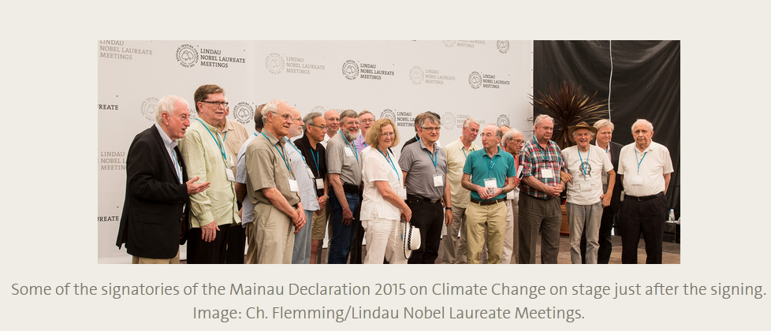
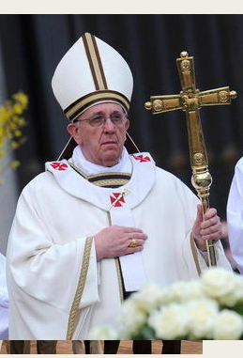


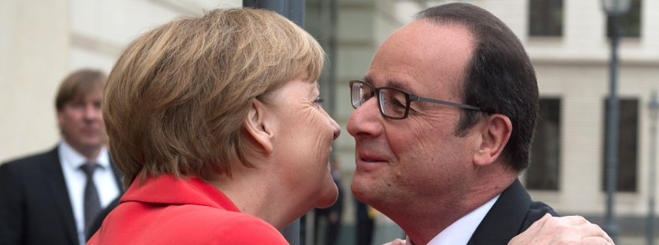
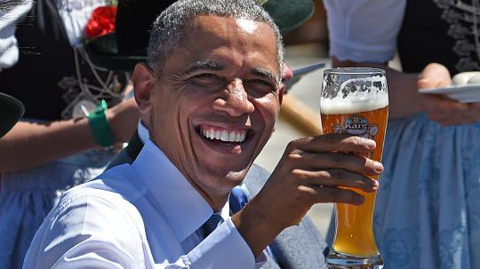

A unique consensus that we have to take action on climate change
Mainau Declaration of Nobel Laureates, 3. July 2015
Petersberg Climate Dialog, 18./.19. May 2015
“Most Ministers stressed that the agreement should be comprehensive and built to last while holding the increase in global average temperature below 2°C or 1.5°C above preindustrial levels…”
G7 Summit, 8. June 2015
“Urgent and concrete action is needed to address climate change, as set out in the IPCC’s Fifth Assessment Report. We affirm our strong determination to adopt at the Climate Change Conference in December in Paris this year (COP21) a protocol…”
The Guardian's
campaign and help urge the world's two biggest charitable funds to move their money out of fossil fuels

Slide 3
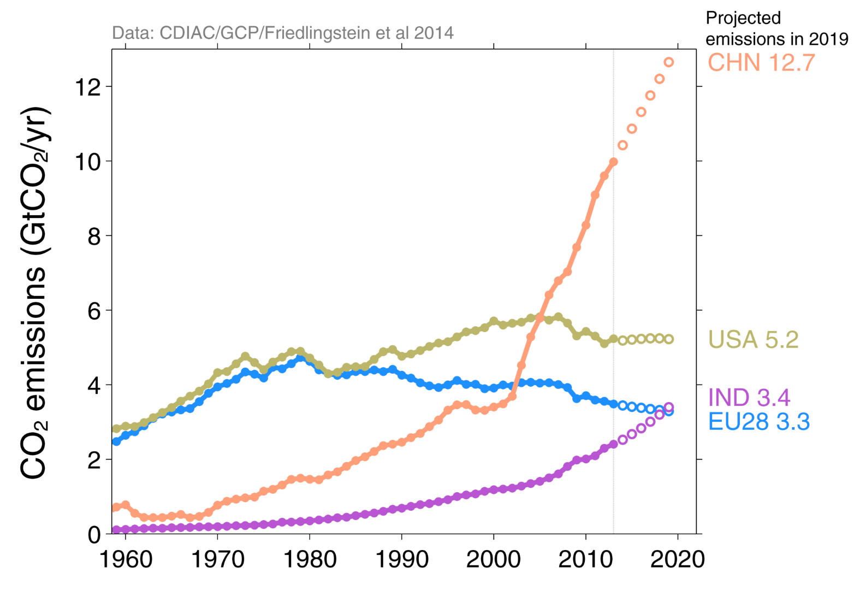
Persistent Growth – Regional
Continued trends suggest that by 2019 China’s emissions could exceed the USA, EU28 and India combined, and India could emit more than the EU28
Economic growth based on IMF projections, fossil fuel intensity based on 10-year trend
Source: CDIAC; Friedlingstein et al 2014

Slide 4
Intended Nationally Determined Contributions (INDCs)

Slide 5
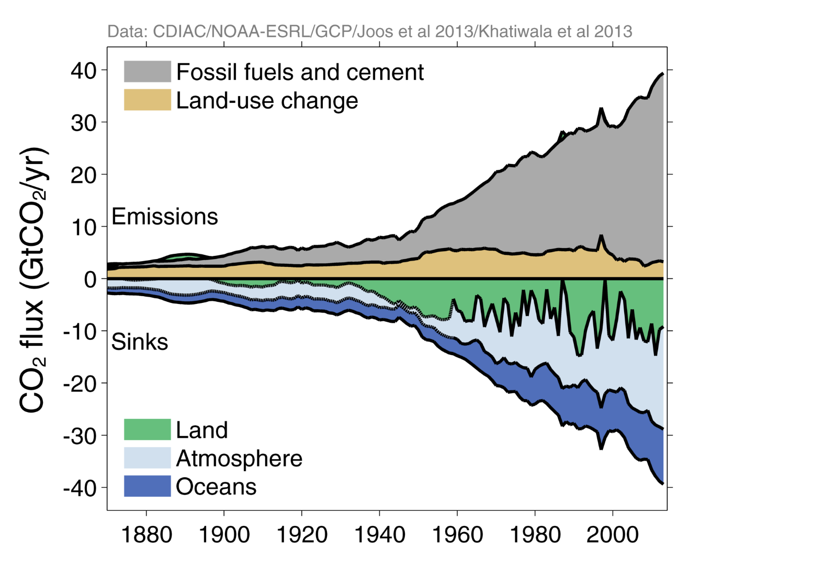
Global Carbon Budget
Emissions are partitioned between the atmosphere, land, and ocean
Source: CDIAC; NOAA-ESRL; Houghton et al 2012; Giglio et al 2013; Joos et al 2013; Khatiwala et al 2013;
Le Quéré et al 2014; Global Carbon Budget 2014

Slide 6
Research Infrastructures
Society faces many future challenges. […] Research Infrastructures are one key instrument in bringing together a wide diversity of stakeholders to look for solutions to many of the above-mentioned problems. They can be seen as a focal point for such interactions, in addition to inspiring new research ideas and attracting young enquiring minds. (ESFRI Roadmap 2006)

Slide 7
The Integrated Carbon Observation Sysytem (ICOS)
Vision and Scientific Mission
fundamental understanding of carbon cycle, greenhouse gas budgets and perturbations and underlying processes,
ability to predict future changes,
verify the effectiveness of policies aiming to reduce greenhouse gas emissions,
technical and scientific innovation,
education and capacity building.

Slide 8
Greenhouse gas exchange between
Oceans and Atmosphere
[curtesy: Dorothee Bakker]

Slide 9

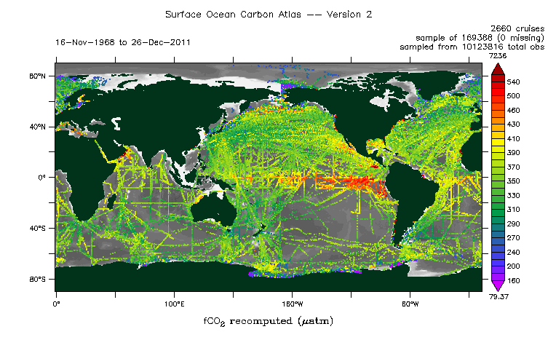
Overall data availability
http://www.socat.info

Slide 10
Ocean fluxes
http://www.socat.info

Slide 11
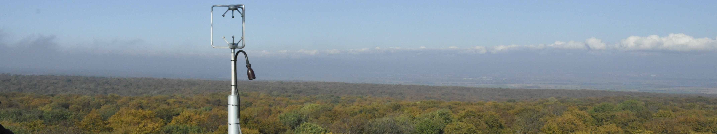
Greenhouse gas exchange between
Ecosystems and Atmosphere
Carbon and Greenhouse Gas Balances of Ecosystems
Luyssaert et al. 2007

Slide 12

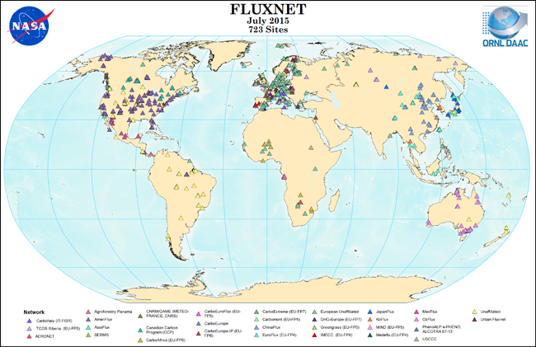
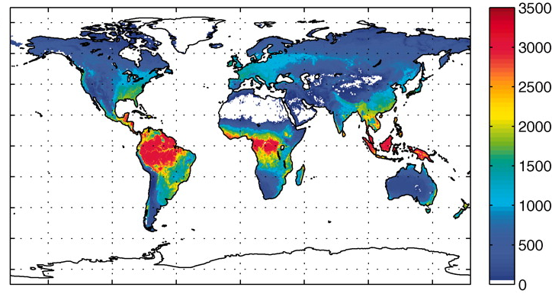
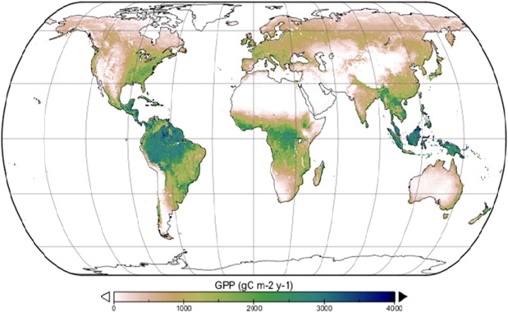
Global GPP products
Beer et al. 2010
Yebra et al. 2015

Slide 13
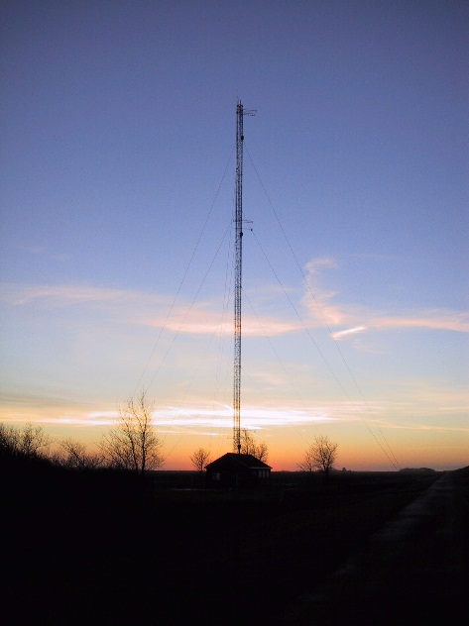
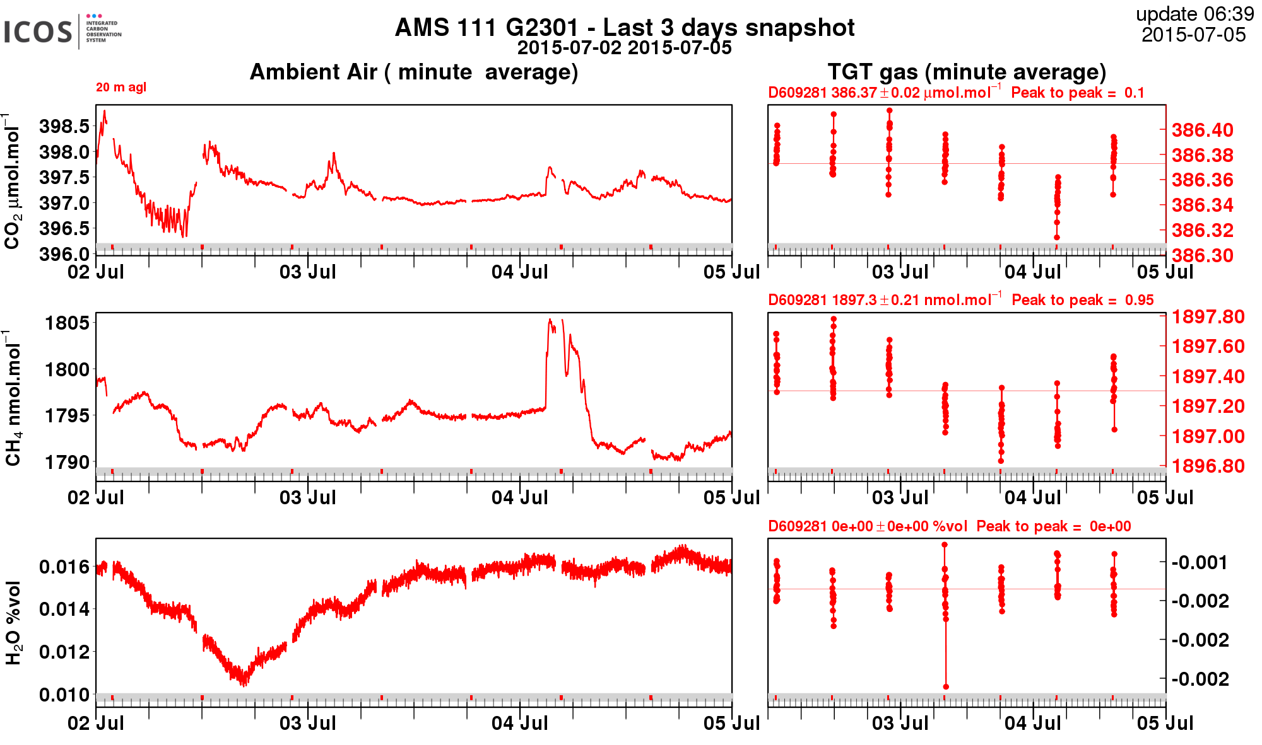
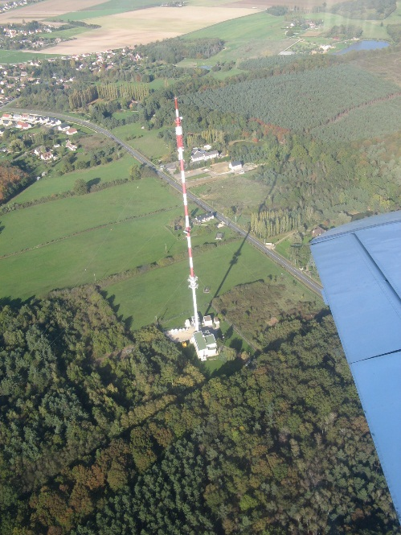
Concentration of GHG in the lower Atmosphere
Near Real Time Data

Slide 14

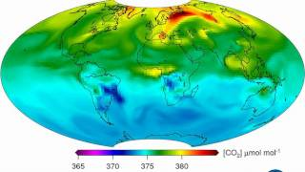
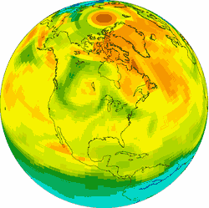

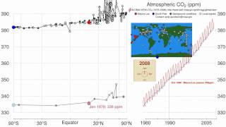
Integration and outreach
https://www.youtube.com/watch?v=j1ehcjjDPy8
https://www.youtube.com/watch?v=vA7tfz3k_9A
CarbonTracker CO₂ weather for June-July, 2008. Warm colors show high atmospheric CO₂ concentrations, and cool colors show low concentrations. As the summer growing season takes hold, photosynthesis by forests and crops draws concentrations of CO₂ down, opposing the general increase from fossil fuel burning. The resulting high- and low-CO₂ air masses are then moved around by weather systems to form the patterns shown here.

Slide 15
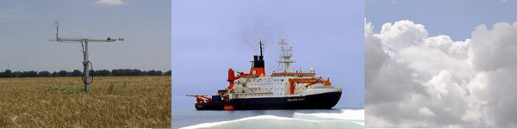
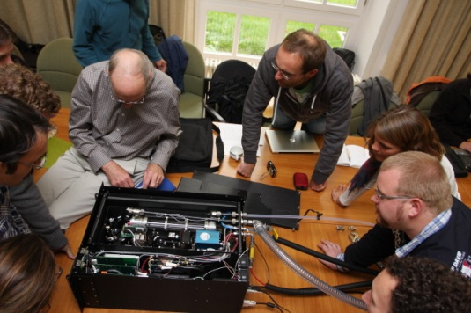
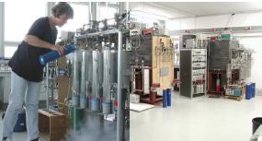
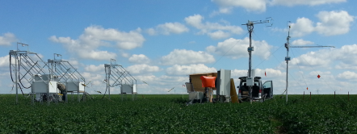
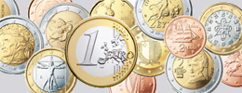
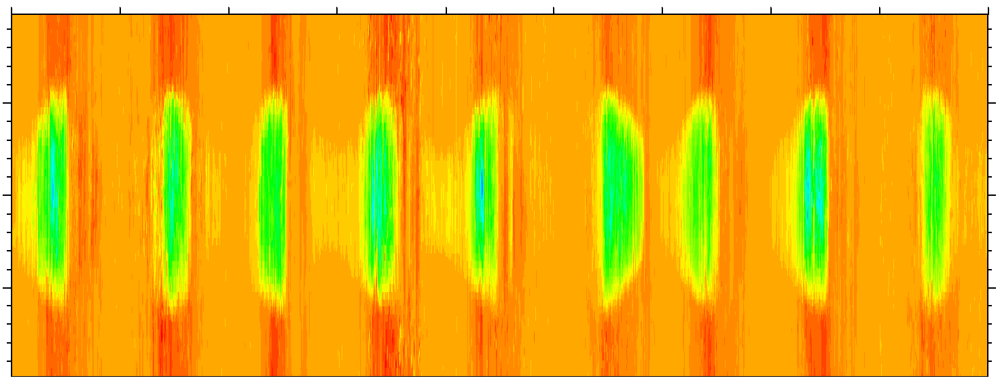
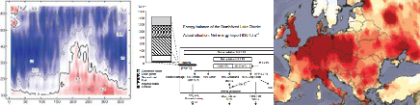
The vision of ICOS
All important parameters
State of the art techniques
Representative networks
Relevant data products
Optimum data streams
Long-term financial security
of all partners
A community to produce
higher level output

Slide 16
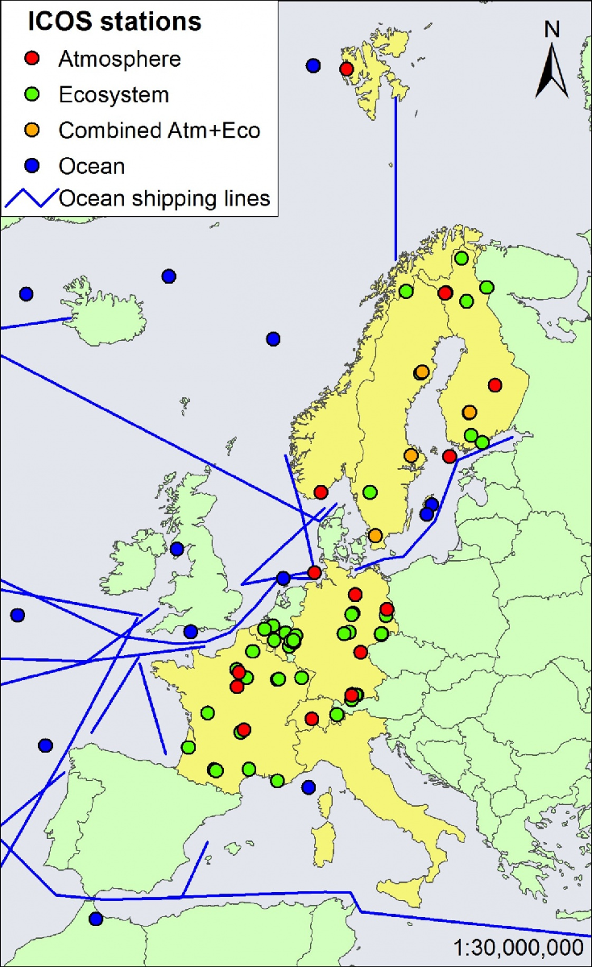
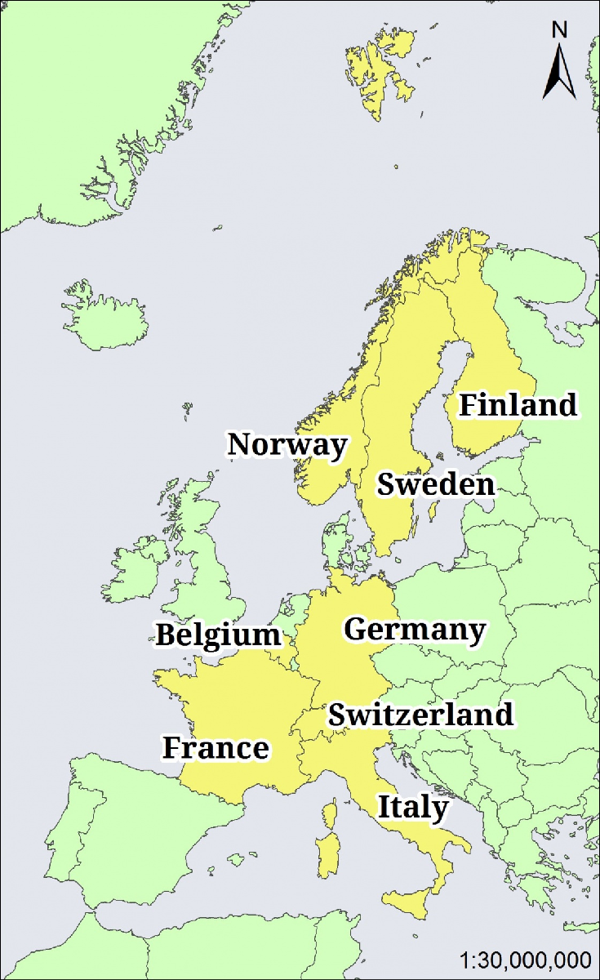
Current status of ICOS: 9 signature countries,
> 100 stations and VOS lines, 2016 fully operational
~100 Mio € Investments
~50 Mio € per year running costs

Slide 17
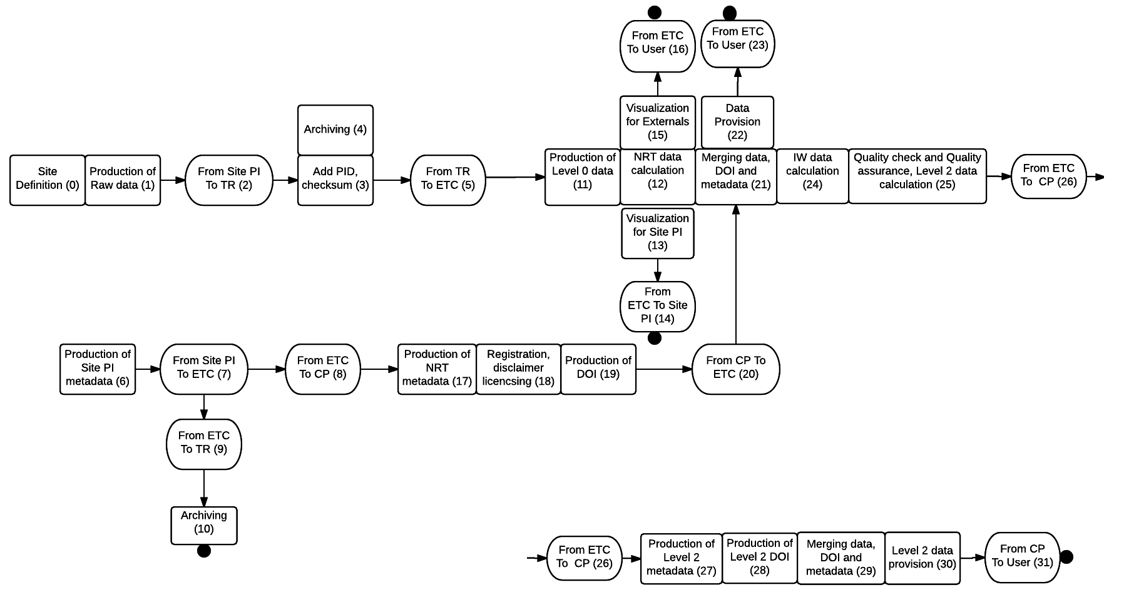
The data lifecycle description

Slide 18
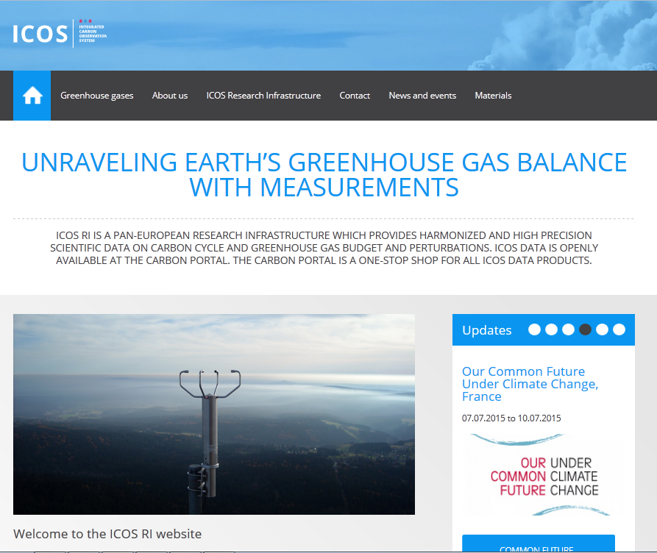
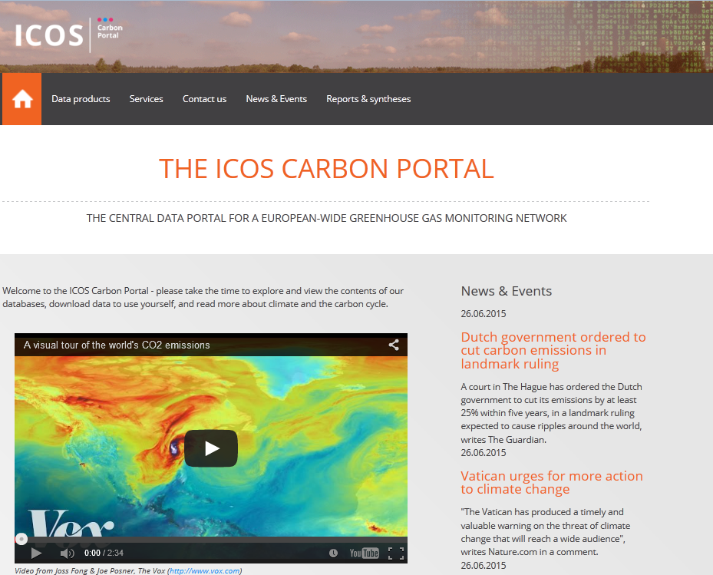
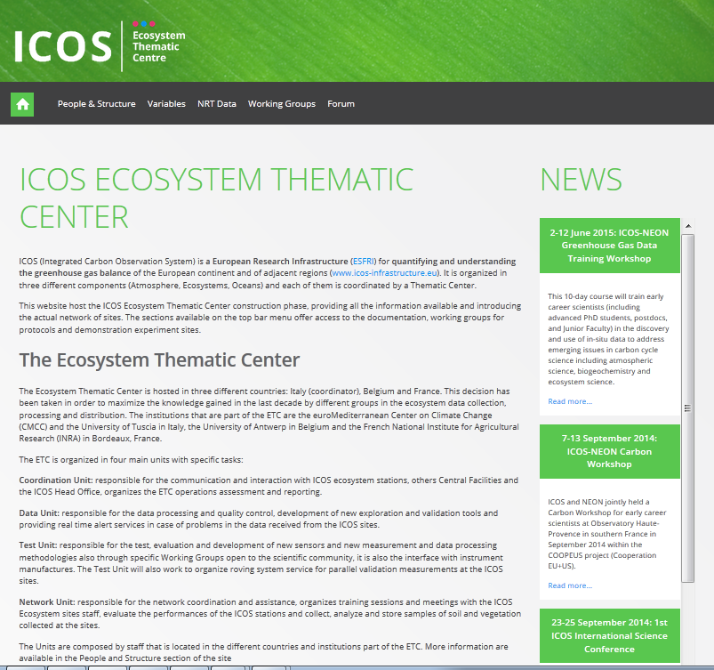
Data Dissemination and Outreach

Slide 19

Data licensing and data citation
Attribution-ShareAlike
CC BY-SA
This license lets others remix, tweak, and build upon your work even for commercial purposes, as long as they credit you and license their new creations under the identical terms. This license is often compared to “copyleft” free and open source software licenses. All new works based on yours will carry the same license, so any derivatives will also allow commercial use. This is the license used by Wikipedia, and is recommended for materials that would benefit from incorporating content from Wikipedia and similarly licensed projects
support researchers by helping them to find, identify, and cite research data and other research objects with confidence;
support data centres by providing persistent identifiers for datasets, workflows and standards for data publication;
support journal publishers by enabling research articles to be linked to the underlying data/objects.
http://creativecommons.org/licenses/?lang=en
https://www.datacite.org/node

Slide 20






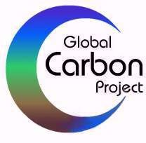
Becoming even more globally interated:
Suggestion for a GEO Carbon FLAGSHIP
- foundational elements to be effective:
Openness and inclusiveness: involve all relevant players
Not a new level of coordination, but a common frame to work together
Integration & Interoperability
Capacity building
To be global!
The FLAGSHIP will include and link all along the value chain
Observations Services Decisions
Data sharing
Data management (incl. metadata)
From data to knowledge
Improve data harmonization
Improve inter-operability
Improve data accessibility
Model-Data Fusion projects
Identifying observational gaps
Sustainability
Capacity building

Slide 21
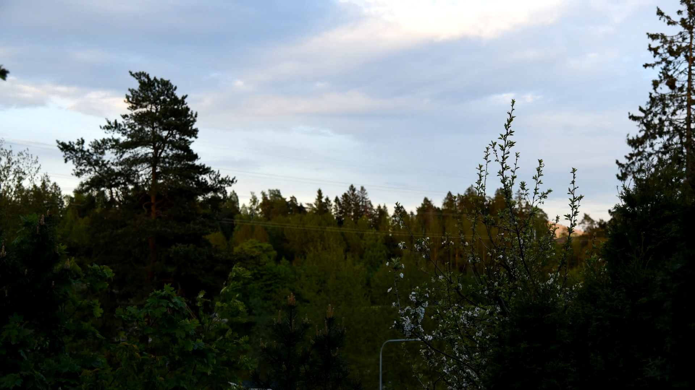
Thank you for your attention!
werner.kutsch@icos-ri.eu
www.icos-ri.eu

